Slide 1
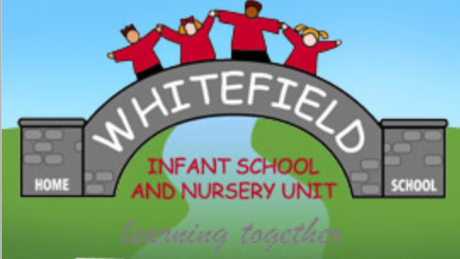
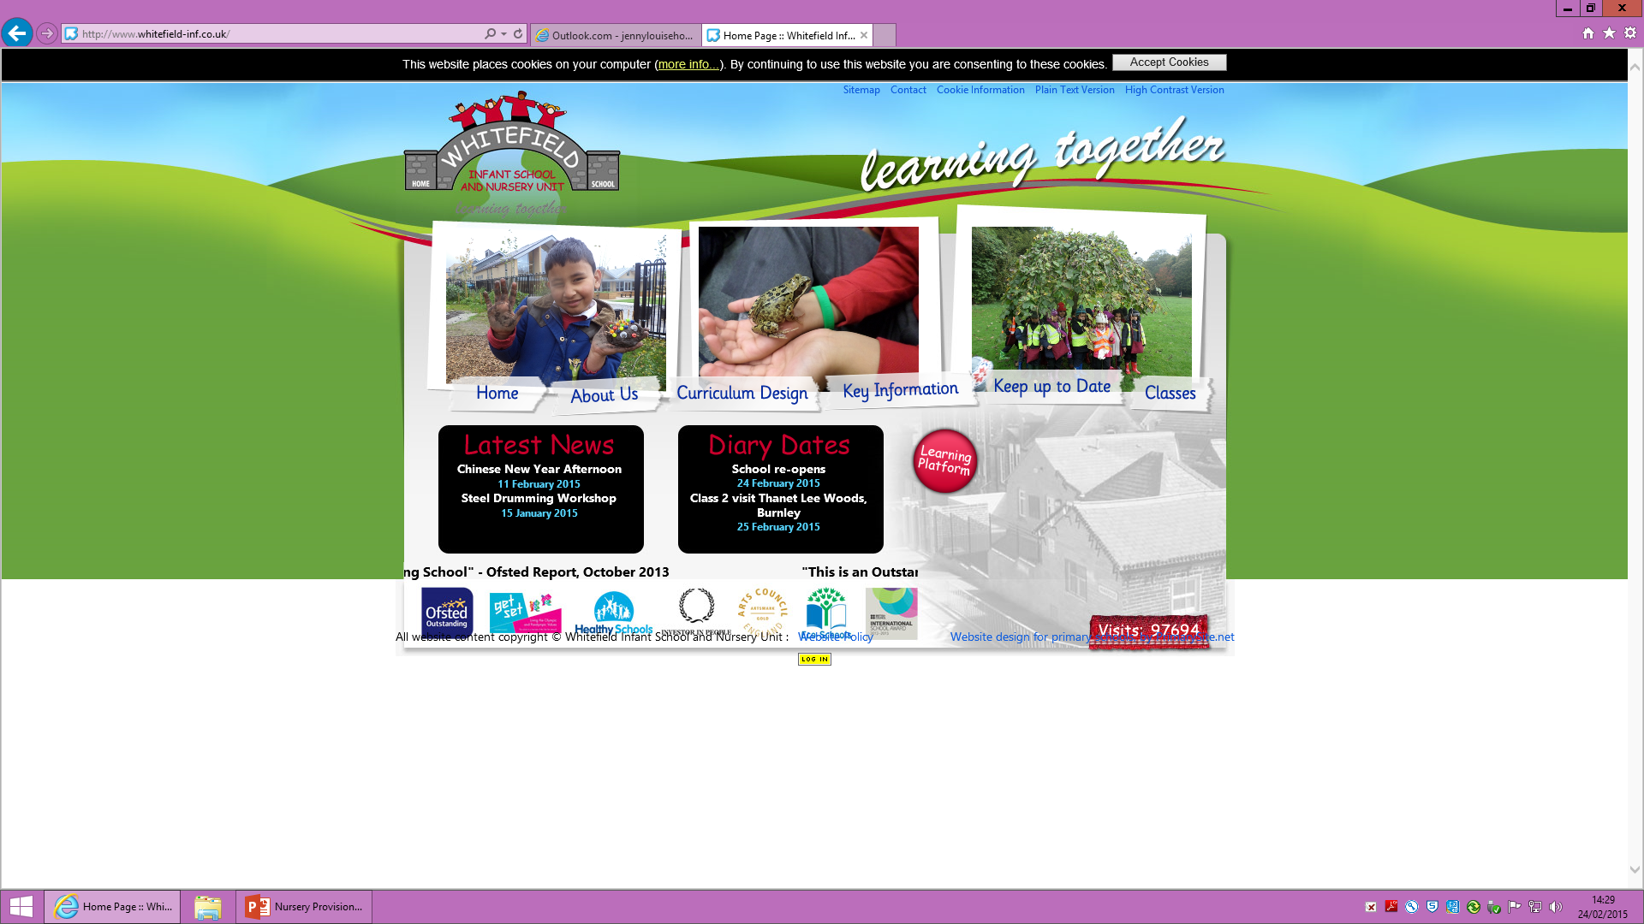
Whitefield Infant School
And Nursery
Nursery Leader –Rebecca Burns

Slide 2
Welcome
Staff introduction
Nursery times
am 8.30 – 11.30 pm 12.15- 3:15
Clothing
snack
Routines
Independence
Named adults

Slide 3
7 Areas of Learning:
Prime:
PSED
Communication and Language
Physical Development
Specific:
Mathematics
Literacy
Understanding the World
Expressive Arts and Design

Slide 4
Basic Areas of Provision:
Sand and Water
Maths
Literacy
Construction
Reading
Malleable
Creative

Slide 5
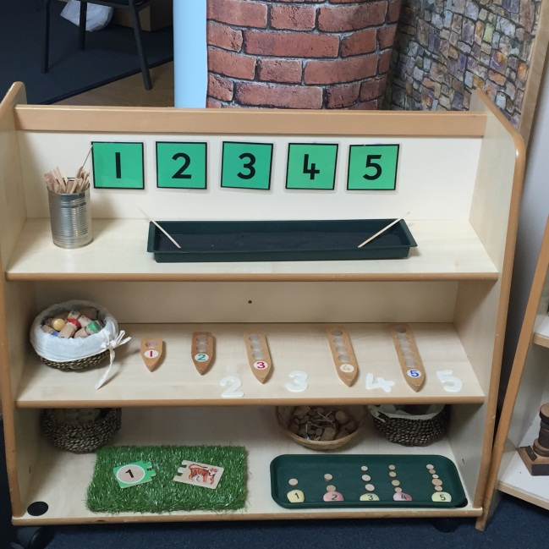
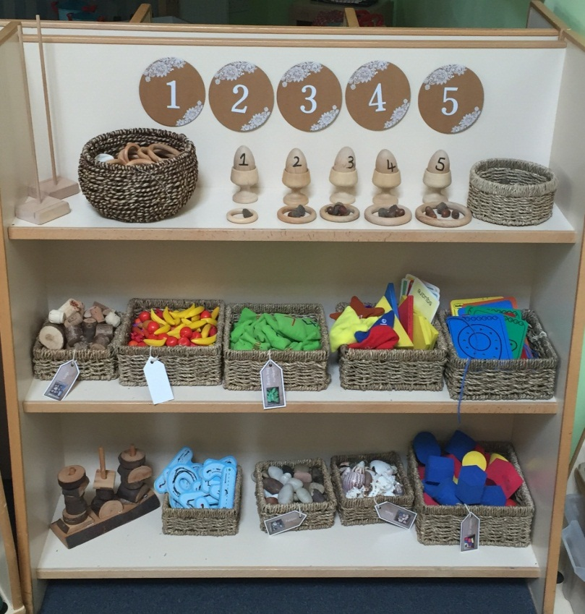
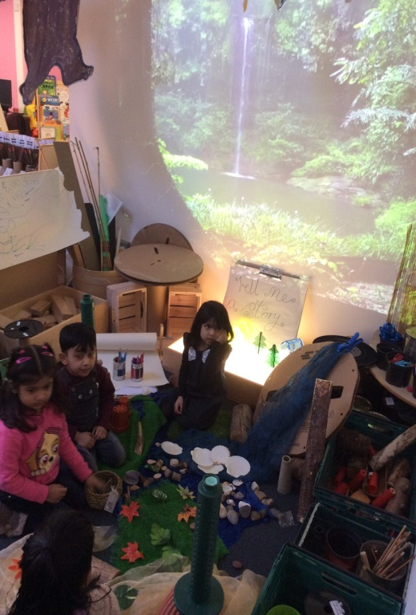
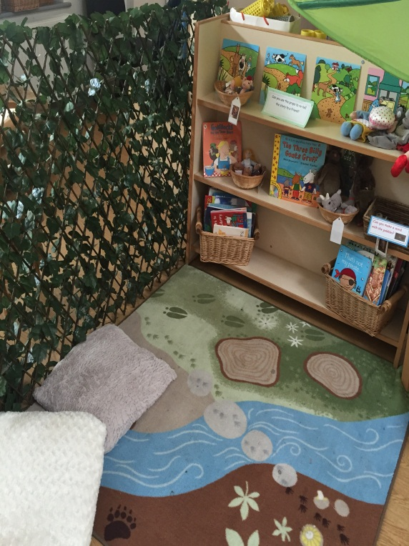
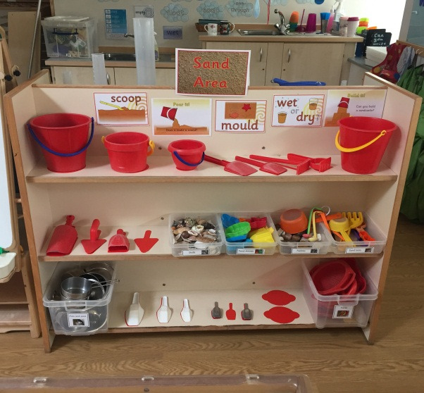
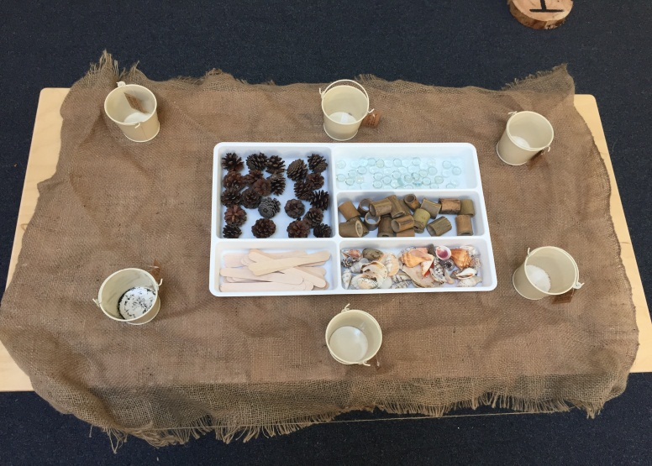
Whitefield Nursery

Slide 6
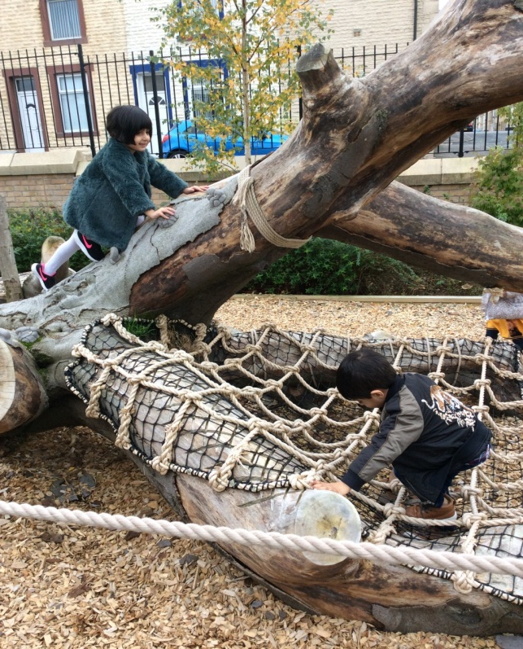
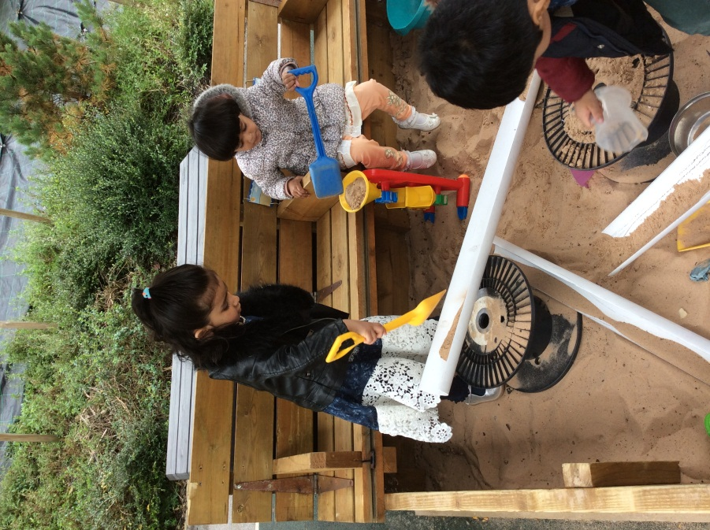
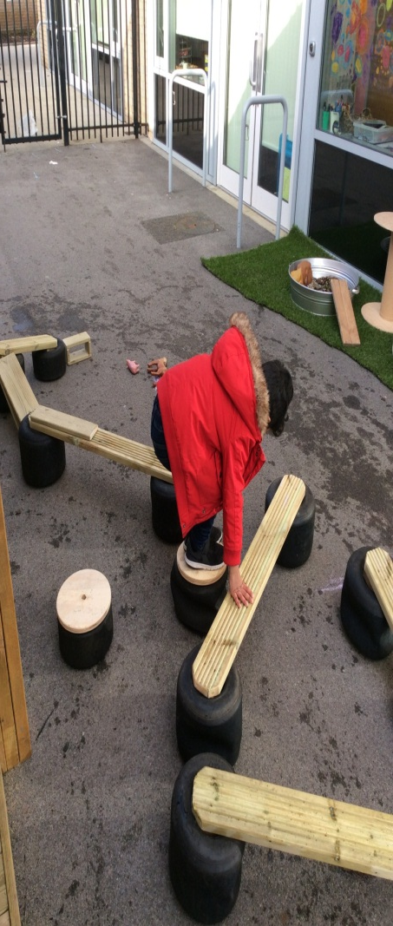
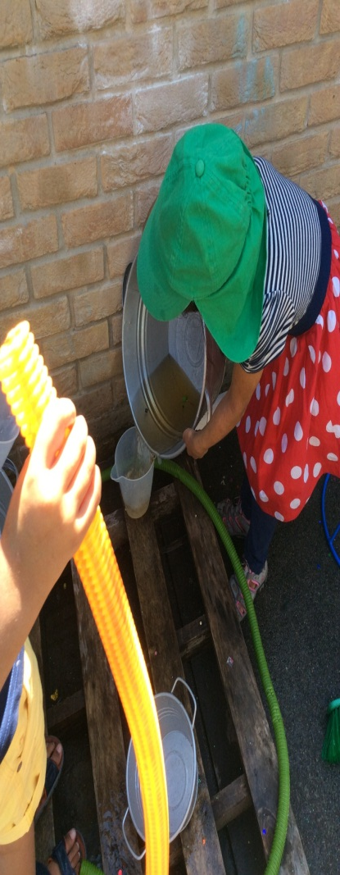
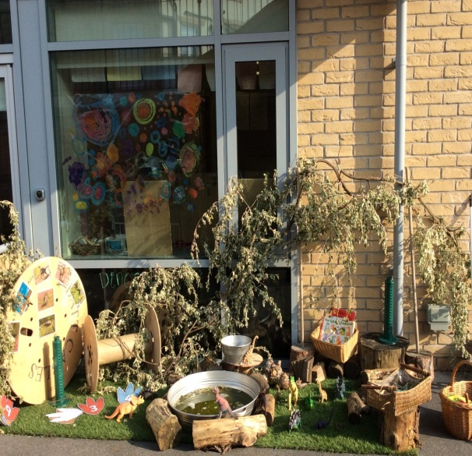
Outdoor provision

Slide 7
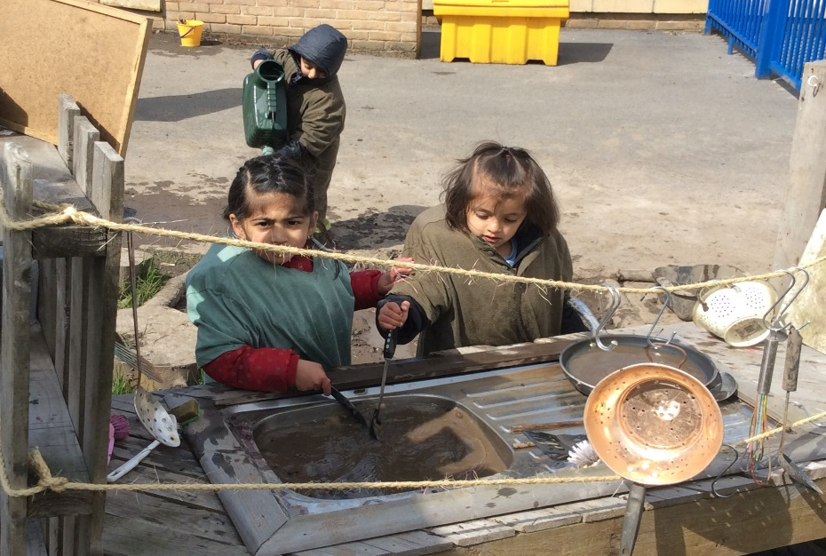
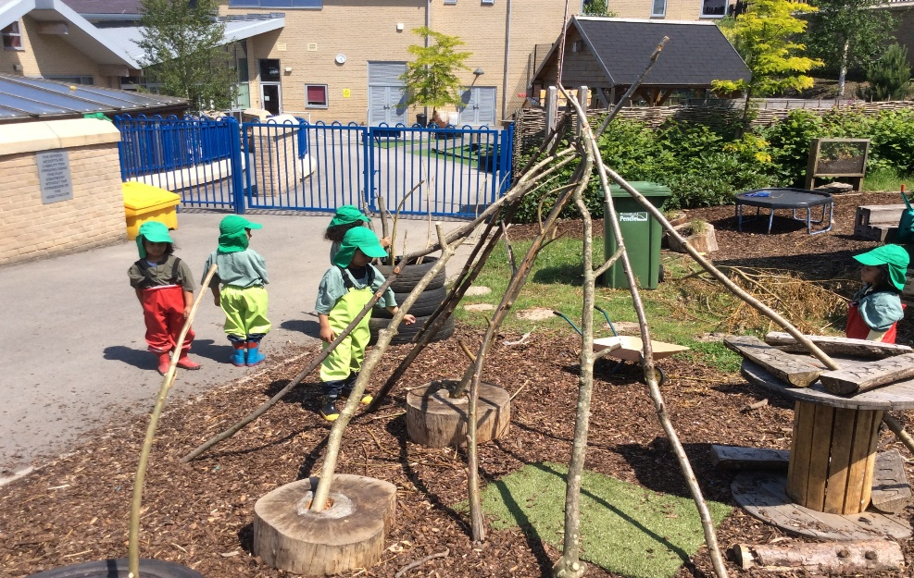
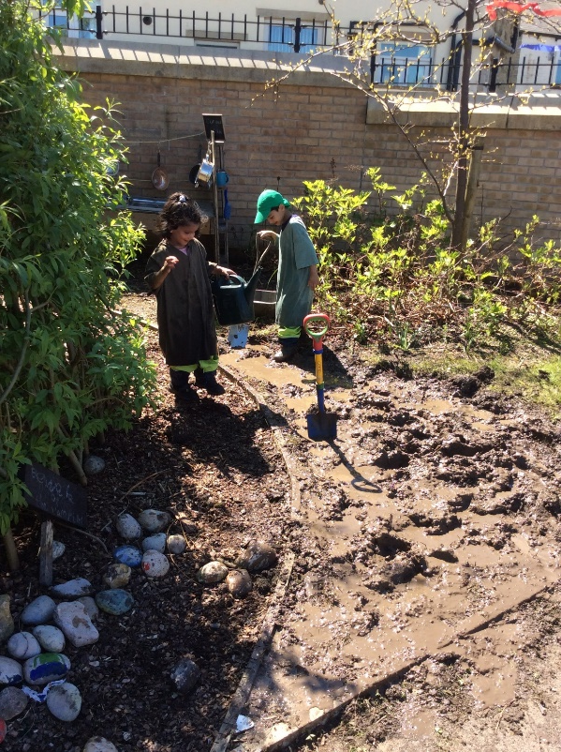
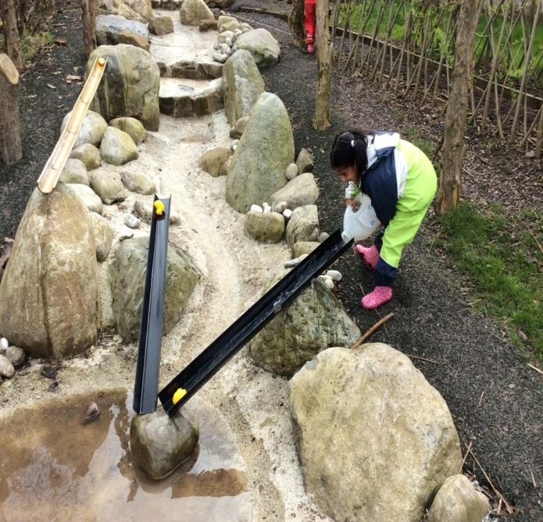
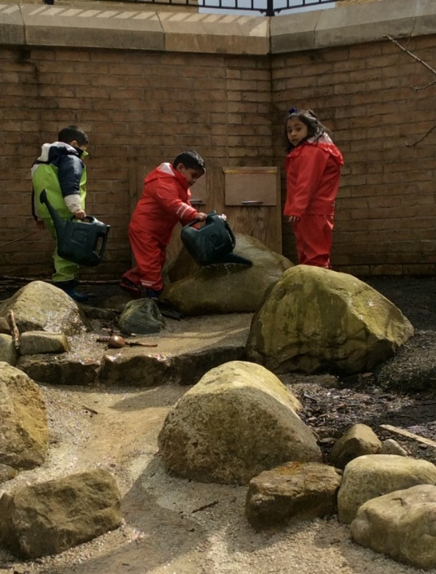
Forest school

Slide 8
Our curriculum
Autumn 1 | Autumn 2 | Spring 1 | Spring 2 | Summer 1 | Summer 2
Nursery Rhymes | Night and day | Where are we going? | People who help us. | What's in the garden? | Whole school summer project
 | Owl Babies | We’re Going on a Bear hunt | Busy people – non fiction | The very hungry caterpillar

Slide 9
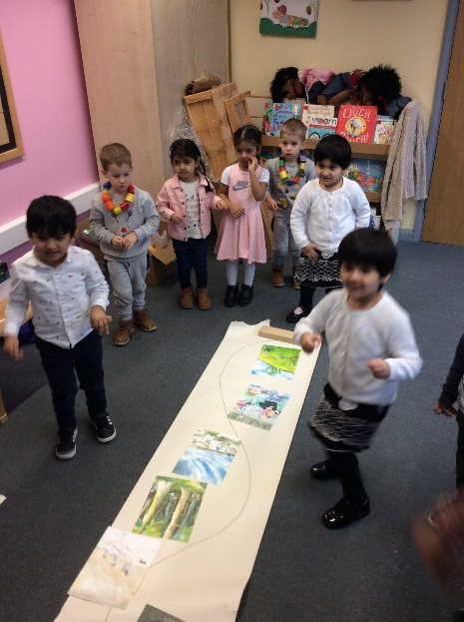
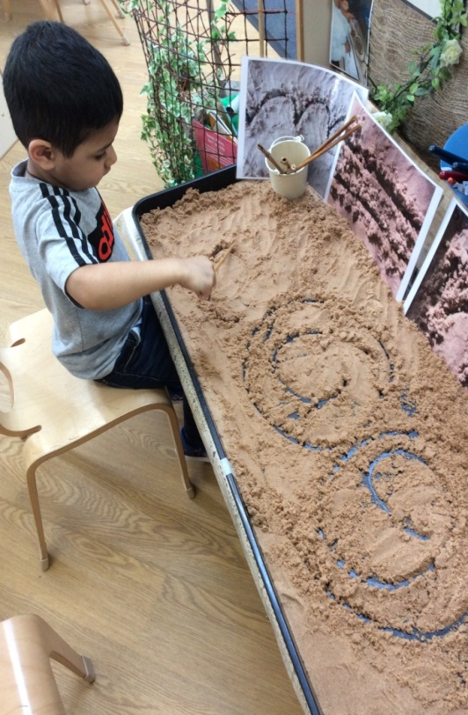
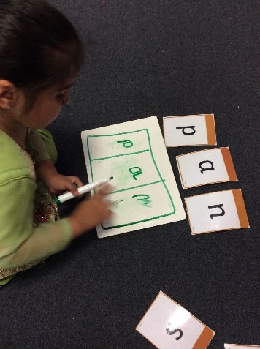
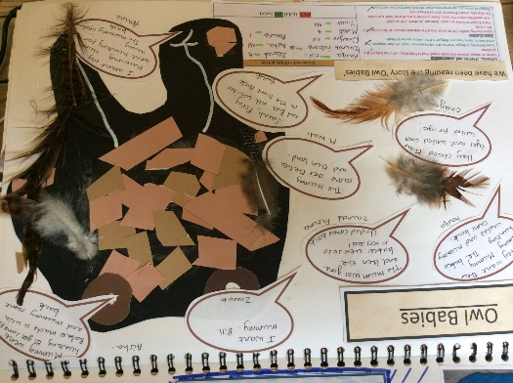
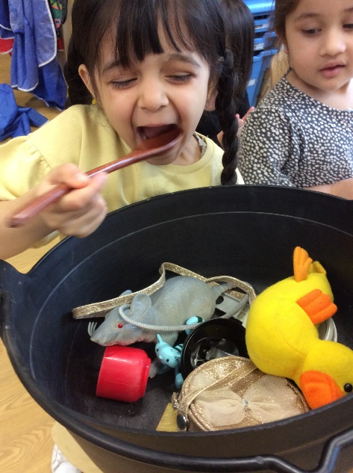
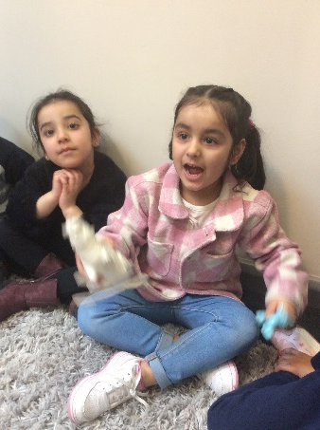
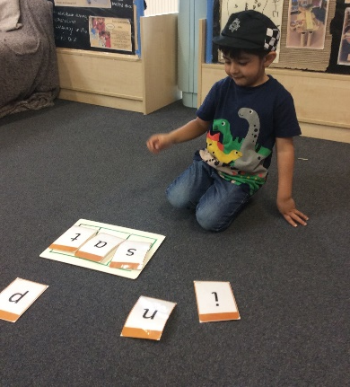
Literacy
Early writing skills
Core texts
Phonics
Our favourite five

Slide 10
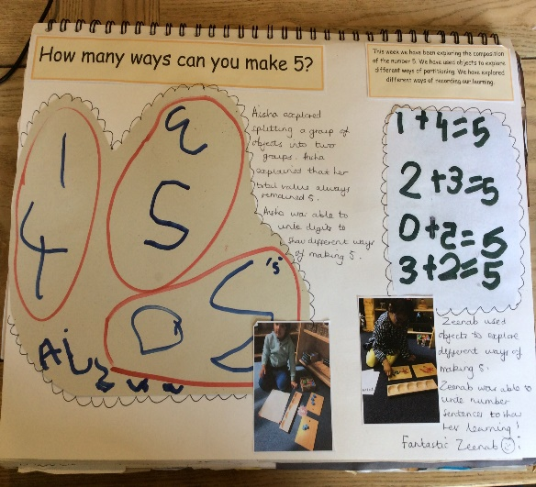
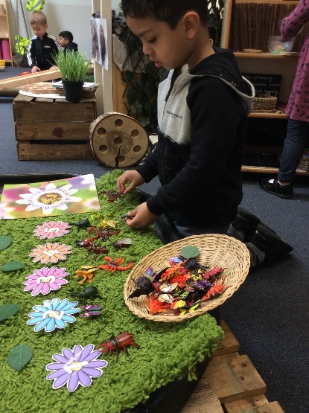
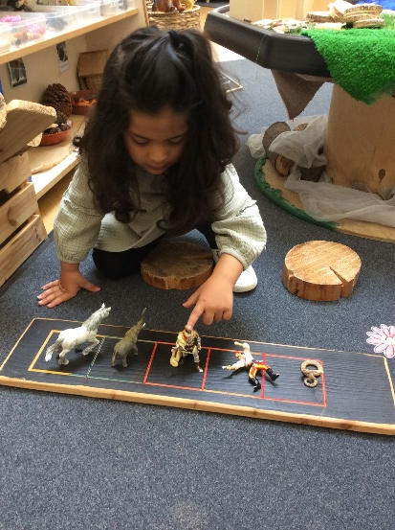
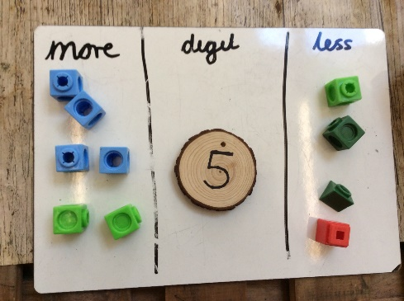
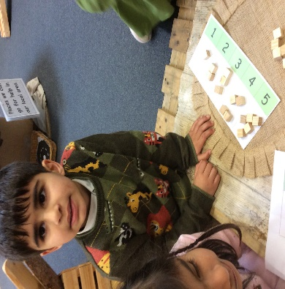
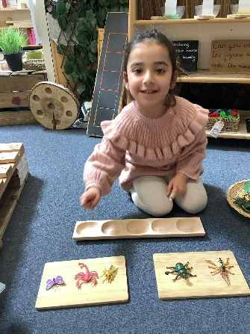
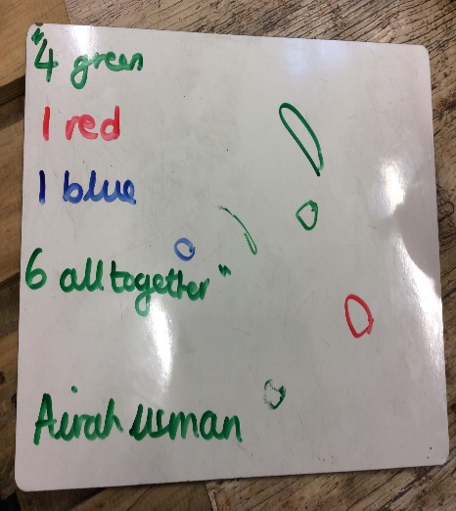
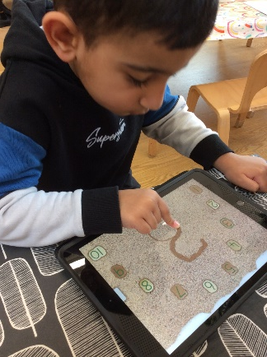
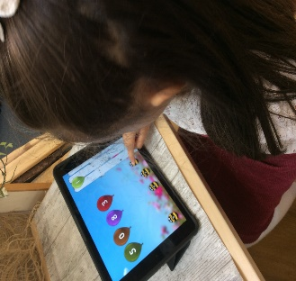
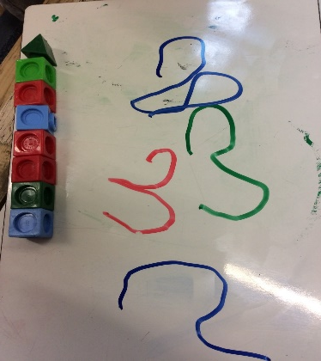
Maths
Number - counting
Number
sense
Number recognition
Calculating
Number
graphics

Slide 11
Learning through the
seasons

Slide 12
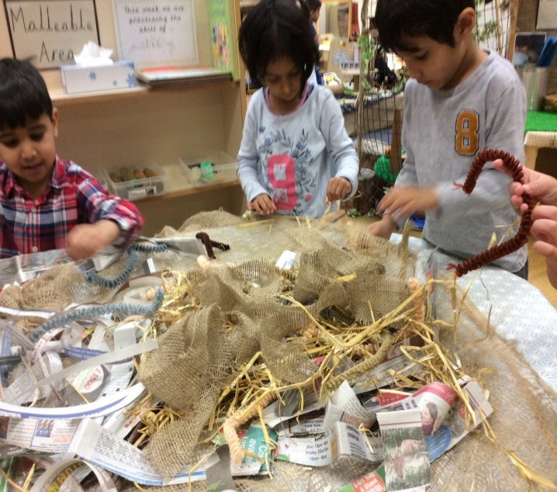
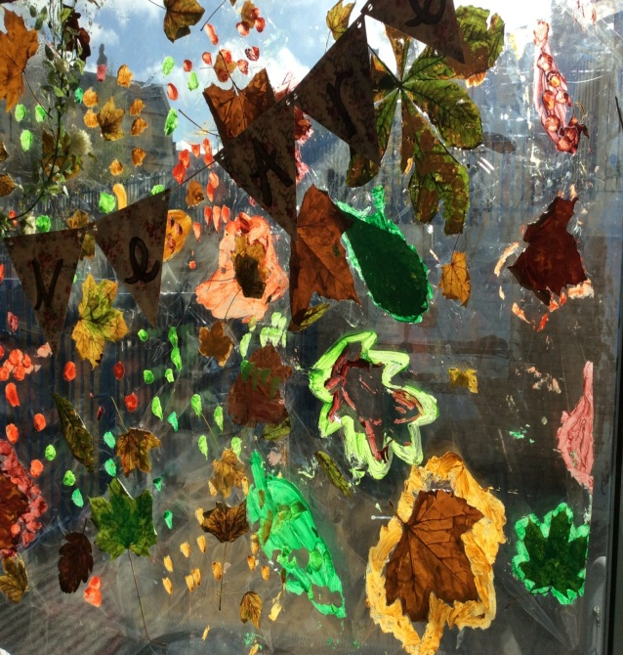
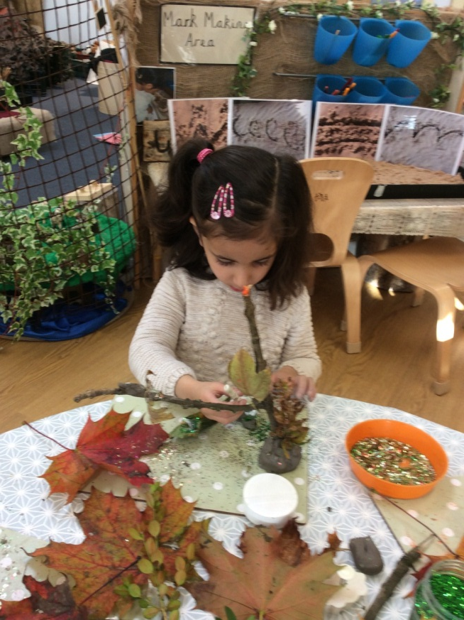
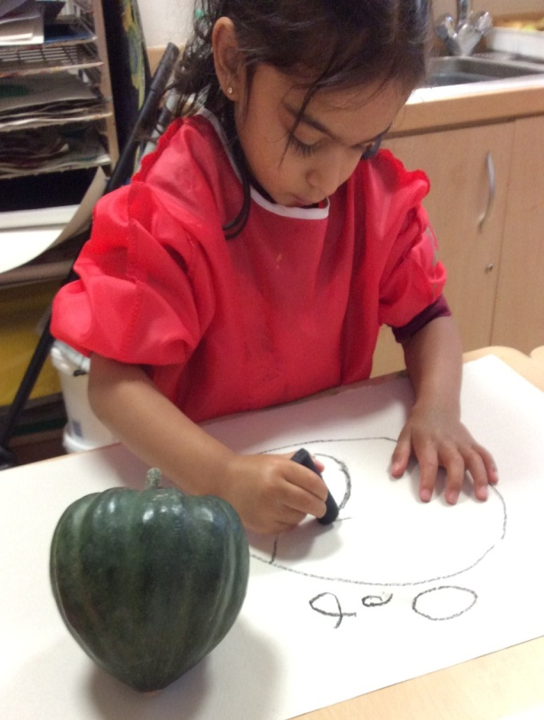
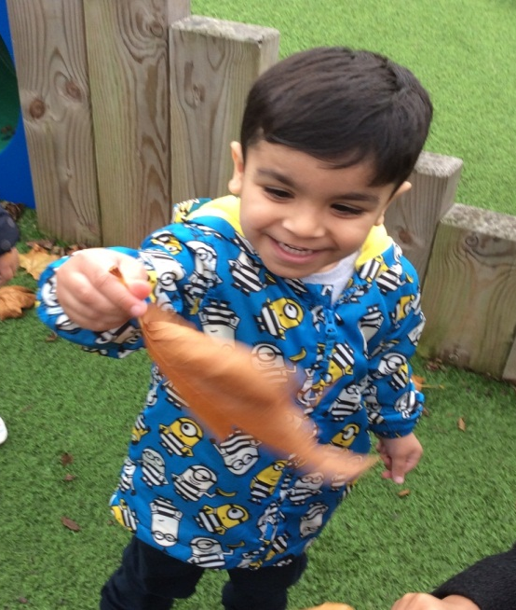
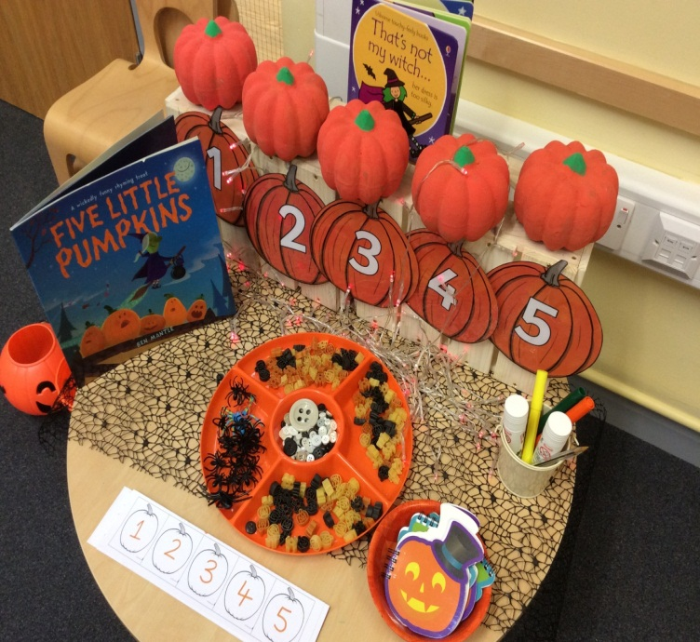
Autumn

Slide 13
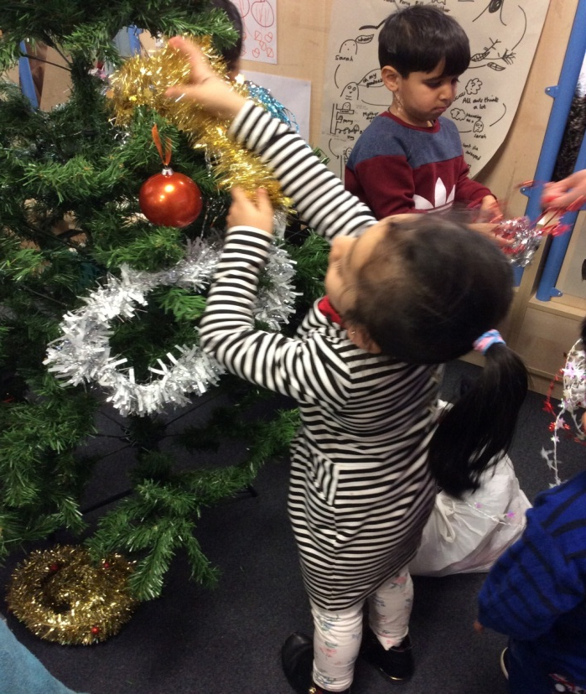
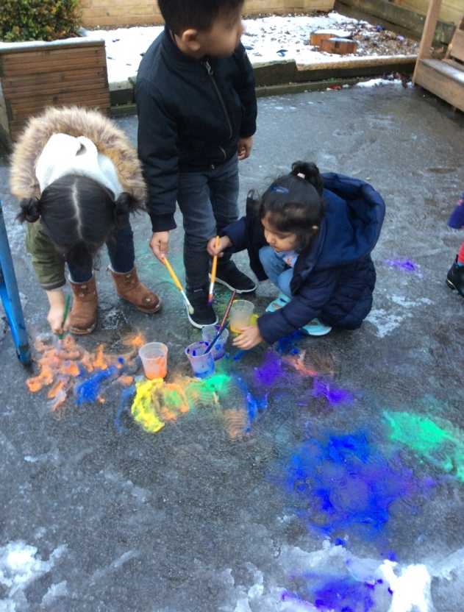
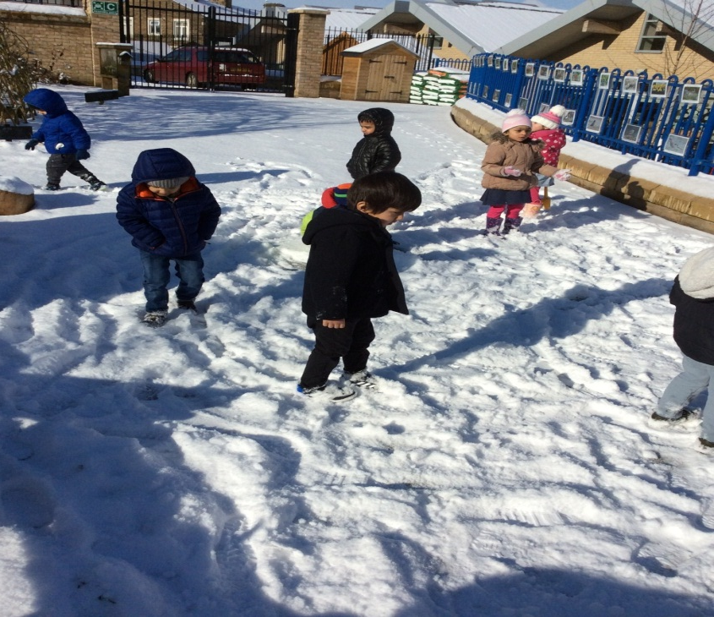
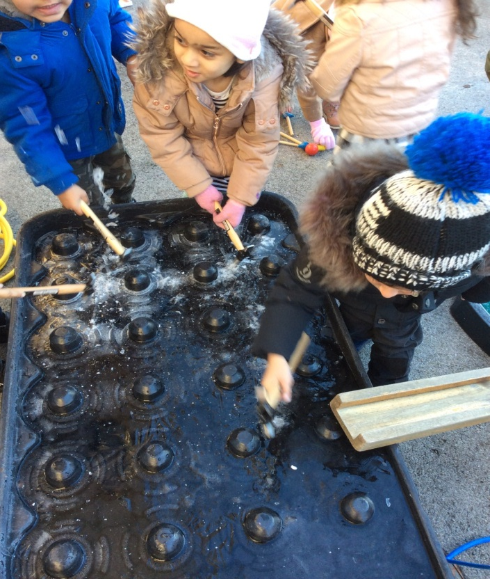
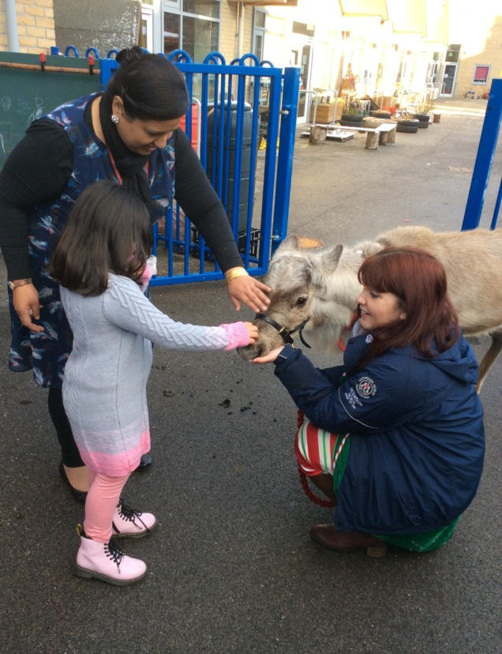
Winter

Slide 14
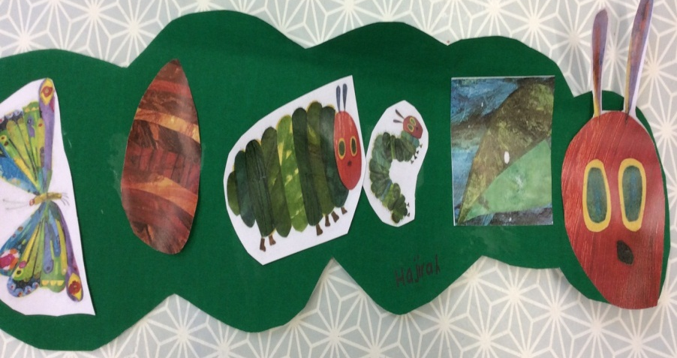
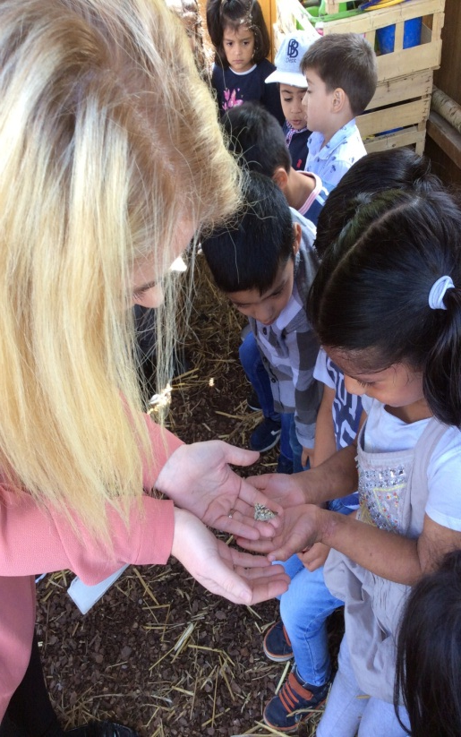
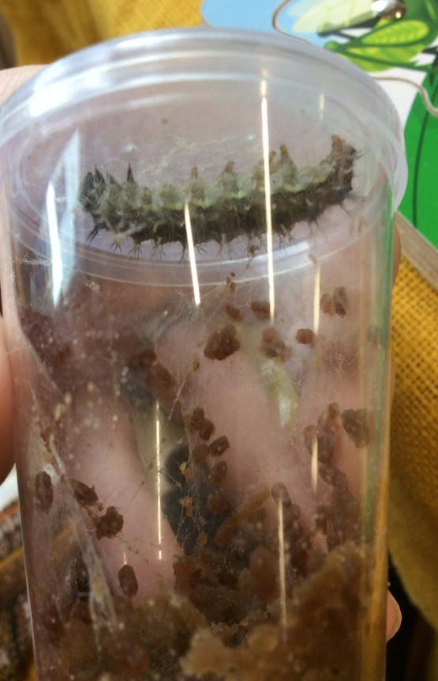
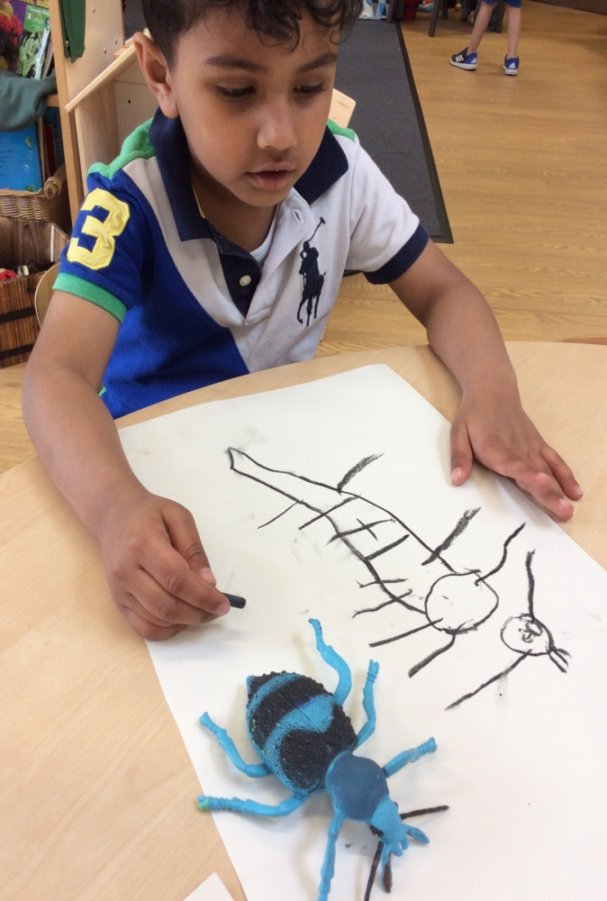


Spring

Slide 15




Summer

Slide 16



Extra enrichment
Miss Smith – Artist in residence

Slide 17




Baking

Slide 18

Keeping in touch…
See your child’s rewards
Keep up to date with what’s happening in nursery.
Receive reminders and updates.
Message teachers directly.
How to connect
Follow the link emailed by staff. Or
1. Download the ClassDojo app
2. Open app and tap 'Parent' to create a parent account
3. Enter name, email & create a password
4. Tap ‘Add child (+)’ and add personalised code (ask member of staff)

