Slide 1

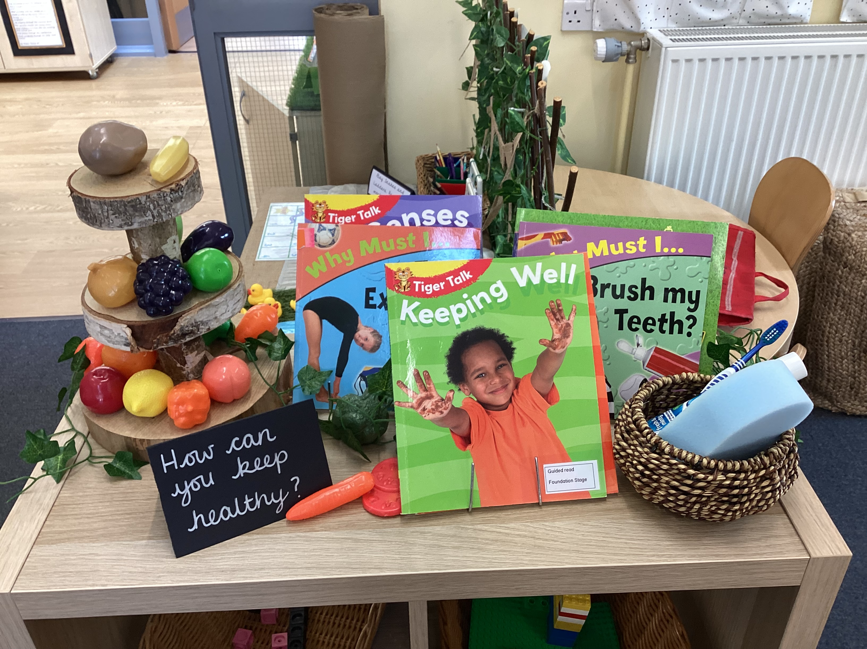
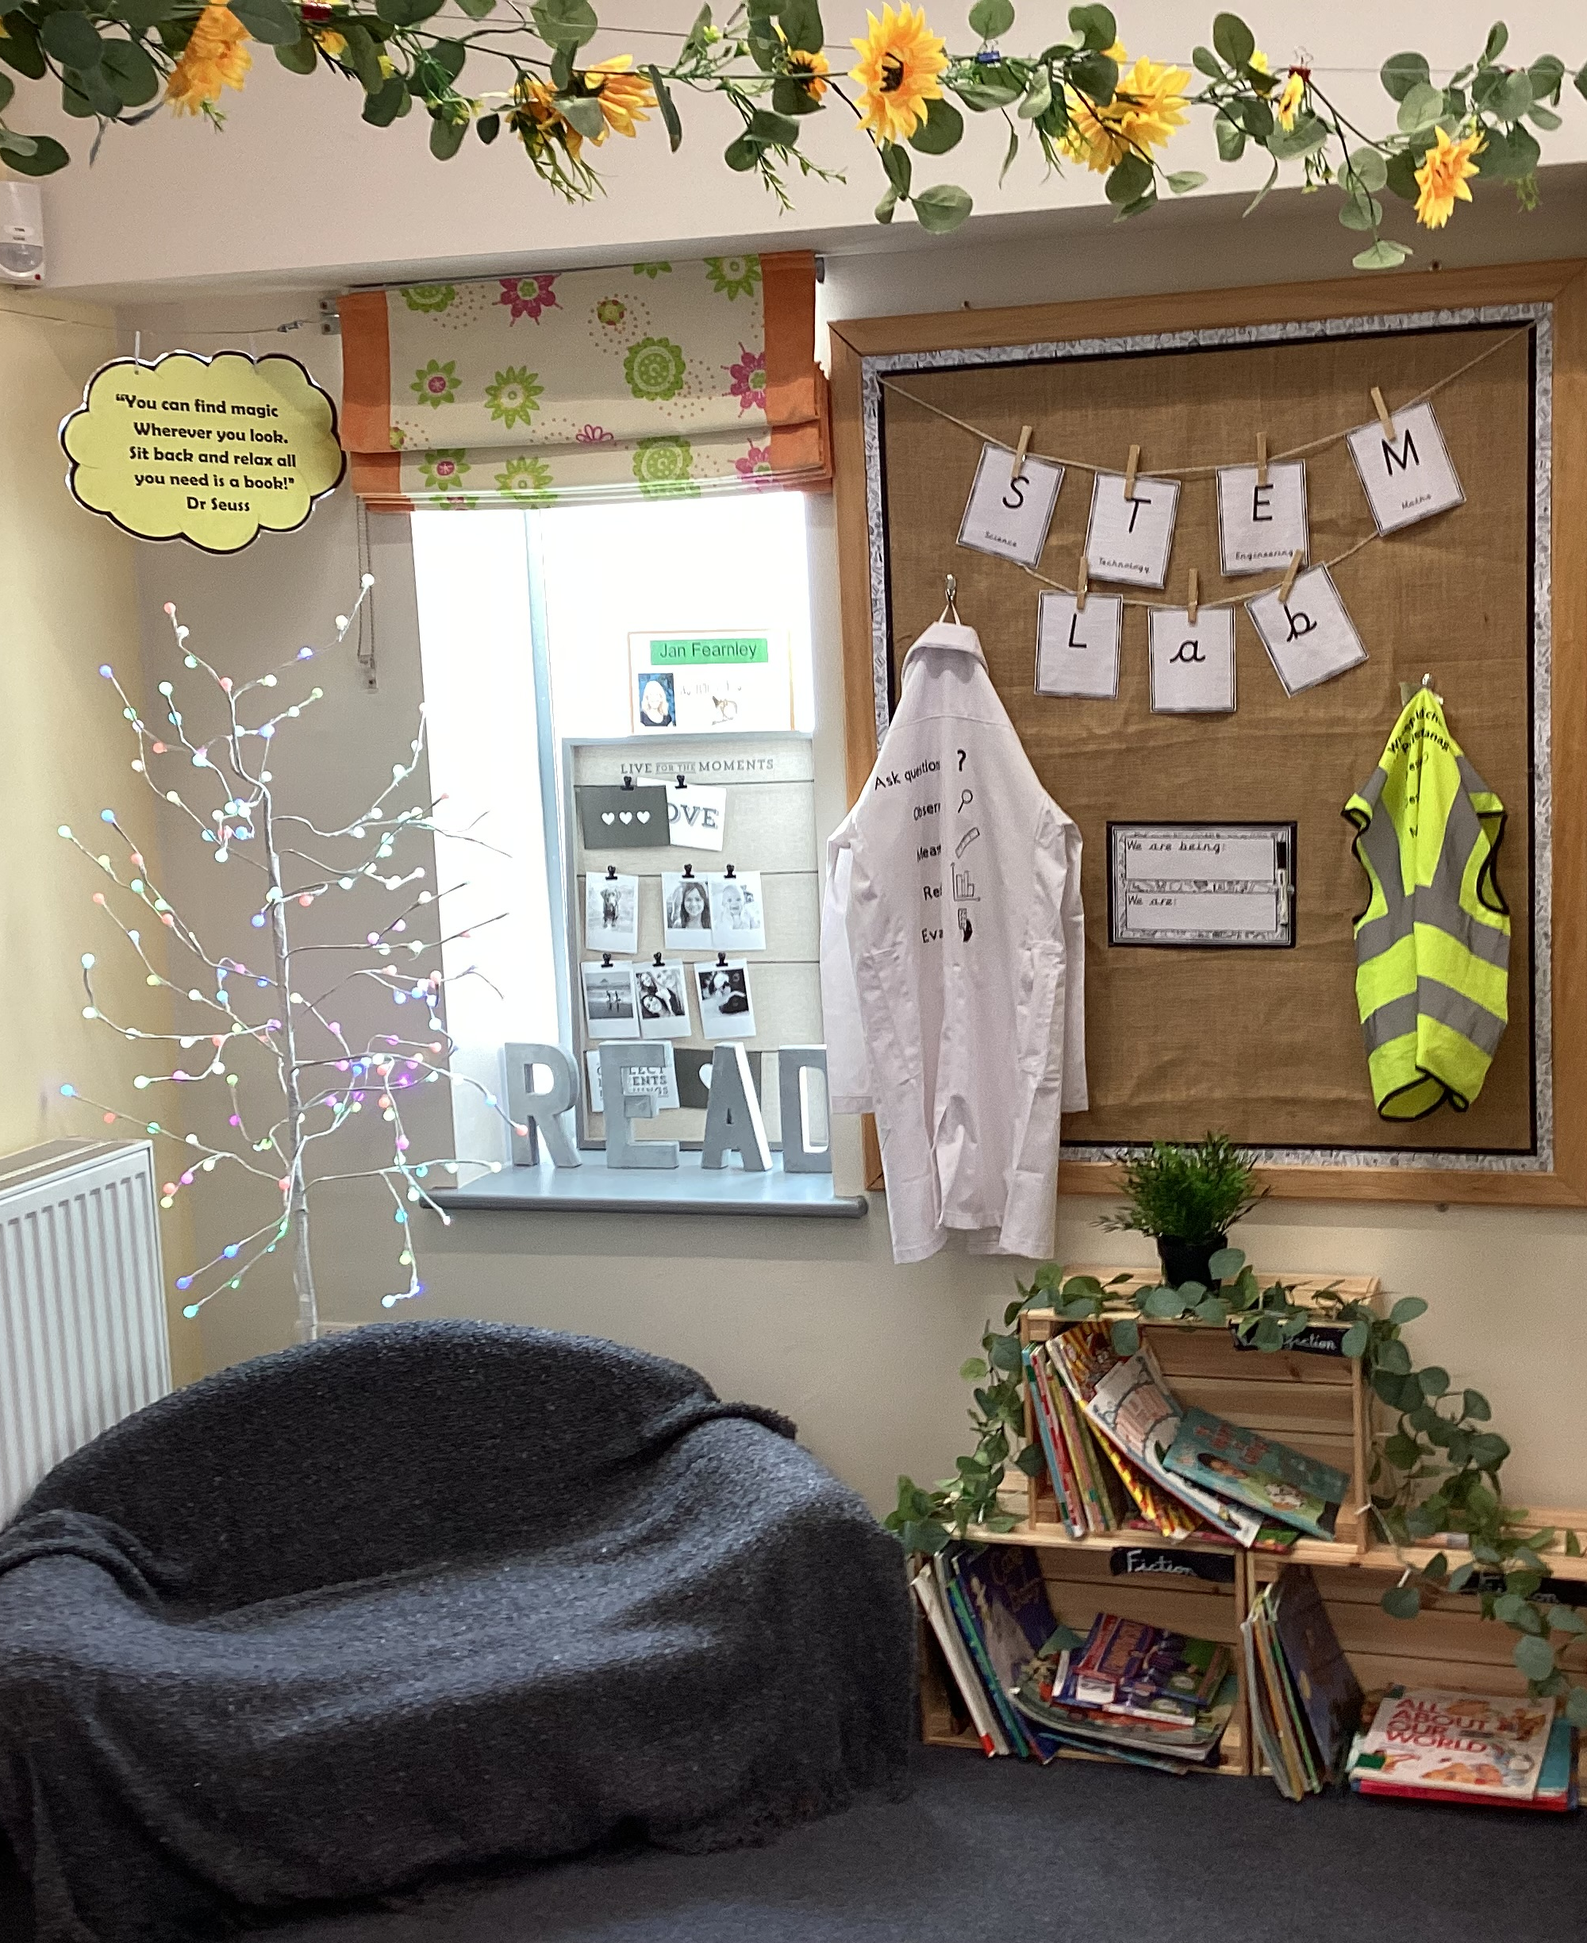
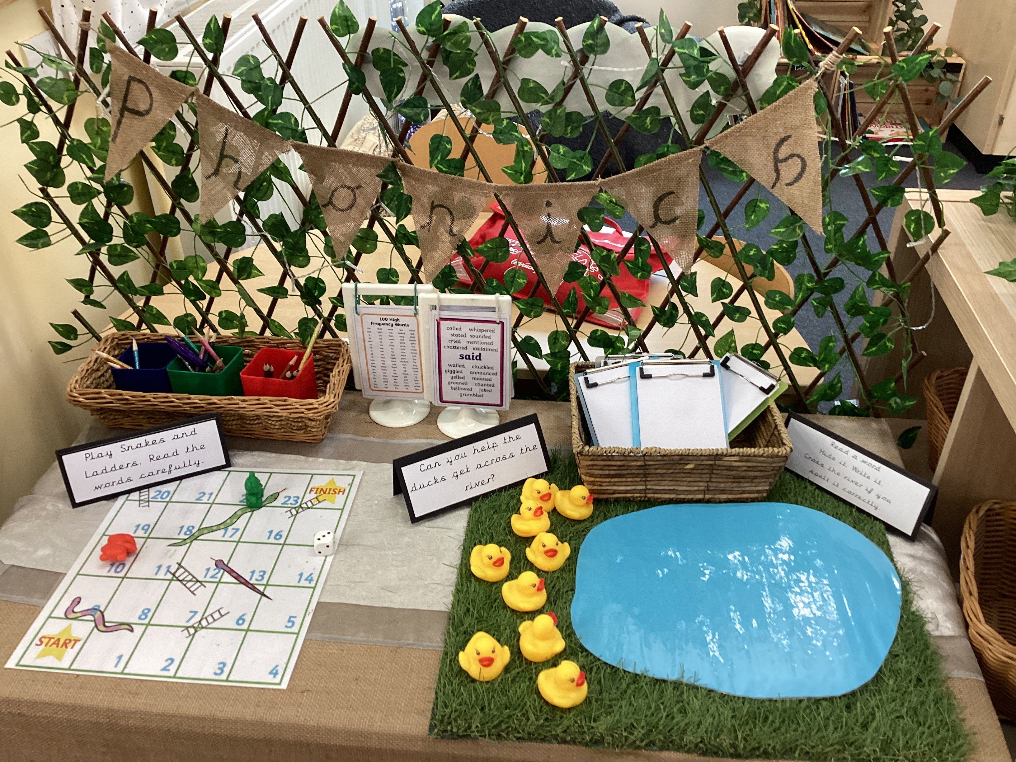
Welcome to
Class 9

Slide 2
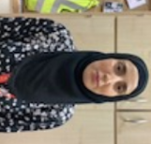
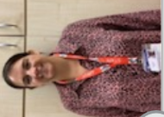
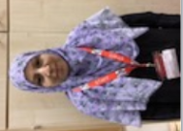
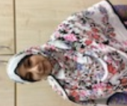
Meet the class team
Mrs Bates
Class Teacher
Mrs Akhtar
Teaching Assistant
Mrs Parveen
Teaching Assistant
Mrs Malik
Teaching Assistant

Slide 3
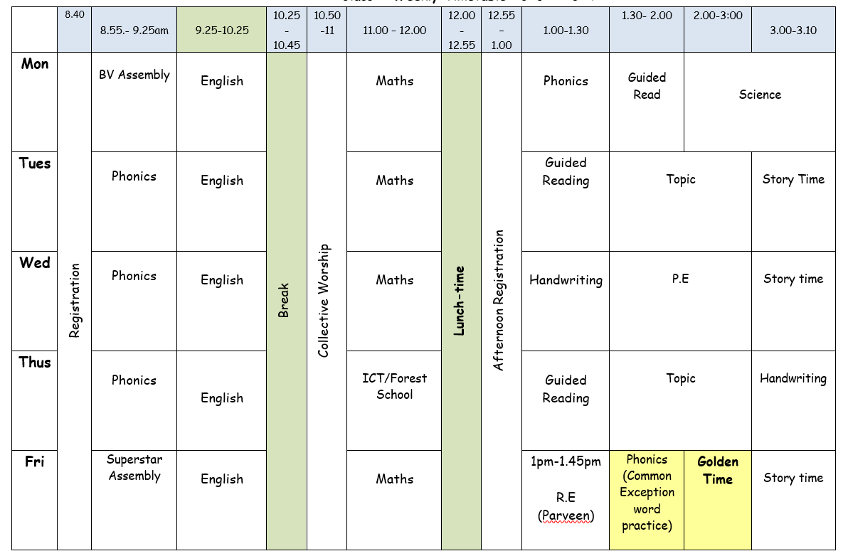
Our class timetable

Slide 4
Phonics
Phonics is a way of teaching children the skills of reading and writing.
How we teach phonics in school
Phonics is taught every day in a discreet 20 minute session.
Phonics interventions also take place daily. This is an additional phonics session aiming to boost any children that have gaps in their phonics knowledge.
Phonics is differentiated in class and children are grouped based on their phonics needs.
Phonics is reinforced throughout all lessons and learning to embed the skills and knowledge taught.

Slide 5
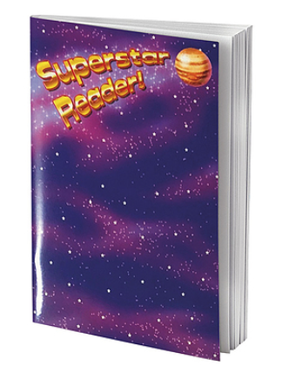
Reading
Children will be provided with a reading book that matches their phonics level. Throughout the week, your child’s reading will be listened to in school, so they will need to bring their book and reading record everyday.
It is incredibly important that you listen to your child read every night to help develop their reading ability. Please write what page your child has read up to or if they have read all their book.
Please sign your child’s reading record after you have listened to them read and we will change their book on a Monday, Wednesday and Friday.

Slide 6
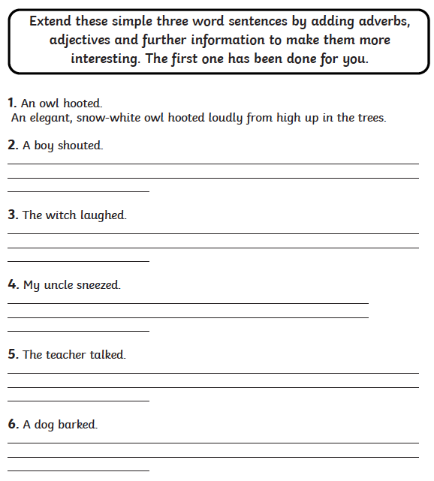
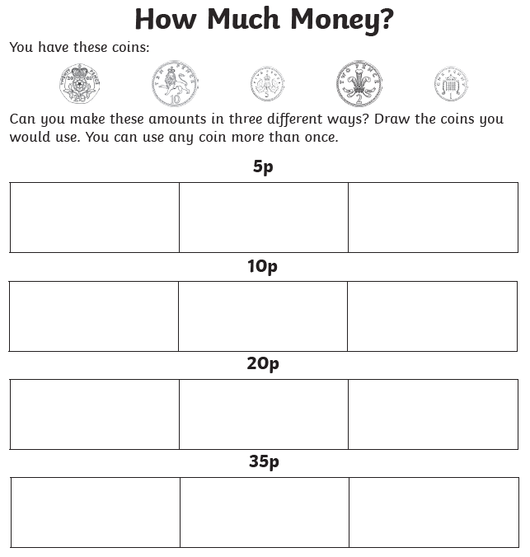
Home learning
Your child will receive home learning each week. This will be sent home on a Wednesday and is expected to be completed and returned on the following Monday.
This learning will consist of an English and maths activity. If you have any questions regarding your child’s home learning, then please do not hesitate to ask.

Slide 7

Knowledge Hands
This year, we will continue to use knowledge hands. These will be sent home at the start of each half term and will include the 5 key pieces of information that children will be learning about in each subject area.
We encourage you to discuss these with your child at home, in order to help strengthen and retain their subject knowledge.
The fire started on 2nd September 1666.
It began in a bakery on Pudding Lane.
History – The Great Fire of London
Houses were made out of wood and straw so the fire spread quickly.
The fire lasted 4 days.
Houses were rebuilt out of brick.

Slide 8
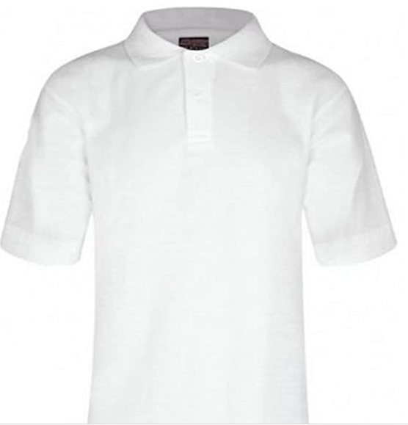
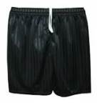


PE
Our PE day is Wednesday. Children should come to school wearing their PE kit on this day.
Our school PE kit is:
White t-shirt
Black pants or shorts
Black pumps or trainers
School jumper or cardigan

Slide 9
Year 2 SATs
At the end of Year 2, we will judge the standard that your child is working at in English, maths and science. To help make these judgements, your child will sit national curriculum tests in maths and English, known as standard attainment tests (SATs).
These tests, along with your child’s work throughout the year, help to assess your child’s performance and, as they move up to key stage 2, identify their needs. More information about the SATs will be shared with parents closer to the time of taking them.
Subject | Test paper
English reading | Short text and questions and long text and questions
Mathematics | Arithmetic and mathematical reasoning
English grammar, punctuation and spelling (optional test) | Spelling and punctuation and grammar (including vocabulary)

Slide 10
General reminders
Classroom doors open for drop off at 8.40am and for pickup at 3.10pm. Please ensure your child is dropped off and picked up promptly.
All children must be collected by an authorised adult on the class collection sheet. If another adult is going to collect your child, then please inform the class teacher or school office.
All items of clothing, including your child’s school jumper or cardigan should be clearly labelled with their name to prevent them getting misplaced.
Please provide your child with a plastic water bottle that is labelled with their name. These will be sent home every night to be washed.
If your child has any new medical conditions, then please inform the class teacher or school office.

Slide 11
Are there any questions?
Thank you for your continued support and cooperation.

