Slide 1
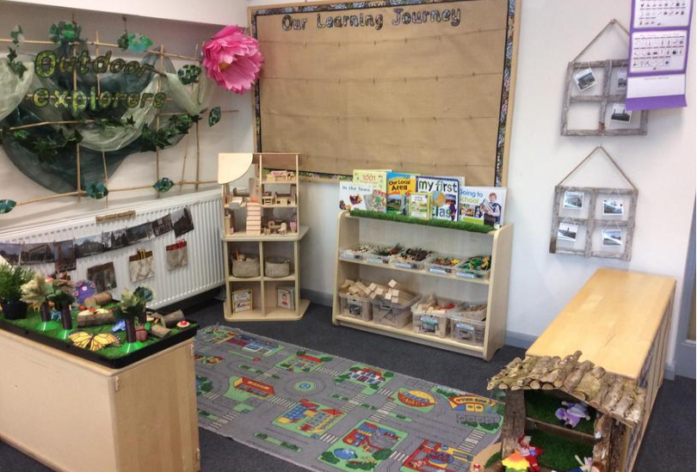
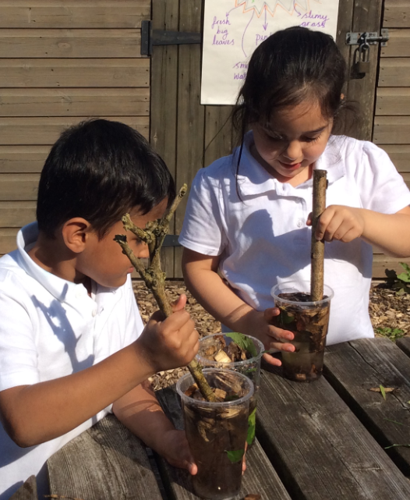
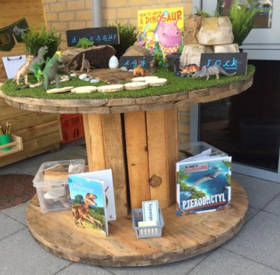

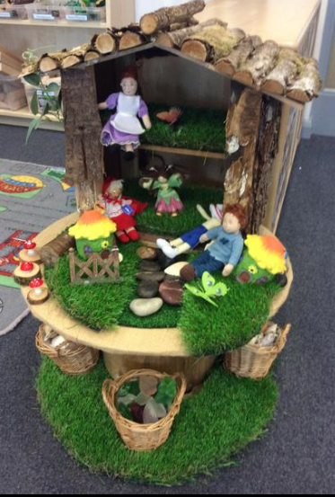
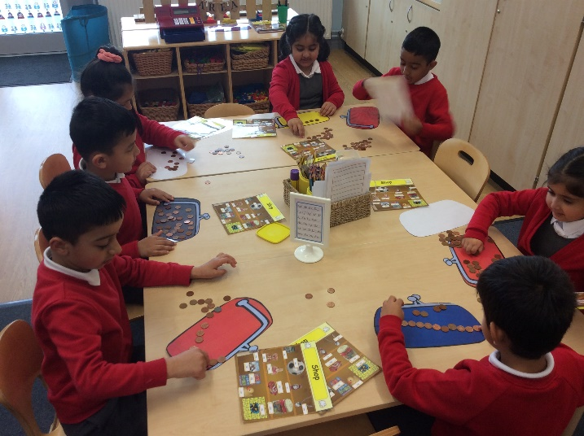
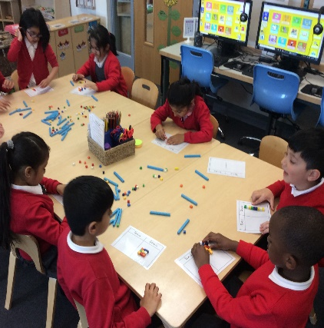
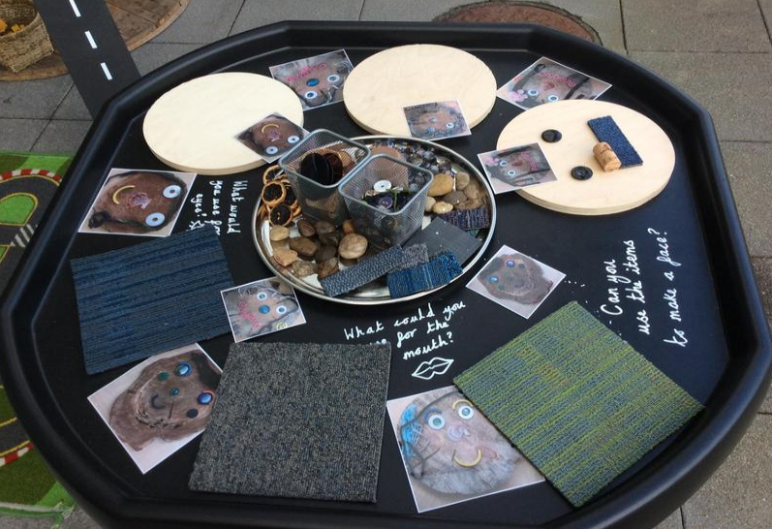
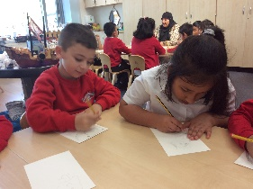
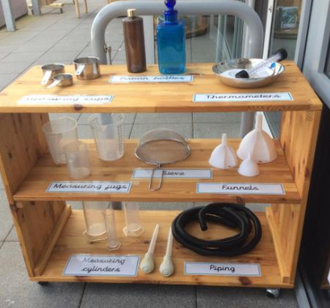
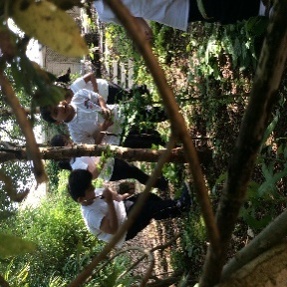

Welcome to Year 1

Slide 2
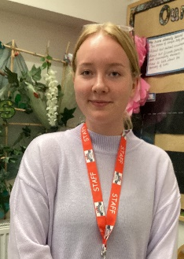
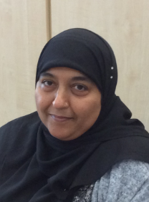
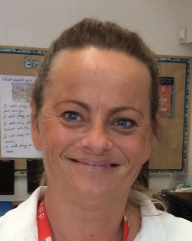
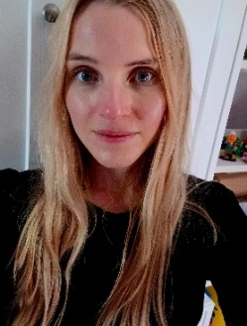
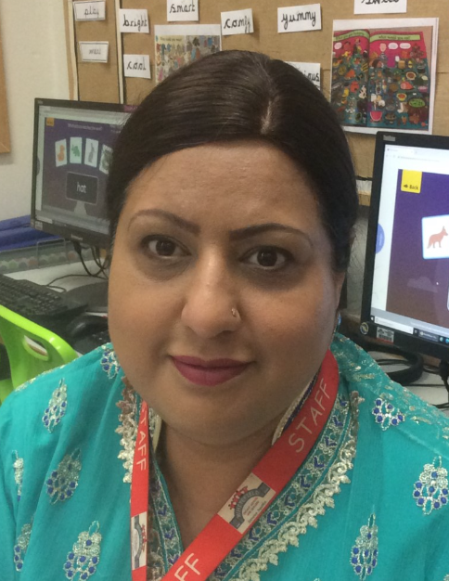
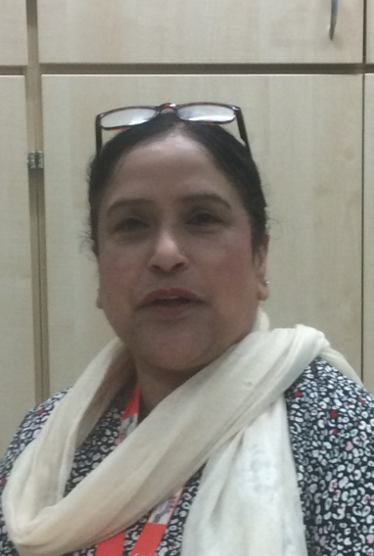
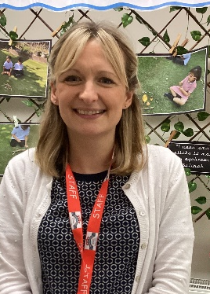
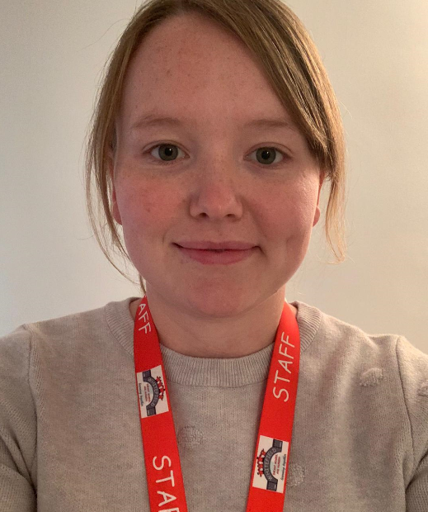
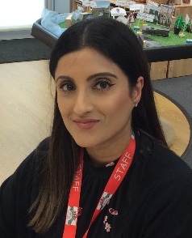
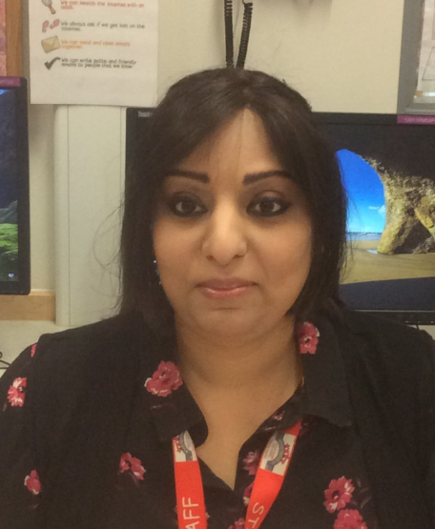
Meet the Year 1 Team!
In Class 4 we have …
Miss Elliott
Mrs Azam
Mrs
Willan
In Class 5 we have …
Mrs Williams
Mrs Kausar
Mrs
Harries
Mrs Liaqat
In Class 6 we have …
Mrs Hutton
Mrs Ahmed
Mrs Aziz

Slide 3
Classroom doors open for drop off at 8.40am and for pickup at 3.10pm
Please ensure your child is dropped off and picked up promptly and you must hand your child over to the classroom team.
All children must be collected by an authorised adult on the class collection sheet. If another adult is going to collect your child please inform your class teacher.
Parent Reminders

Slide 4
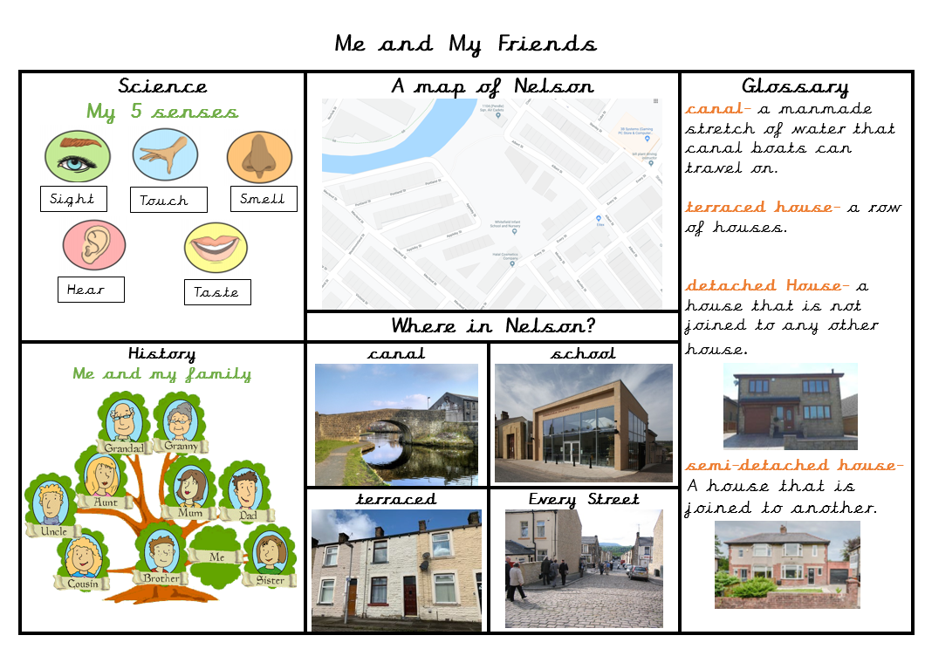

Vocabulary Mats
Each half term your child will bring home a vocabulary mat and key learning hands to show you what we will be learning over the half term.
Please have a look at these with your children and talk about some of the language and things we will be looking at in preparation.

Slide 5

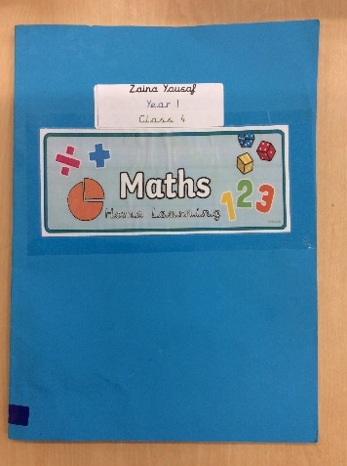
Your child will receive Maths and English home learning every week.
Home learning will be sent home on a Wednesday and should be completed and returned the following Monday.
If you have any questions about home learning please don’t hesitate to ask!
Home Learning

Slide 6
Phonics is a way of teaching children the skills of reading and writing.
How we teach phonics in school
Phonics is taught every day in a discreet 20 minute session.
Phonics interventions also take place daily. This is an additional phonics session aiming to boost any children that have gaps in their phonics knowledge.
Phonics is differentiated in each class and children are grouped based on their phonics needs.
Phonics is reinforced throughout all lessons and learning, to embed the skills and knowledge.
Please visit the ‘Phonics’ page on the school website for more information.
Phonics

Slide 7
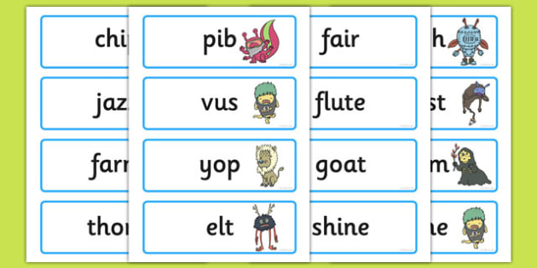
Phonics Screening
At the end of year 1 in June we have a phonics screening check to asses the children’s phonics ability.
Children have to read 40 real and nonsense words.
This is used as an assessment tool to inform teachers planning.
If your child doesn’t meet the pass rate they will retake the check in year 2.
More information regarding the phonics screening check will be given nearer the time.

Slide 8

Reading
Children’s reading will be listened to throughout the week so they will need to bring their reading book, reading record and book bags every day.
It’s incredibly important that you listen to your children read every night to help us develop your child’s reading ability.
Please sign their reading journal
when you have listened to
your child read and we will
give them a new book the
following day.
Books will be changed on a
Monday,
Wednesday,
Friday.
Please read the book twice.
1- for phonics practise
2- to develop reading fluency

Slide 9
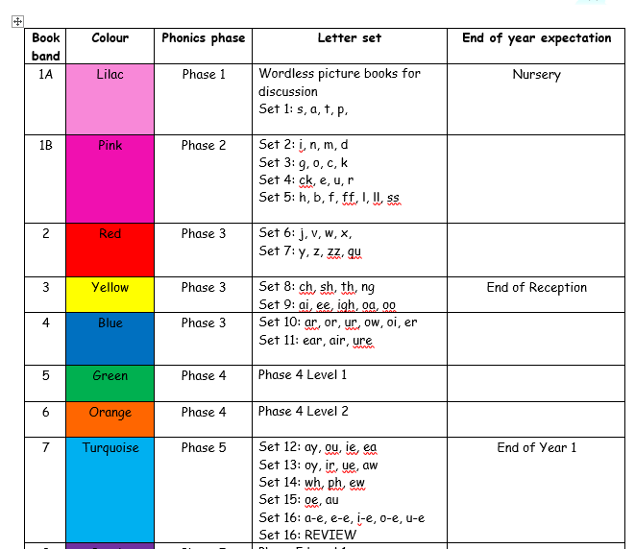
The importance of reading
Children’s reading will be listened to throughout the week so they will need to bring their reading book, reading record and book bags every day.

Slide 10
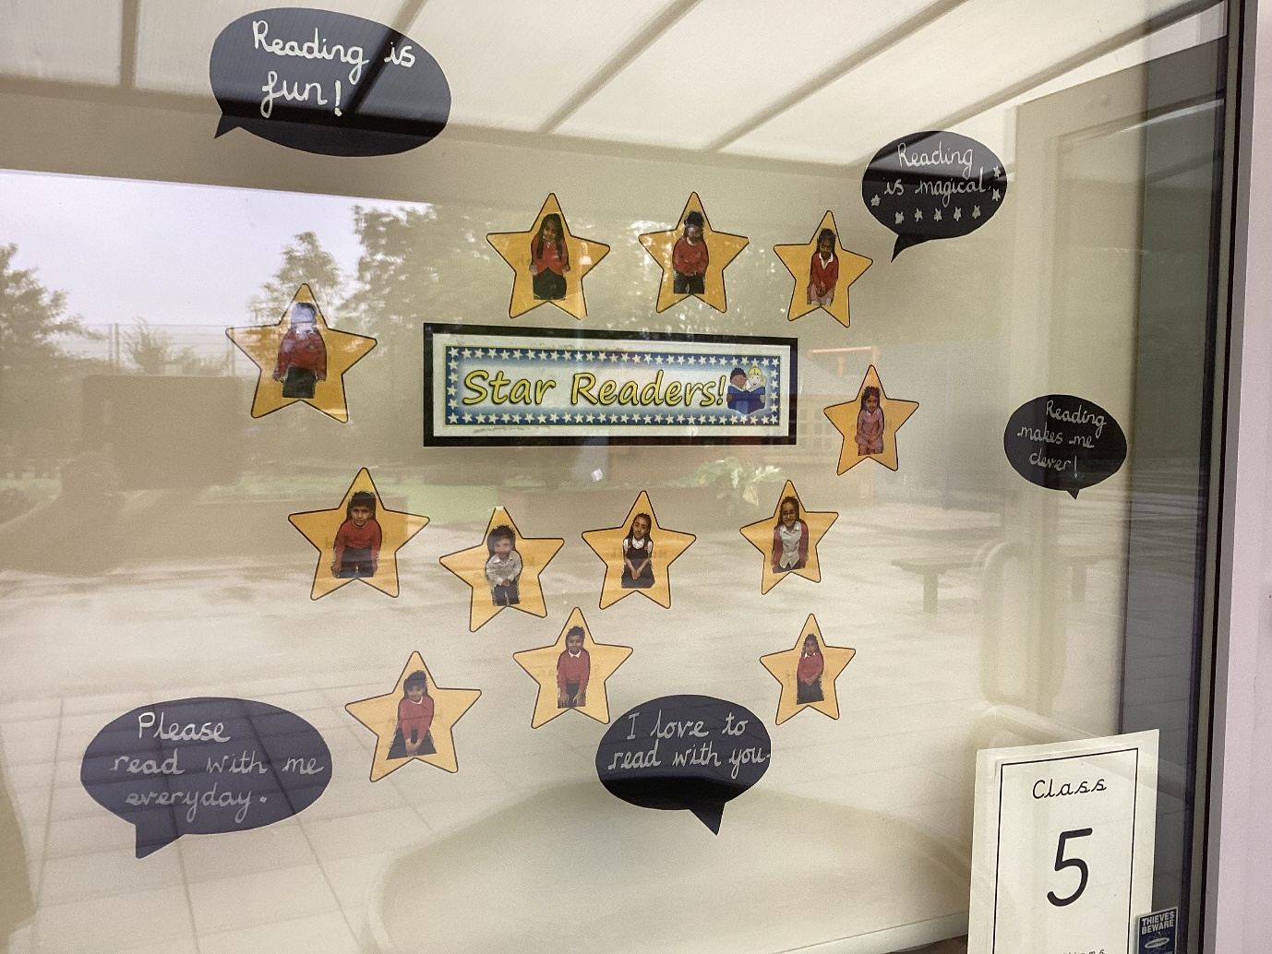
Reading Stars
Each Year 1 class has a ‘Reading Stars’ display in their window which celebrates children’s achievements with reading at home.
When children have read at home their star will be placed in the window. This is checked and updated by teachers everyday.

Slide 11
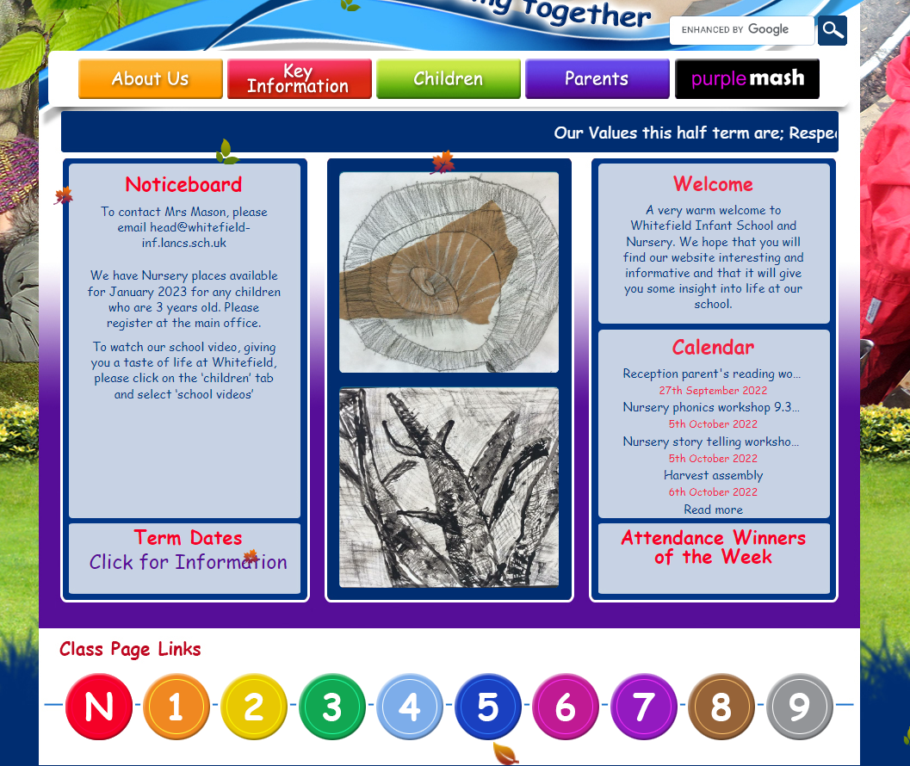
The school Website
The school website contains lots of information about school and what’s going on.
Your class teachers will upload pictures and information about your child’s class so you can keep up to date with their learning.
If you do not want your child to be on pictures on the school website please inform your class teacher.
You can access your class page by clicking on the numbers at the bottom of the homepage.

Slide 12

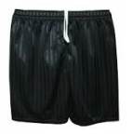


To keep your children as safe as possible we are asking all children to come to school wearing their PE kit on their PE day.
P.E days are as follows
Class 4 – Tuesday
Class 5 – Thursday
Class 6 – Wednesday
Our school PE Kit is:
White t-shirt
Black pants/shorts
Black pumps/ trainers
School jumper or cardigan
P.E

Slide 13
General Reminders
Please ensure all your children’s jumpers have their names in them.
Please send them to school with a named water bottle every day.
Please keep your class teacher updated with any medical needs or changes.

Slide 14
If you have any questions please phone the school office and make a telephone appointment or send your class teacher an email.
We will not hesitate to help!
Thank you for all your support!

