Slide 1
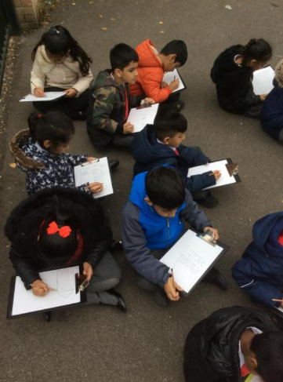
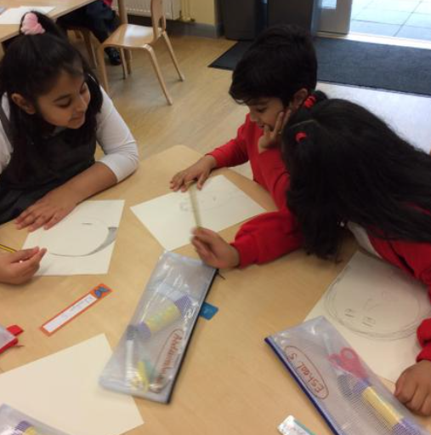
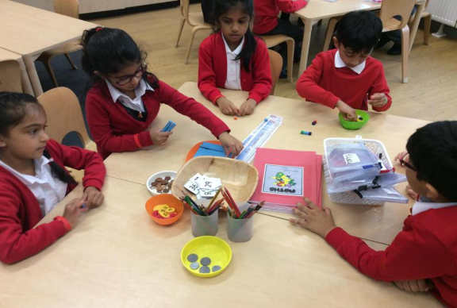
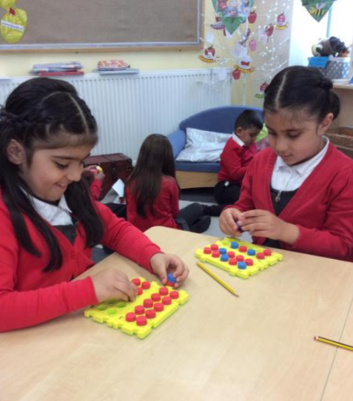

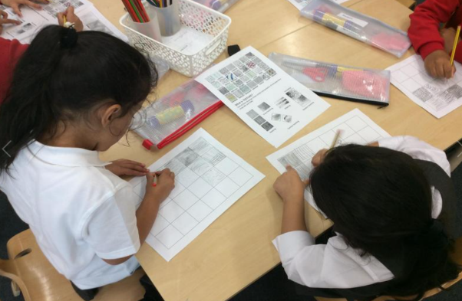
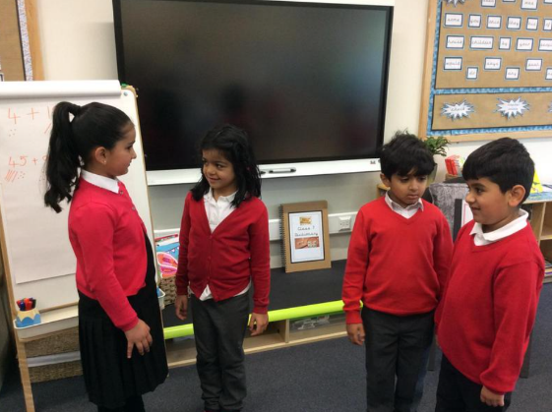
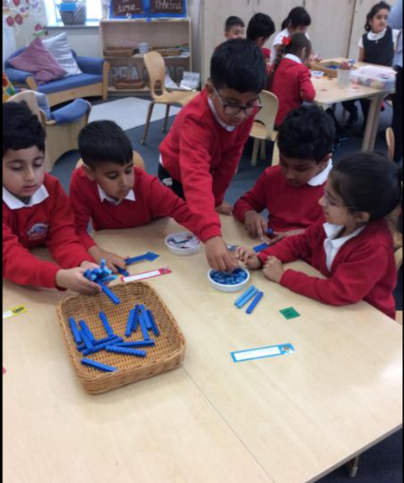
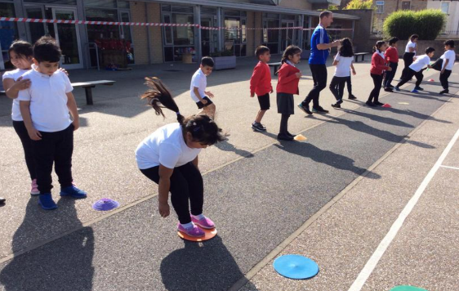
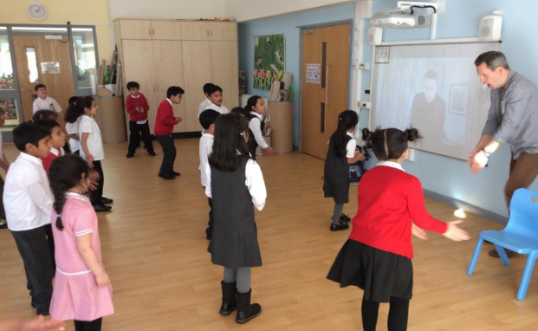
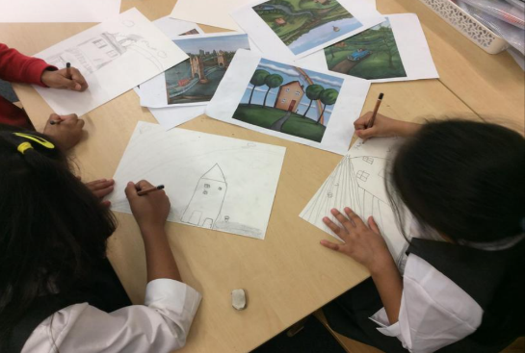
Welcome to Year 2

Slide 2
Classroom doors open for drop off at 8.40am and for pickup at 3:10pm
Please ensure your child is dropped off and picked up promptly.
All children must be collected by an authorised adult on the class collection sheet. If another adult is going to collect your child please inform your class teacher.
Parent Reminders

Slide 3
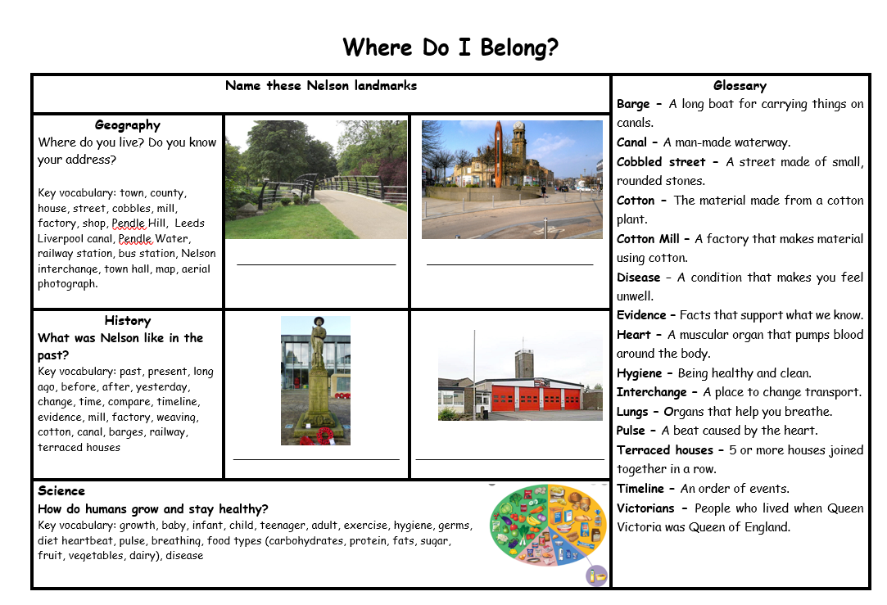
Vocabulary Mats
Each half term your child will bring home a vocabulary mat to show you what we will be learning over the term.
Please have a look at these with your children and talk about some of the language and things we will be looking at in preparation.

Slide 4
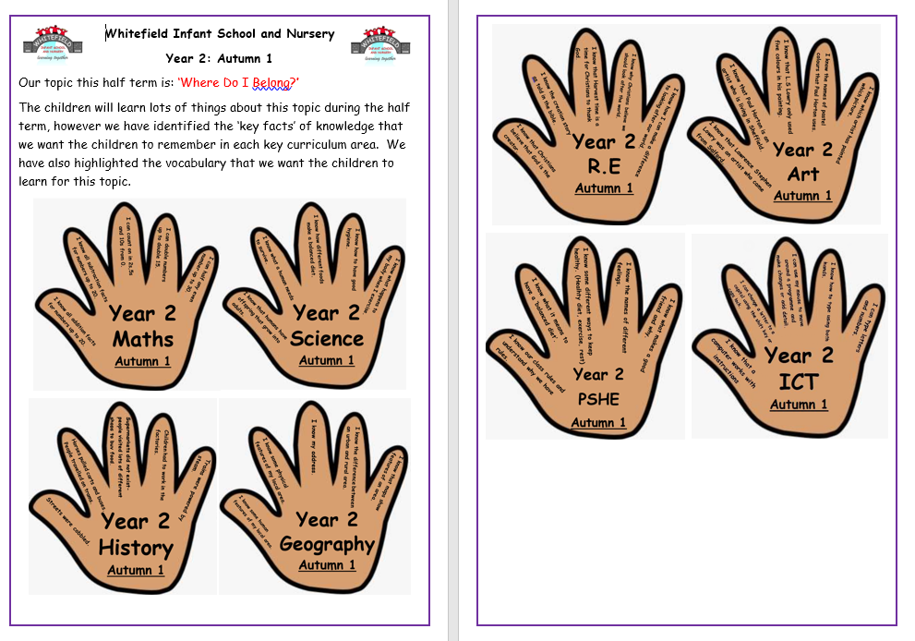
Knowledge Hands
Each half term your child will also bring home knowledge hands.
These hands will include 5 key facts for each subject that we want the children to remember.
Please read these at home and talk about them at home.

Slide 5
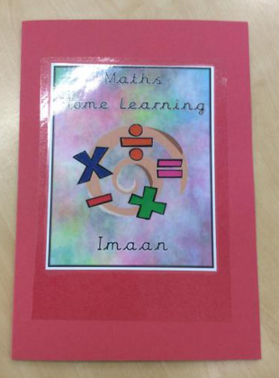
Your child will receive Maths and English home learning every week. The home learning will relate to topics covered in class.
Home learning will be sent home on a Wednesday and should be completed and returned the following Monday.
If you have any questions about home learning please don’t hesitate to ask!
Home Learning

Slide 6
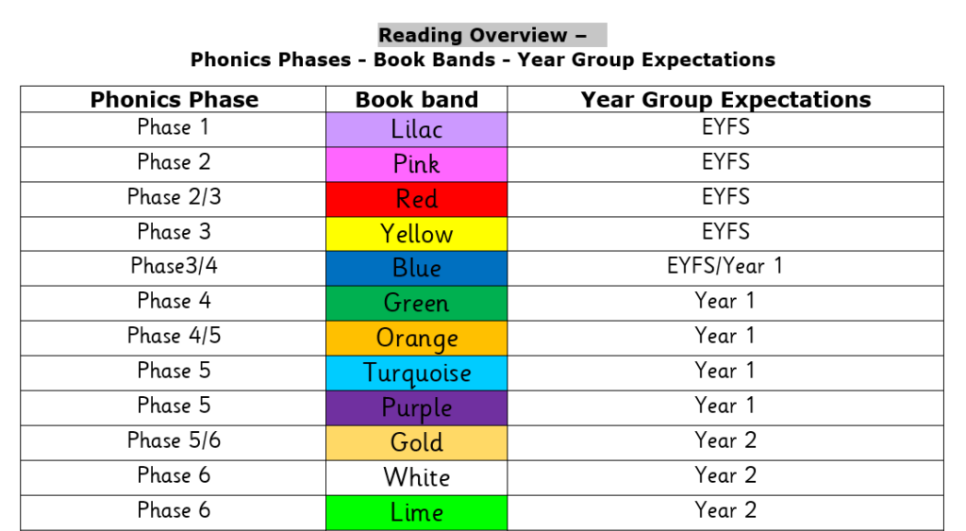
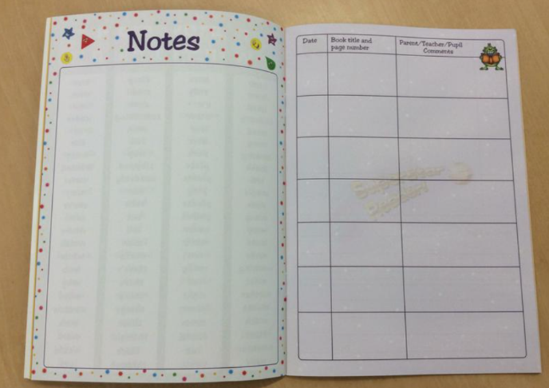
Reading
Children’s reading will be listened to throughout the week so they will need to bring their reading book, reading record and book bags every day.
It’s incredibly important that you listen to your children read every night to help us develop your child’s reading ability.
Please sign their reading journal
when you have listened to
your child read and we will
give them a new book the
following day.

Slide 7
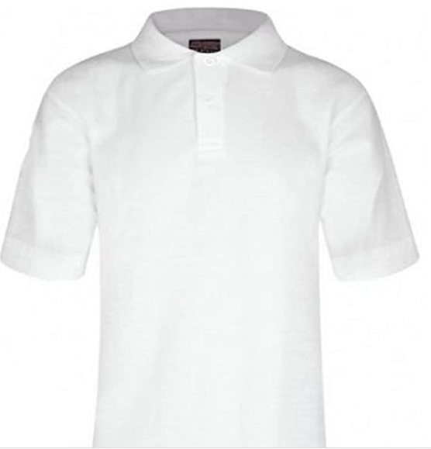
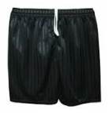


Children may continue to come to school in their P.E kit on P.E days.
Class 8 – Tuesday
Our school PE Kit is:
White t-shirt
Black pants/shorts
Black pumps/ trainers
School jumper or cardigan
P.E

Slide 8
And Finally …
Please ensure all your child’s jumpers and coats have their names in them.
Please send them to school with a named water bottle every day.
Please check your child’s book bag every night for any newsletters or important information.
If your child has any new medical issues or allergies please let your class teacher know.

Slide 9
If you have any questions please phone the school office and make a telephone appointment or send your class teacher an email. Teacher emails are on class pages on the website.
We will not hesitate to help!
Thank you for all your support and cooperation!

