Slide 1
Parents Information
SATS 2024

Slide 2
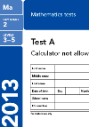
Outline
To put your mind at ease
What are SATs?
An outline of the tasks and tests the children will complete.
What you can do to help your child in Year 2

Slide 3

What are sats?
SATs = Standard Assessment Tasks
KS1 SATs papers are taken by pupils in Year 2 as part of the National Curriculum assessment programme.
They are now optional, but being an infant school, it is important that we use them as part of our assessment process.
SATs inform Teacher Assessments and are only one piece of evidence

Slide 4
Teacher Assessment
If your child is not working at the Year 2 standard the teacher will inform you that they are not taking the test and the work in their books will be used to make a judgement of their attainment.
If children do not perform to their best ability in the test, please don’t worry as teacher assessment is used in conjunction with the test
Children will not know that they are taking SATs, it’s done as subtly as possible.
We will remain incredibly positive and will provide as many rewards and as much encouragement as possible, but we cannot help children during the test.

Slide 5
TESTS AND TASKS
English Reading | Maths
Paper 1 30 minutes Reading paper. Paper 2 40 minutes Reading paper. | 20 minutes Arithmetic test. 35 minutes Maths test focussing on fluency, problem-solving and reasoning.
Please don’t worry about the timings, they are a guide.

Slide 6
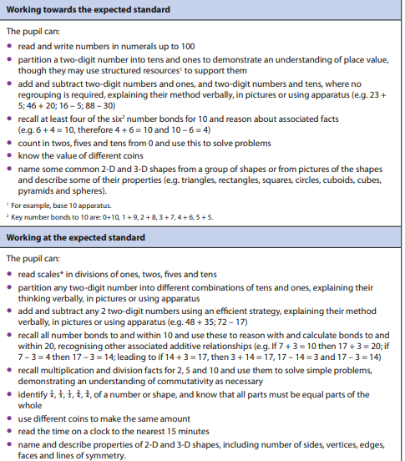
Year 2 Expectations - Maths

Slide 7
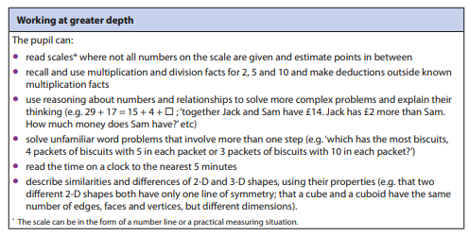
Year 2 Expectations - Maths

Slide 8
Math Test
Mathematics SATs consist of;
Arithmetic test (approx. 20 minutes)
This will focus on the four main calculations.
Mathematical fluency, problem-solving and reasoning test (approx. 35 minutes)
variety of question types e.g.:
multiple choice,
matching,
true/false,

Slide 9
What do the tests look like?
Maths Paper one
Arithmetic

Slide 10
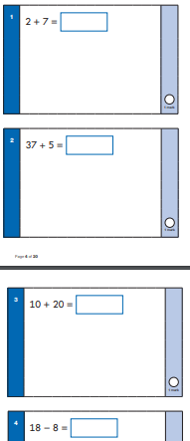
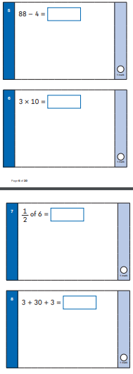
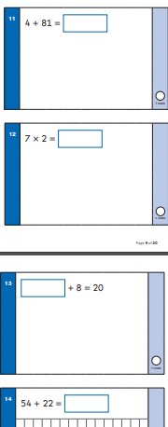

Slide 11
What do the tests look like?
Maths Paper two
Reasoning

Slide 12
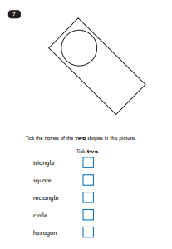
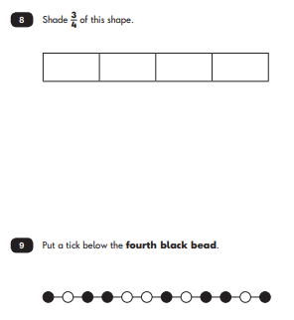

Slide 13
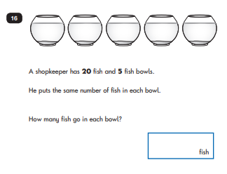
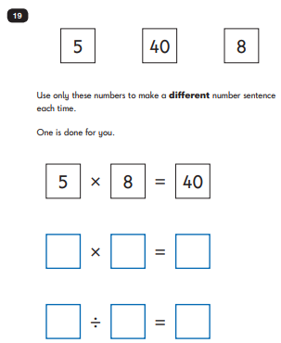

Slide 14


Reading
Children will complete two papers:
The texts will cover a range of fiction, non-fiction and poetry
Paper 1 consists of a selection of texts, with questions interspersed.
Paper 2 comprises a reading booklet of a selection of passages.
Children will write their answers in a
separate booklet.

Slide 15
Reading Question types
There will be a variety of question types:
Multiple choice
Ranking/ordering -Number the events below as they happened
Matching –’Match the character to the job that they do in the story’
Labelling -‘Label the text to show the title’
Find and copy -‘Find and copy one word that shows what the weather was like in the story’
Short answer - ‘What does the bear eat?’
Open-ended answer -‘Why did Lucy write the letter to her grandmother? Give two reasons.’

Slide 16
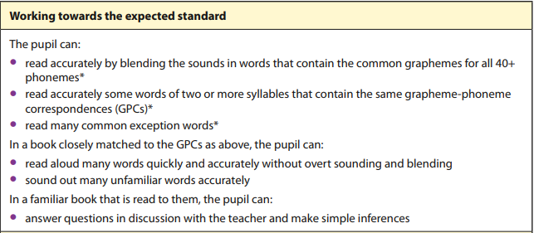
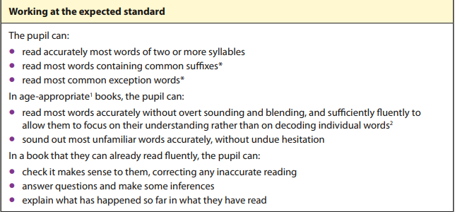
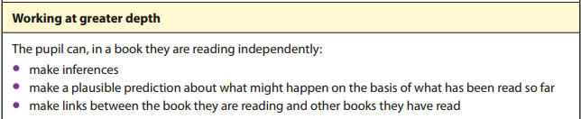
Year 2 Expectations - Reading

Slide 17
Reading - Paper one

Slide 18
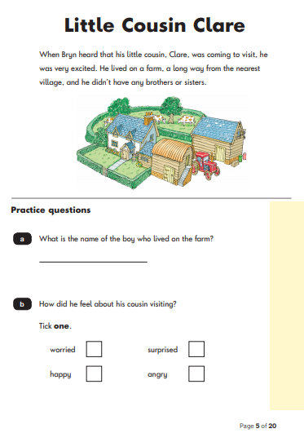
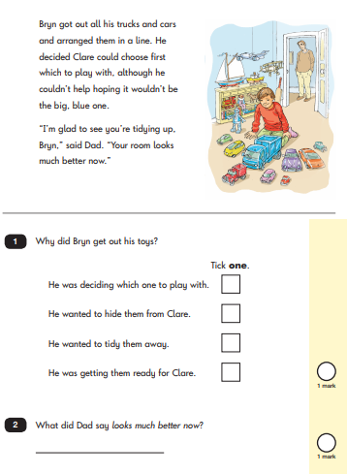

Slide 19
Reading - Paper two
In this paper, the texts and questions come in separate booklets. Children will need to be able to refer back to the text to answer questions as they read them. However, each question has a page reference to assist in this.

Slide 20

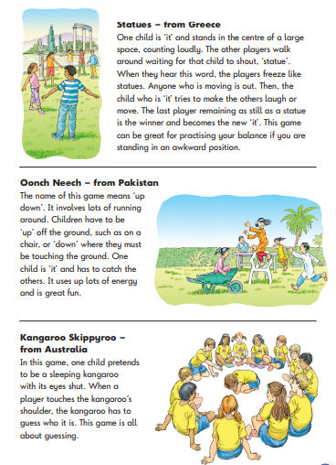

Slide 21
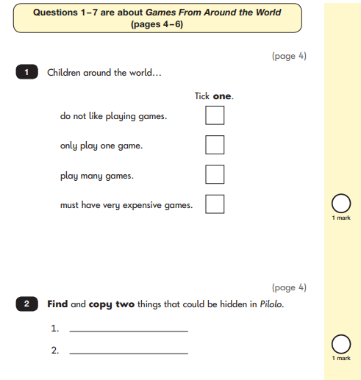
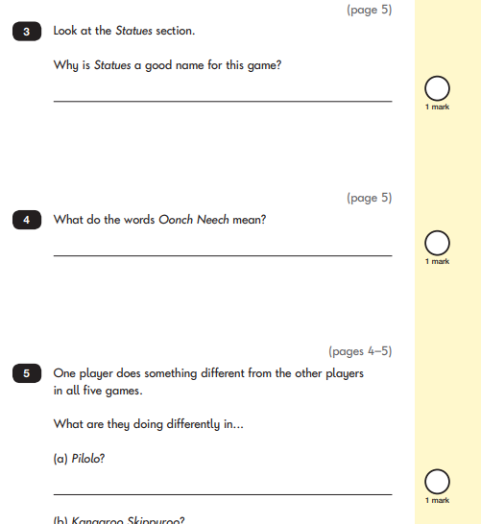

Slide 22

What will happen during sats week in school
Tests will take place in small groups, in class with a familiar adult- quiet, calm environment
If required, your child will sit with an adult (we do everything we can to make the children feel relaxed and comfortable)
We will have plenty of ‘rest time’ during the week (Art, Music, outdoors)
Don’t worry if your child is unwell.

Slide 23
How can you help your child
Reading every night (as always!)
Supporting home learning.
Good communication between the school and home.
Getting a good night’s sleep on a school night.
100% attendance and in school on time.

Slide 24
Help with reading
Ensure your child reads every night, and let them see you reading.
Encourage them to read fiction and non-fiction.
Try to listen to your child read and ask questions about what they are reading.
Help them with the different skills of reading especially ‘skim’ reading where they are looking for key words in the text. Find and copy etc
Speed reading for fluency
Sharing books with siblings

Slide 25
Maths help
Maths home learning
4 rules practise- addition, subtraction, division and multiplication.
Practise the written methods - number line
TIMES TABLES!!! (2,5,10 and 3)
Number Bonds - Numbers within 20
Counting forwards and backwards in 1s, 2s, 3s, 5s and 10s (from any given number).

Slide 26
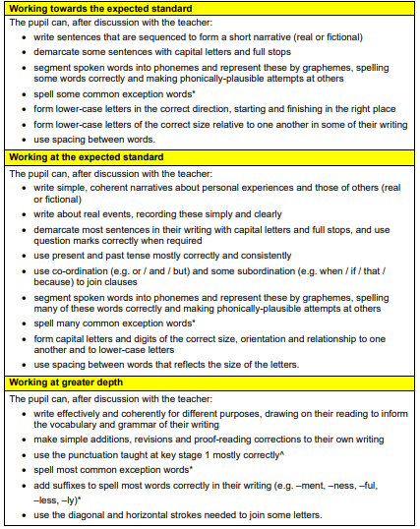
Writing Expectations
Writing is assessed using the work that the children produce throughout the year against these statements.

Slide 27
How we report the results
At the end of the academic year, you will receive a school report with your child’s end of year outcomes.
You will receive your child’s Teacher assessment judgement based on the interim assessment.
The judgements are:
Working at pre key stage level (PRE)
Working towards the expected standard (WTS)
Working at the expected standard (EXS)
Working at greater depth (GDS)

