Slide 1

Year 1: Phonics Screening Check Information for Parents
Wednesday 10th May 2023

Slide 2

Phonics Assessment: Year 1
During the week beginning 12th June all Year 1 children across the country will take a ‘phonics screening check.’
The aim of this check is to make sure that children have confidently learnt to recognise all 40+ phonemes and that they are able to blend and segment words fluently. These are vital reading skills.
It is essential that your child is in school this week in order to ensure that they complete the phonics screening check.

Slide 3

What is the Year 1 phonics screening check?
The phonics screening check is designed to give teachers and parents information on how your child is progressing in phonics. It will help to identify whether your child needs additional support at this stage so that they do not fall behind in this vital early reading skill.

Slide 4
What will the phonics screening check look like?
The children will be shown 20 real words and 20 pseudo (nonsense) words to sound out and read.
The children are given a practice set of 4 real words and 4 nonsense words before the check starts so that they understand what they need to do.
Nonsense words are included in the check specifically to assess whether your child can decode a word using phonics skills and not their memory.
The nonsense words will be shown to your child with a picture of a monster and they will be aware that they are reading a non-word.

Slide 5
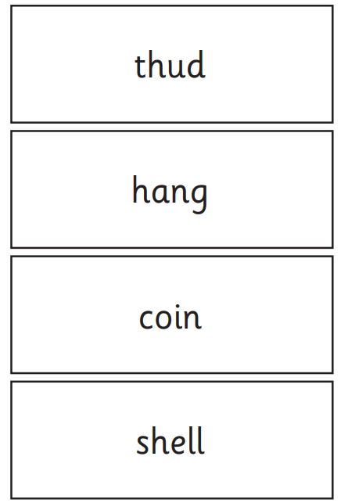
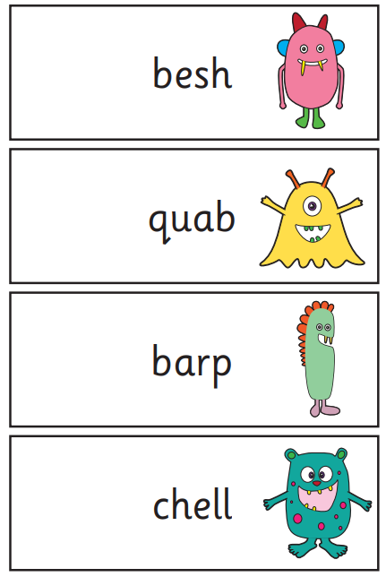
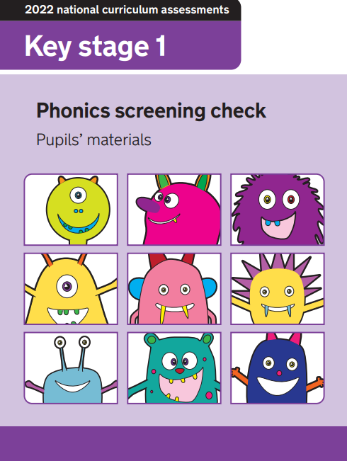
What will the phonics screening check look like?
Below is an example of materials from a past phonics screening check.
Children’s booklet
Real words
Nonsense words

Slide 6

What does it check?
It checks that your child can:
Sound out and blend graphemes in order to read simple words.
Read phonically decodable one-syllable and two-syllable words, e.g. cat, sand, windmill.
Read a selection of nonsense words which are referred to as pseudo words.

Slide 7

Where will it take place?
The screening check will take place with each child’s teacher in a quiet room. Children will be given as much time as they need to complete the check and it will be very similar to the activities that the children already complete during their daily phonics sessions.

Slide 8
When will I find out if my child has passed the check?
Parents will be informed as to whether their child passed the screening check in the summer. We will not know a pass mark until it is released nationally in the summer, so cannot tell you before then.

Slide 9
What happens to the results?
The school will report your child’s results to you by the end of the summer term as well as to the local authority, but the results won’t be published in a league table as with SATs. If you have any concerns, do talk to your teacher about this in a parents’ meeting or after school.

Slide 10
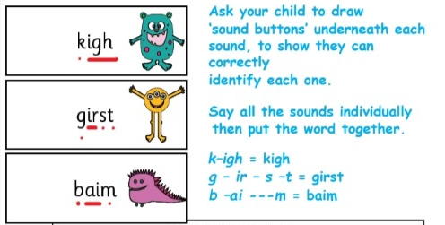
What should I do if my child is struggling to decode a word?
Say each sound in the word from left to right.
Blend the sounds by pointing to each letter

Slide 11

What should I do if my child is struggling to decode a word?
Work at your child’s pace.
Always be positive and give lots of praise and encouragement.

Slide 12

How can I help?
REMEMBER: Phonics is not the only thing needed to become a fluent reader.
Please continue to read with your child each night and encourage them to:
Sound out
Re-read to check it makes sense.
Use pictures for clues.
Ask questions about the book.
And most importantly ENJOY READING!

Slide 13
Useful phonics websites
Alphablocks - lots of videos and games to help with recognising letters and reading.
www.bbc.co.uk/cbeebies/shows/alphablocks
​Phonics Games - A variety of different interactive games
www.ictgames.com/mobilePage/forestPhonics/index.html
Letters and sounds initial sound game- this game lets your child reveal a sound/letter and then try to find the picture that starts with the same sound. www.letters-and-sounds.com/phase-3-games.html
​
BBC Bitesize - this game allows your child to listen to the sounds in a word and to pick the correct letter. Then they can see what word they have made with all of the sounds together. www.bbc.co.uk/bitesize/topics/zyfkng8/articles/zt27y4j
Phonics play - there are several free games to play that will help your child with their blending and segmenting.
www.phonicsplay.co.uk/Phase3Menu.htm

Slide 14

Please do not hesitate to come and see us if you have further questions.
Thank you so much for coming.

