Slide 1


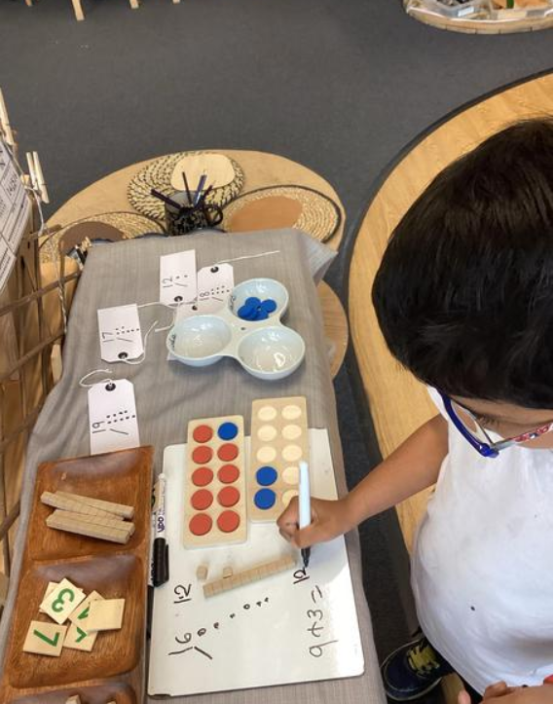
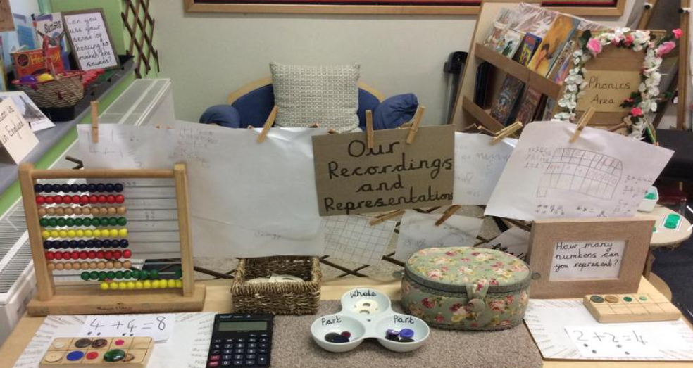
Maths Workshop for Year 1 Parents
Wednesday 5th February 2025

Slide 2
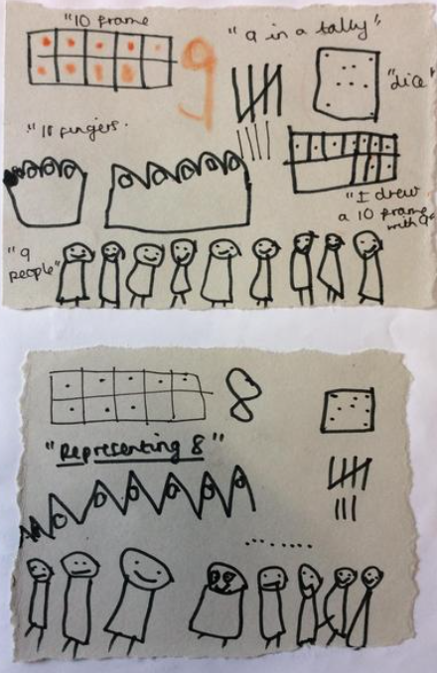
Welcome!
How will this workshop help you?
Understand taught mathematics strategies in Year 1.
Become more familiar with taught processes using concrete materials.
Understand Year 1 end-of-year National Curriculum outcomes.
Ideas for supporting your child’s maths learning at home.

Slide 3
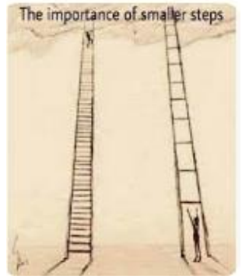
What do we have to do?
Not racing up a ladder!
Maths is about spotting patterns, making links and understanding how pieces of knowledge fit together. NOT purely memorising facts and procedures by rote and then rushing on to new content.

Slide 4
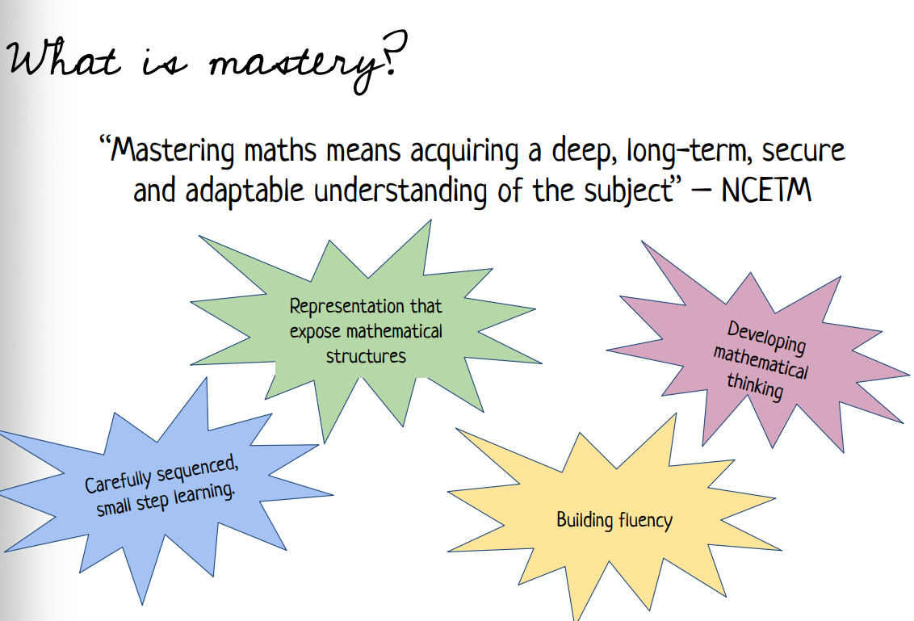

How is Maths taught at Whitefield
Maths is taught through the Lancashire Red Rose Mastery scheme.

Slide 5
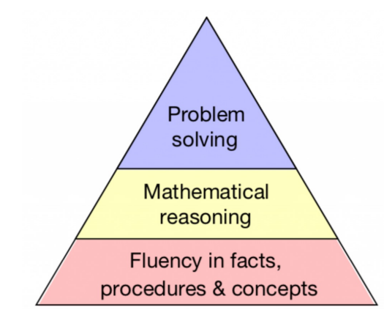
Mastery in Maths
Fluency is the foundation for reasoning and problem solving
Fluency plays an important role in the national curriculum in Year 1. It means that a child is able to quickly use their skills to establish the best way to solve a problem.
What does it mean?
Children develop a deep understanding of numbers and their relationships
Children can choose the most effective method to solve a problem
Children can be flexible in their choice of strategies
Children feel confident working with numbers
Children can explain their thinking and approaches

Slide 6
Mastery in Maths
What is reasoning in Maths?
Reasoning in maths helps children to be able to explain their thinking, therefore making it easier for them to fully understand what is happening in the maths they are doing. It helps them to think about how to solve a problem, explain how they solved it and to think about what they could do differently.

Slide 7
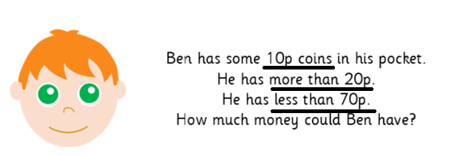
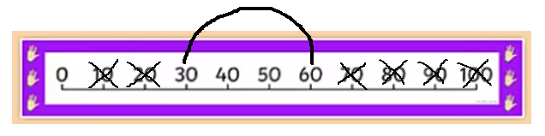
Mastery in Maths
What is problem solving in Maths?
Problem solving is finding a way to apply knowledge and skills to answer unfamiliar types of problems. A number of strategies may be used to solve the problem such as: visualising, finding a pattern, using different methods, working backwards. Some problems may even require more than one solution and more than one answer!

Slide 8
Supporting your child at home
Encourage your child to talk to you about what they are learning / doing in maths
Ask them to show you how to use the models and images they are using in the classroom
Ask an adult in class if you are not sure how a strategy works.
Maths learning can take place anywhere! Maths is all around us, so look for opportunities for you to do some problem solving together, making connections between what your child is learning at school and the world around them.

Slide 9

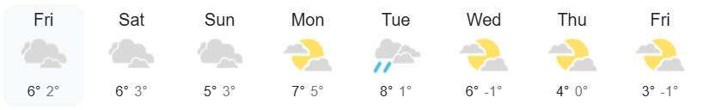
Supporting your child at home
Follow a recipe: work together to find the quantities needed, then discuss how you would halve or double the recipe.
Talk about the weather forecast: is the temperature today higher or lower than yesterday’s? What do the numbers
mean?
Shopping: discuss the cost of items and how the cost
might change if you buy two items instead of one.
Planning an outing: discuss how long it takes to get to
the park. Work out what time you need to leave the house to reach there at a certain time. Discuss what shapes can be seen at the park.

Slide 10
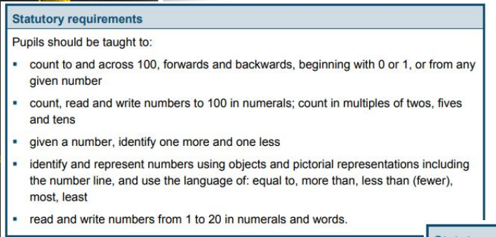
End of Year 1 expectations
Number and Place Value

Slide 11
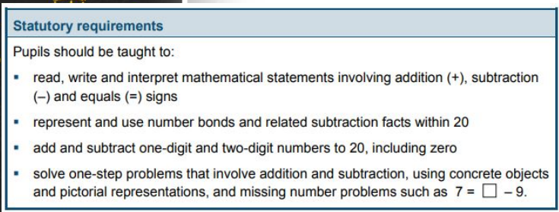
End of Year 1 expectations
Addition and subtraction

Slide 12
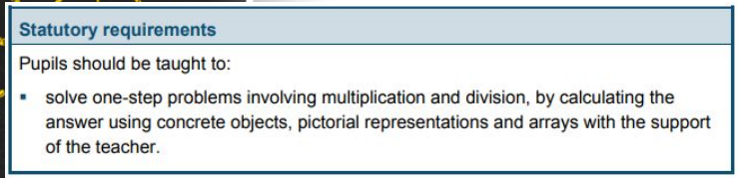
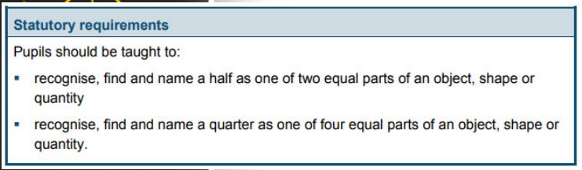
End of Year 1 expectations
Multiplication and division
Fractions

Slide 13
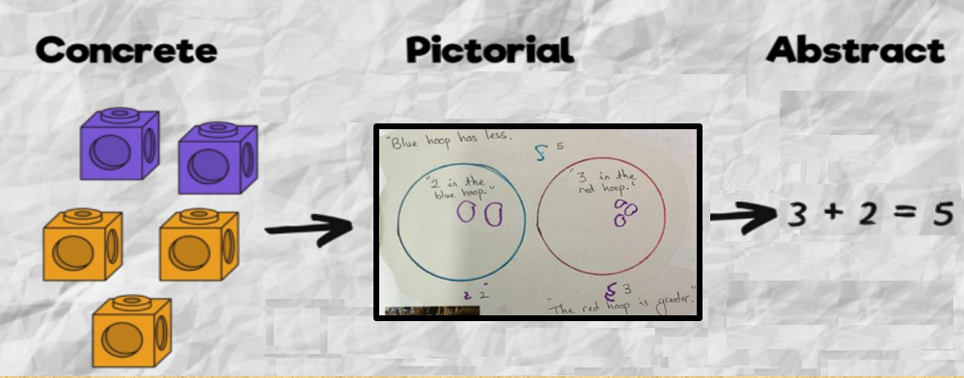
Concrete – Pictorial - Abstract
Concrete – Using physical objects to solve maths problems.
Pictorial – Using drawings to solve maths problems
Abstract – Solving maths problems using only numbers
We encourage children to continue to use the concrete resources to solve their problems and help to justify the answers.

Slide 14
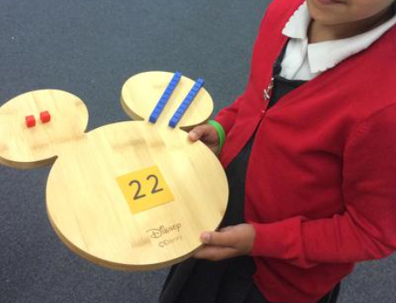
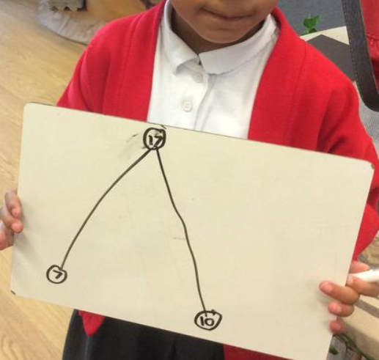
Mathematical representations used at Whitefield.
Part whole models

Slide 15
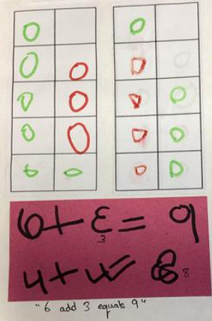
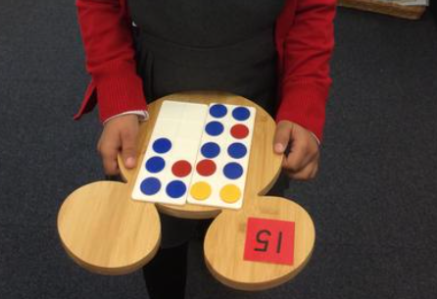
Mathematical representations used at Whitefield.
Ten frames

Slide 16
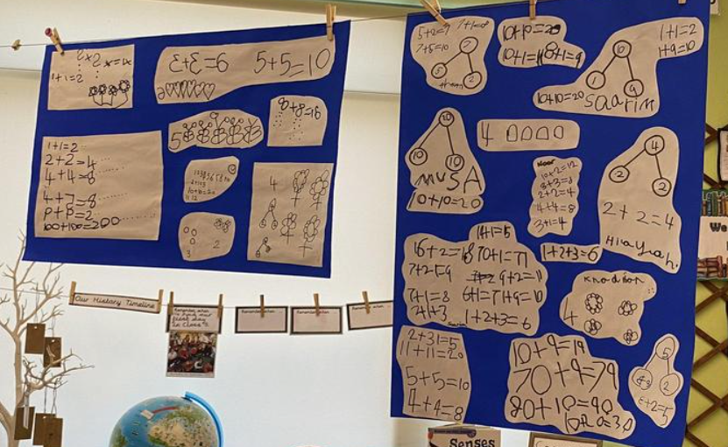
Mathematical representations used at Whitefield.
Jottings

Slide 17

Thank you!
Any questions?

