Slide 1
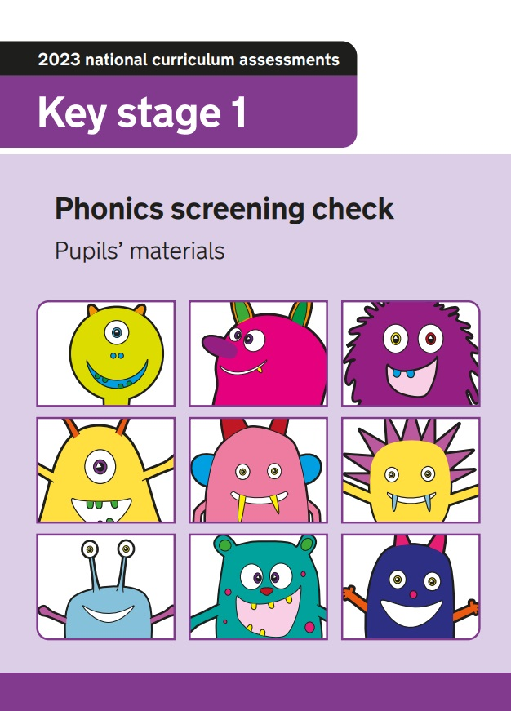

Year 1 Phonics Screening Check

Slide 2
What is the phonics screening check?
Statutory reading assessment
Informs class teacher about how individual children have progressed in phonics
Designed to confirm whether children have learnt phonemes and the ability to decode to an appropriate standard

Slide 3
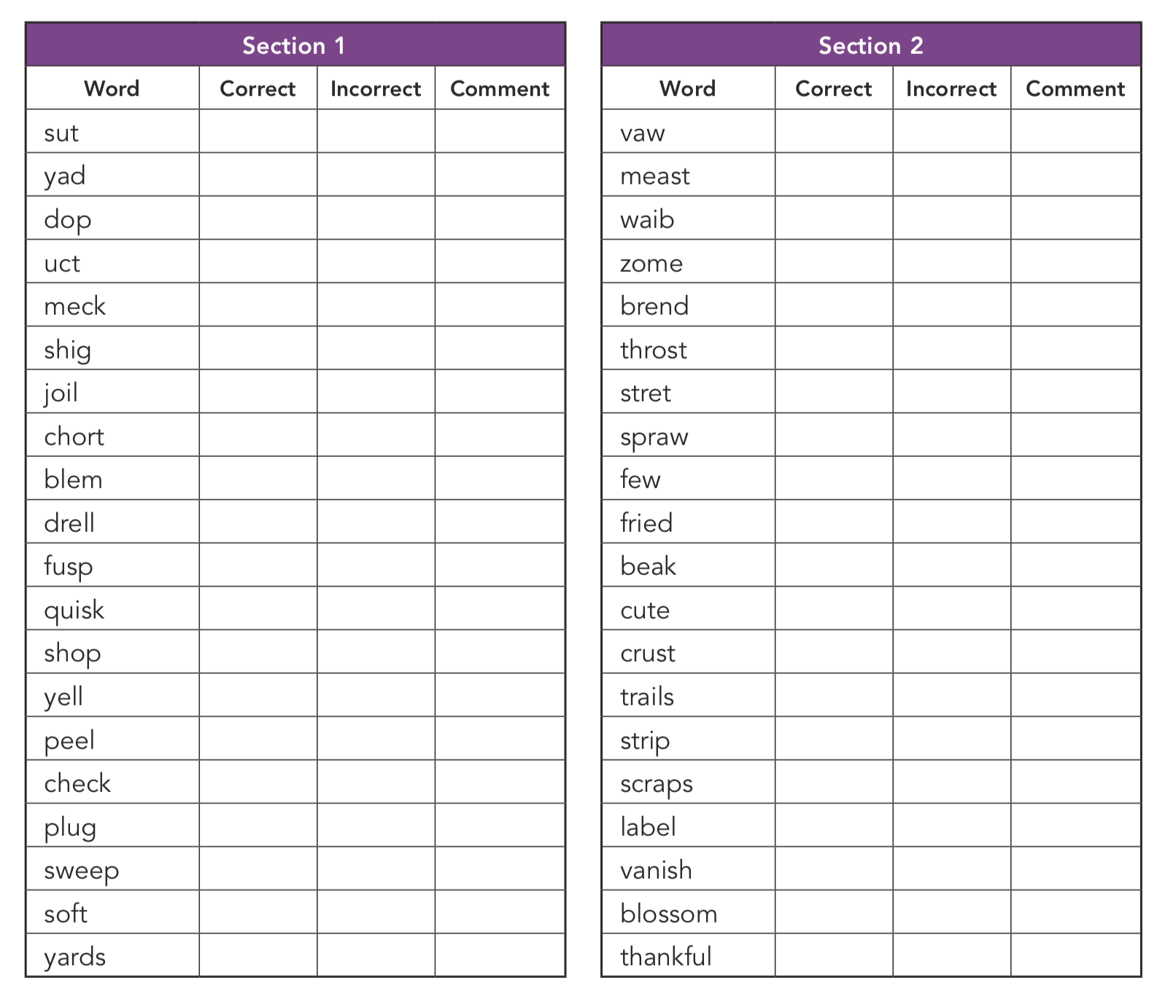
Who takes the check?
All Year 1 children will take the test the week beginning the 8th June 2026.
Some Year 2 children might also be checked if they didn’t achieve the expected standard in Year 1.

Slide 4
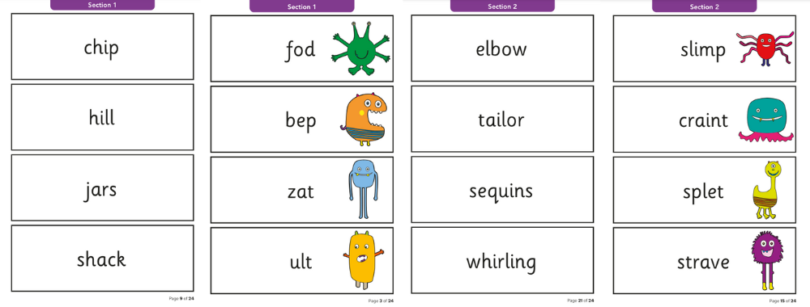
What happens during the phonics screening check?
The check contains 40 words.
Each child sits one to one with a teacher and reads each word aloud.
Each child will read 20 real words and 20 pseudo words (nonsense words)
The check will take about 10 minutes but each child can complete it at their own pace.

Slide 5
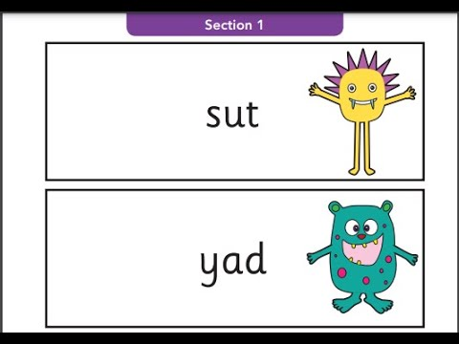
What are pseudo words?
Pseudo words are nonsense/ alien words.
The words are phonetically decodable but are not actual words with an associated meaning.
Children can not read these words by sight using their memory, so they have to use their decoding skills.
All nonsense words in the check have an alien picture next to them so children can recognise these as nonsense words.
Children have become familiar with recognising pseudo words through practise in class.

Slide 6
How are the results reported?
We will report results of the check to parents and confirm if children have met the standard threshold to pass the check.
This information will be in the envelope with your child’s end of year report in Summer term.
You will have the opportunity to ask questions or discuss with your child’s class teacher at the summer term ‘Learning and Reporting Meeting’ if needed.

Slide 7

What happens if a child does not meet the standard?
The screening check will identify children who need extra help and support with phonic decoding skills in Year 2.
This will be communicated with your child’s Year 2 class teacher so support can be put in place.
Children who do not meet the expected standard will retake the test when they are in Year 2.

Slide 8
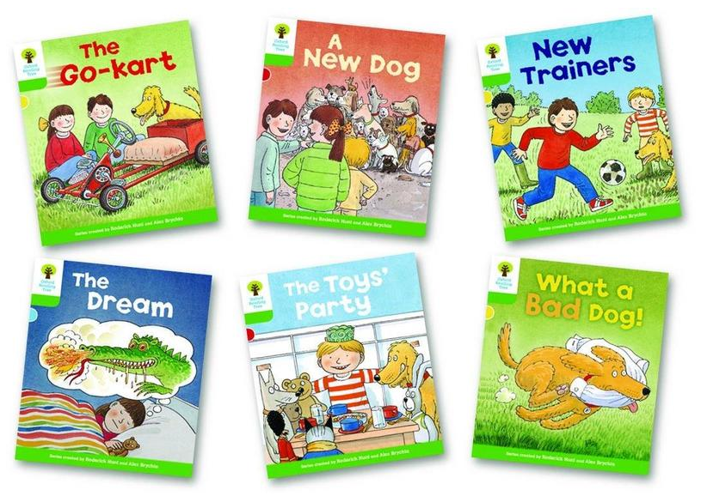
How can I support my child at home?
Enjoy sharing and reading books as much as possible.
Continue to read your child’s home reading book with them each evening.
If your child is struggling to read a word encourage them to ‘sound out’ and ‘blend’ the sounds together.
Visit our school website for further resources
https://www.whitefield-inf.lancs.sch.uk/phonics-at-home/
https://www.whitefield-inf.lancs.sch.uk/phonics-screening/
Ask your child’s class teacher if you have any questions at all.

