Slide 2







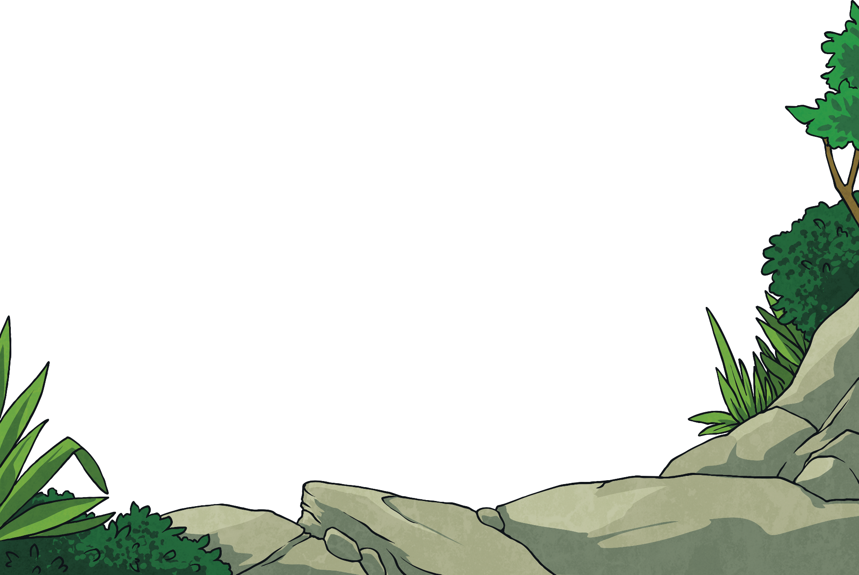
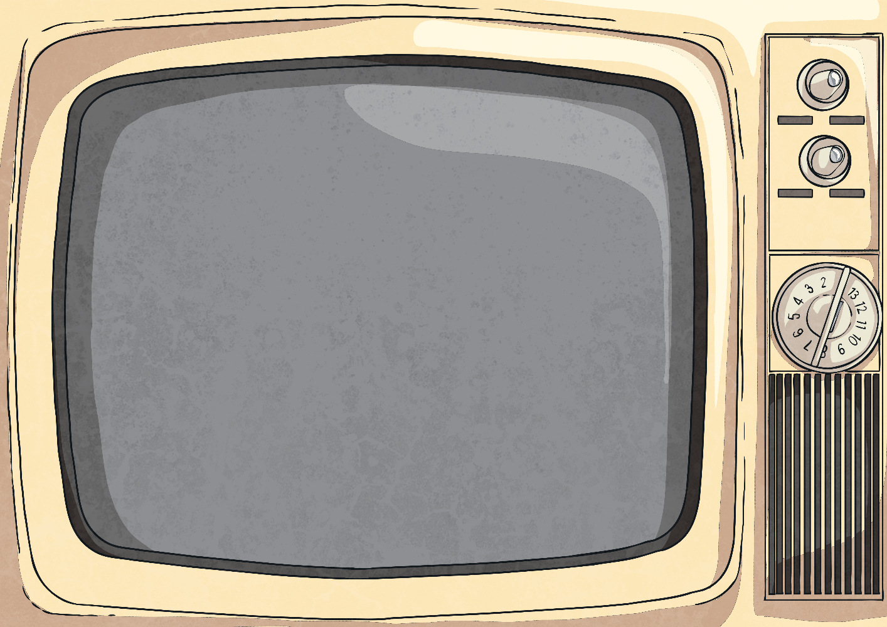
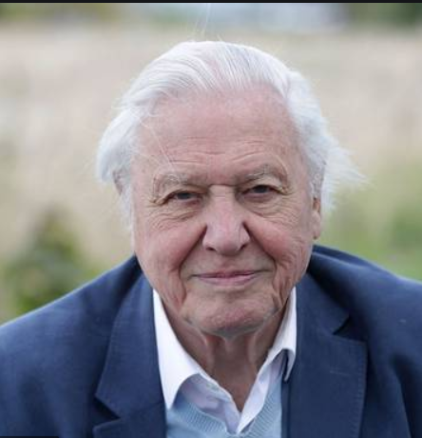
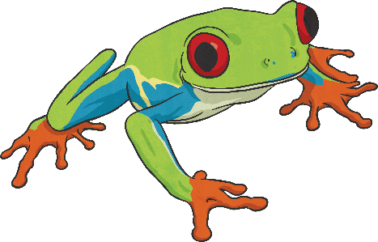
Life on Film
David Attenborough is a wildlife film-maker.
He is a scientist who studies animals and their behaviour.
He has written and presented many TV shows about animals and their lives.
Attenborough has been on our television screens for over 60 years!

Slide 3
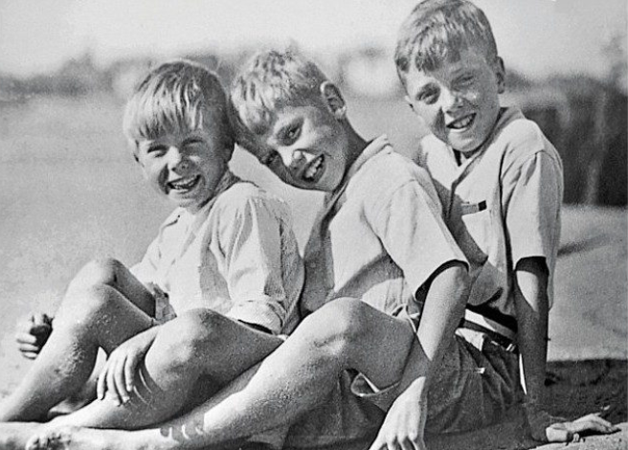
Early Life
David was born in London in 1926.
When he was a little boy he loved collecting fossils and stones he collected. He made a little ‘museum’ in his house to display them.
This is David with his two brothers. David is the one in the middle.

Slide 4
Early Life
David went to university in London and he studied zoology and other sciences.
Then he started to make TV programmes for the BBC all about animals and the places they live. These programmes have helped lots of people learn about animals, their behavior and their habitats.
David also teaches people all about plastic pollution to get people to help save our environment.

