Slide 1
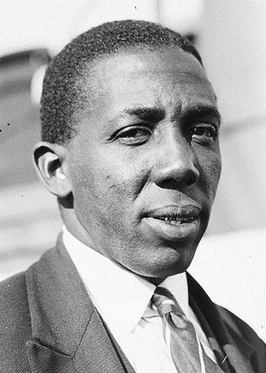
Learie Nicholas Constantine
“If I had not come, I could not have been the person I am today. I am a better person for the time I spent in Nelson.”
Click anywhere to view the contents page

Slide 2
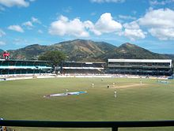
Contents
What do you know?
What do you want to know?
Early Life
Life in Nelson
Life After Cricket
Significant Events
Constantine vs Imperial London Hotel
How is Sir Learie Constantine Remembered?
Glossary
A modern photograph of Queen’s Park Oval, Trinidad’s cricket ground
Click anywhere to view the next page

Slide 3
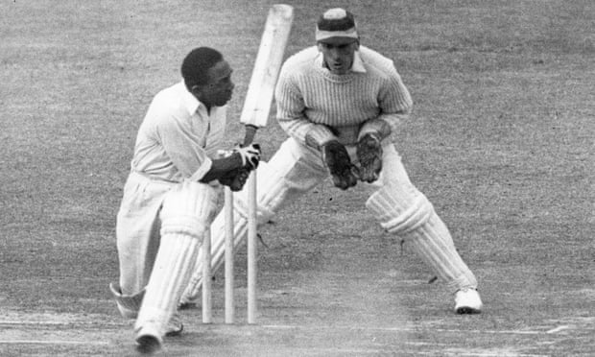
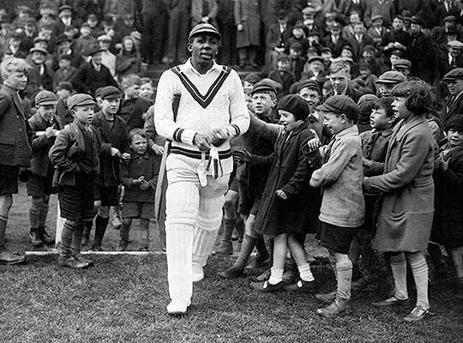
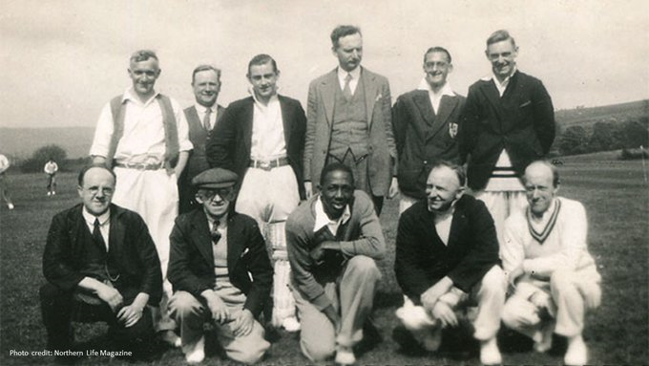
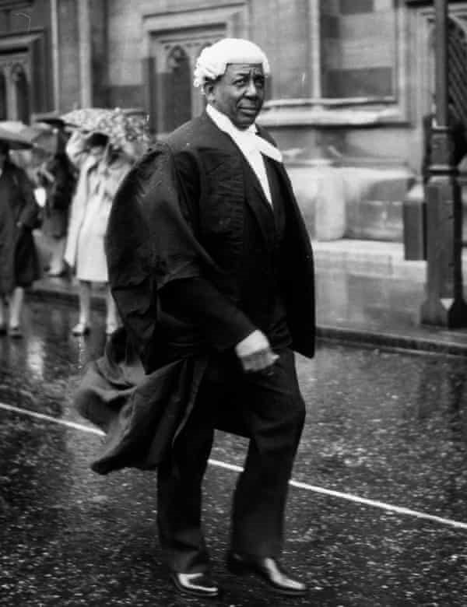
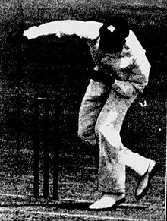
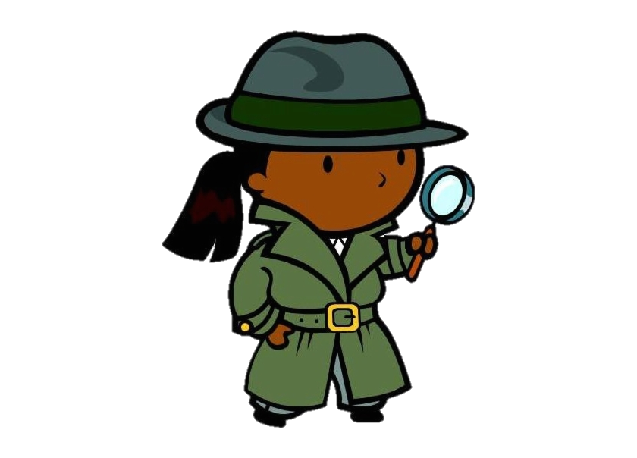
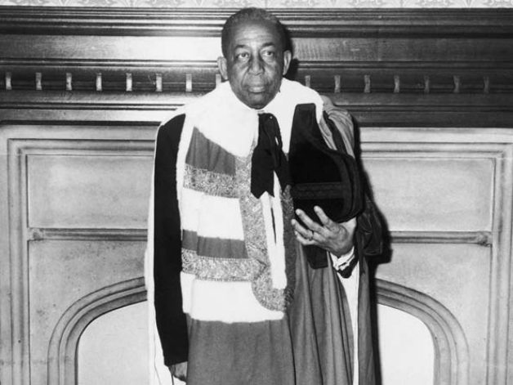
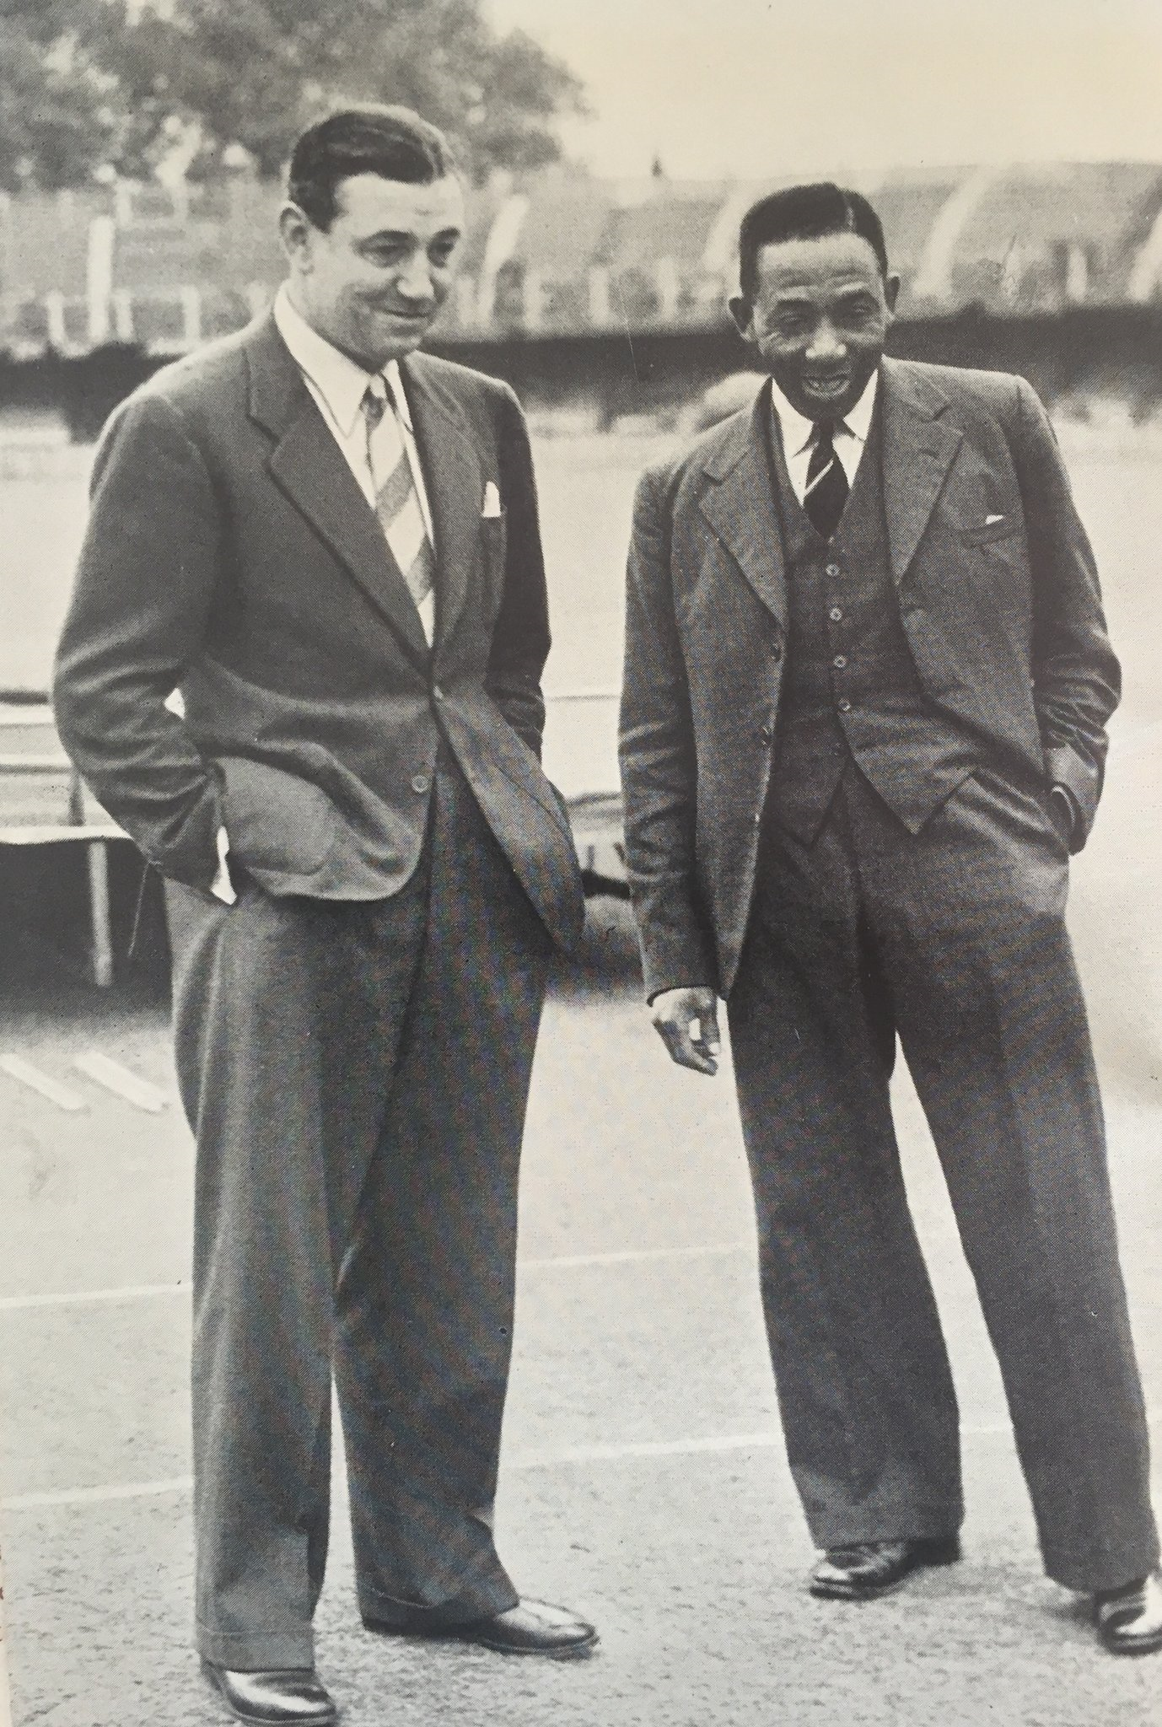
What do you know?
Look at the pictures.
Using your detective skills, what information do they tell us about Learie Constantine?
CLICK HERE to return to the contents page
Click anywhere to view the next page

Slide 4
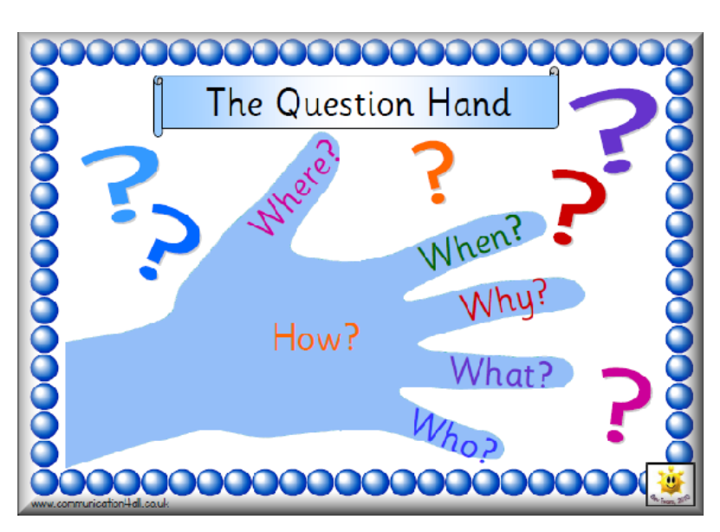
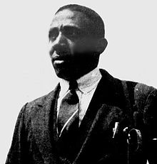
What do you want to know?
Think of some questions that will help you find out more about Learie Constantine.
Can you decide which ones are the better questions?
After reading which ones have been answered in this text?
Learie Constantine 1930
CLICK HERE to return to the contents page
Click anywhere to view the next page

Slide 5
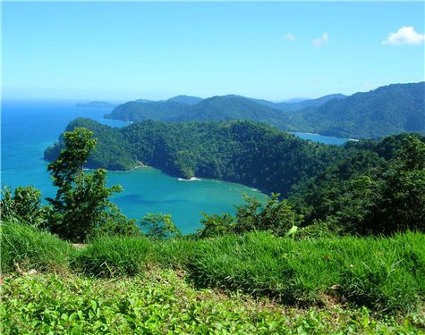
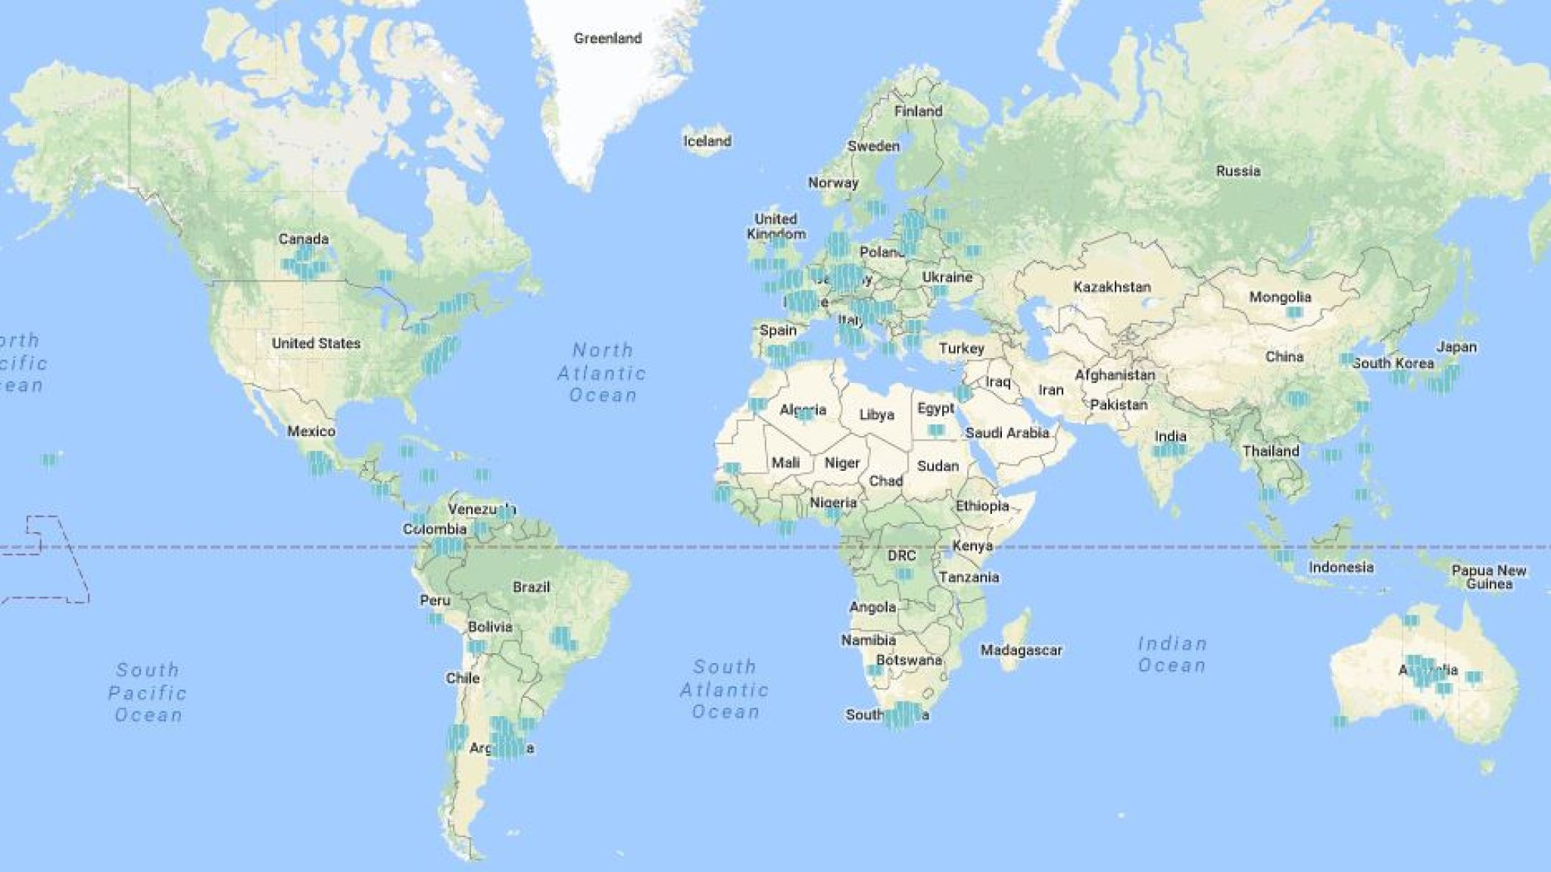
Early Life
Trinidad’s coastline
Learie was born in Trinidad, a small island in the Caribbean, on 21st September 1901.
His Great Grandfather was a slave on the island.
Learie met his wife, Norma, in 1921 and his daughter, Gloria, was born in 1928.
The red arrow shows where Trinidad is on a world map, just off the coast of South America
CLICK HERE to return to the contents page
Click anywhere to view the next page

Slide 6
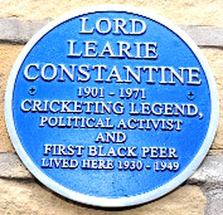
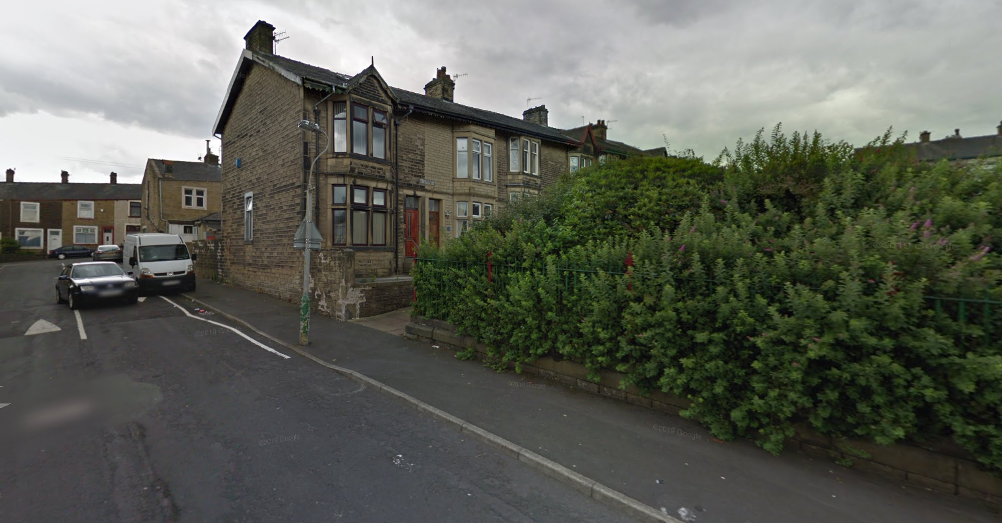
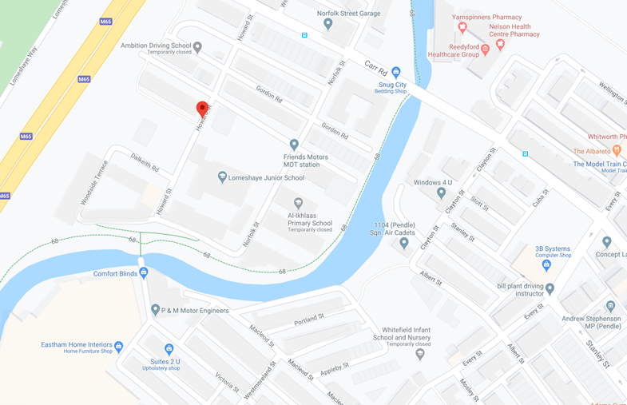
Life in Nelson
This blue plaque shows where Learie lived on Meredith Street
Learie came to England to play for Nelson Cricket Club and played his first game in 1929. With Nelson, he won the league 7 times and the knockout cup twice. He became possibly the best-paid sportsman in the country.
He first lived on Howard Street before moving to Meredith Street.
His daughter went to school in Nelson and became a teacher after attending university in Scotland.
His first house on Howard Street
CLICK HERE to return to the contents page
Click anywhere to view the next page

Slide 7
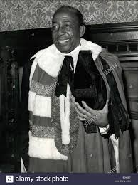
Life After Cricket
Learie returned to Trinidad in 1954 and was elected to work in the government. He became Trinidad’s first High Commissioner and was sent to work in London in 1961.
He was knighted by the Queen in 1962 and became Sir Learie Constantine.
In 1969, he became the first black man to work in the House of Lords.
Sir Learie Constantine died in 1971.
Sir Learie Constantine on the day he was introduced to the Lords
CLICK HERE to return to the contents page
Click anywhere to view the next page

Slide 8
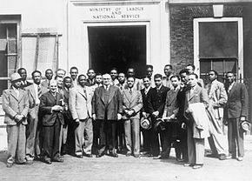

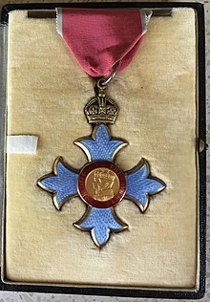
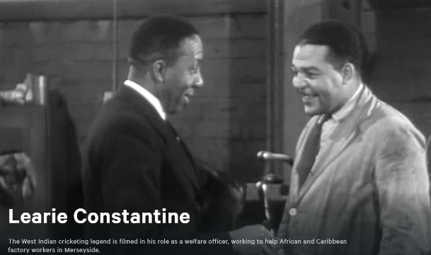
Significant Events
The medal given to Learie by the Queen for his work during the war
When he first arrived in Nelson, the people were not very kind to him because of the colour of his skin. Eventually, he changed people’s minds and was described as a local champion.
He raised lots of money for charity through cricket matches because lots of people wanted to see him play.
During the Second World War, he helped people who came to work in England from abroad and was given an MBE medal for his excellent work.
Learie with West Indian workers during the Second World War
Click the picture to watch a silent film showing Learie at work during the war
CLICK HERE to return to the contents page
Click anywhere to view the next page

Slide 9
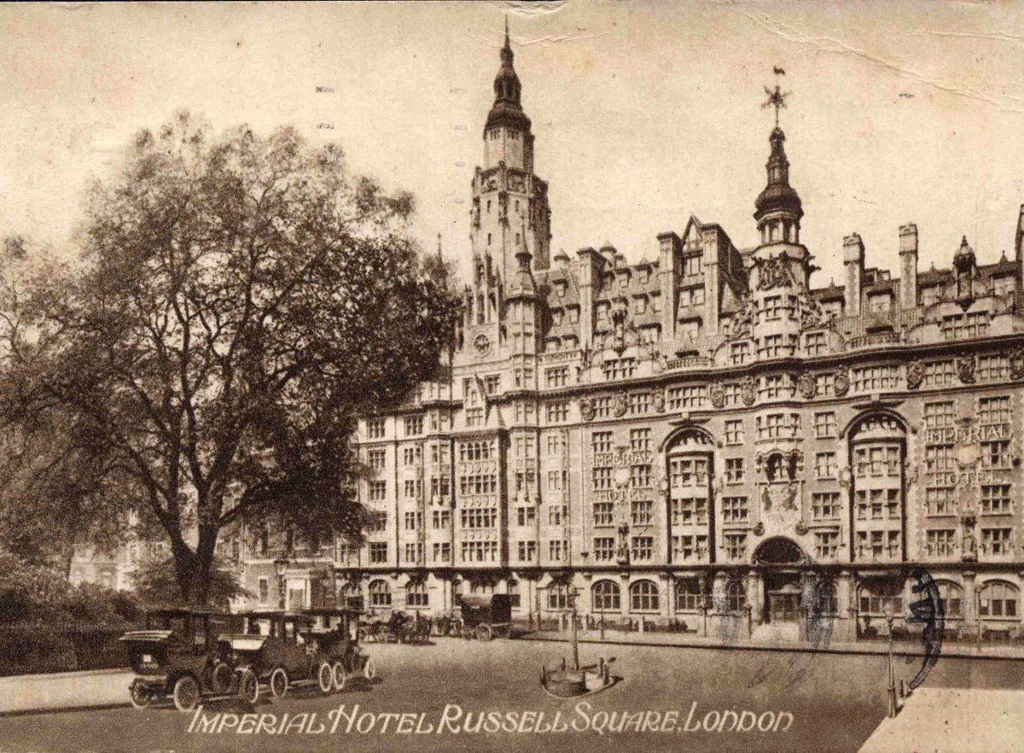
Constantine vs Imperial London Hotel
In 1943, Learie was in London to play a charity cricket match. He had booked himself and his family to stay in a hotel for four nights. When he arrived, he was told that he couldn’t stay there because he was black even though he worked for the British government and was raising money for them.
A judge in the High Court said that the hotel had been racist towards Learie and his family. This was the first time that racism had been challenged in court and led to the Race Relations Act 1965.
The Imperial London Hotel
CLICK HERE to return to the contents page

Slide 10
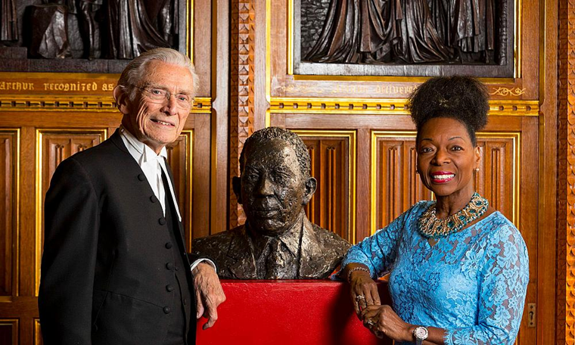
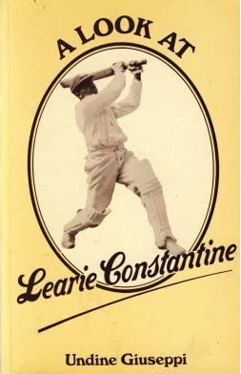
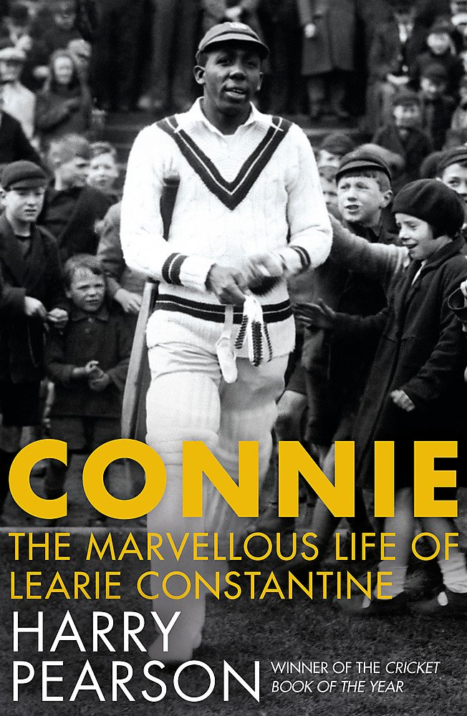
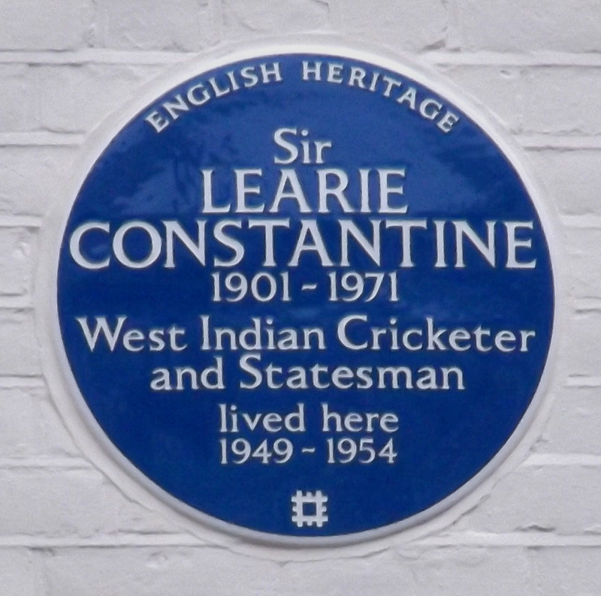
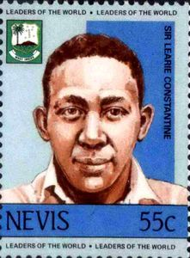
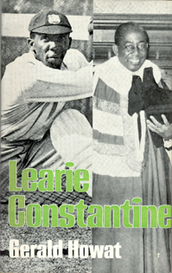
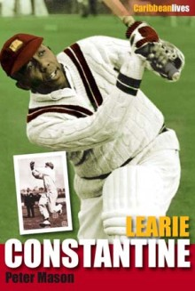
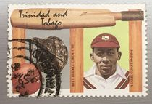
How is Sir Learie Constantine Remembered?
(click to reveal)
Statue
Lord Fowler, speaker of the House of Lords, and Baroness Floella Benjamin, the 2nd Trinidadian member of the House
Plaques
Books
Stamps
CLICK HERE to return to the contents page
Click anywhere to view the next page

Slide 11
Glossary
Abroad – Another country.
High Commissioner – A person sent to represent their country in another.
High Court – People who decide if someone has done something wrong.
House of Lords – People who make and check the laws in England.
Knighted – The highest award given to a man who has done outstanding work for his country. They get to call themselves ‘Sir’ instead of ‘Mr.’
MBE – The third highest award given for outstanding work in the United Kingdom.
Racism – Being unkind to somebody because of their race (skin colour or group)
Slave – When somebody is forced to work with no pay. Many people were taken from Africa a long time ago and forced into slavery.
Click a word to return to that page or CLICK HERE to return to contents

