Slide 1
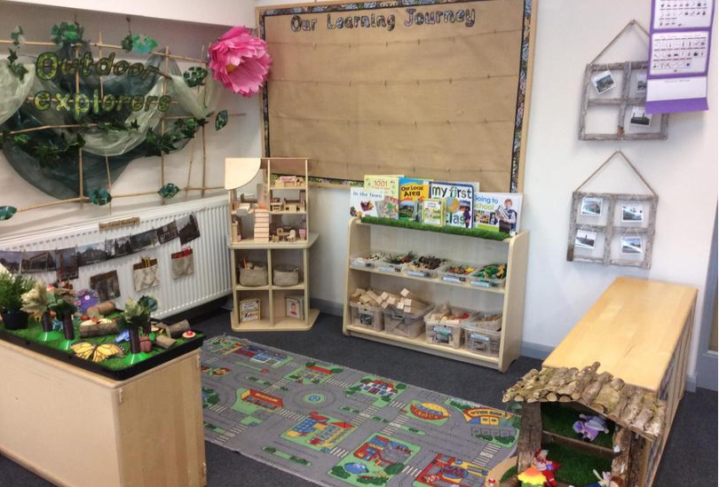
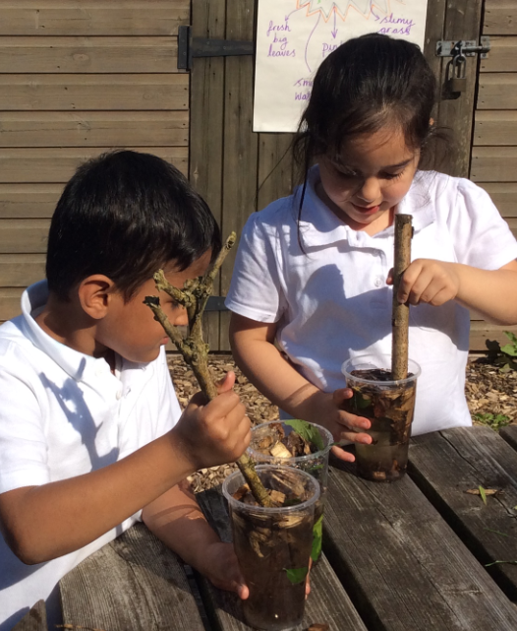
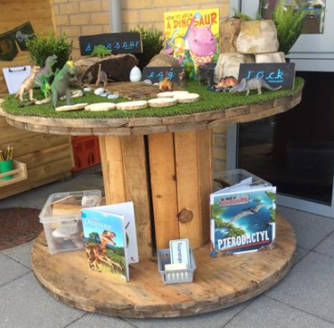

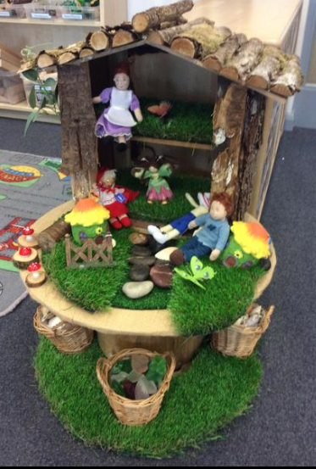
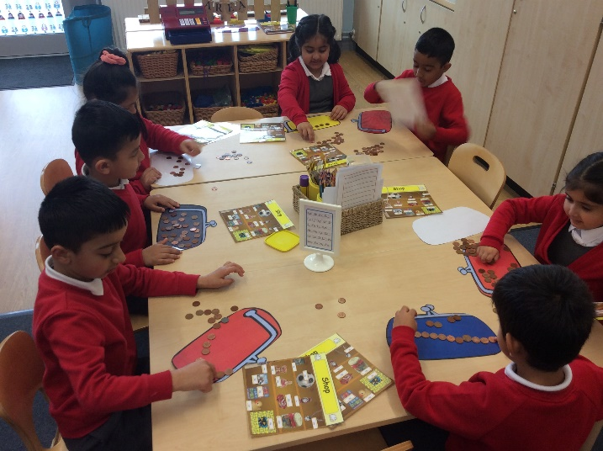
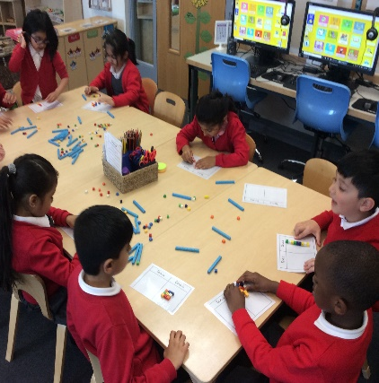
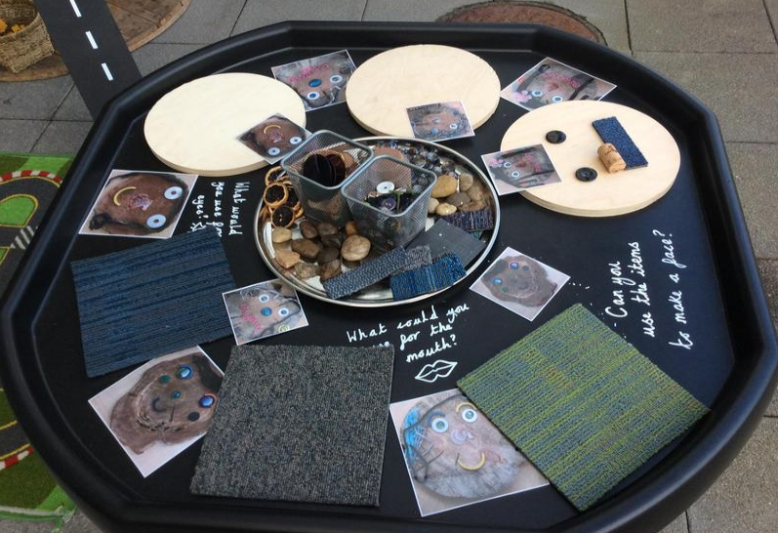
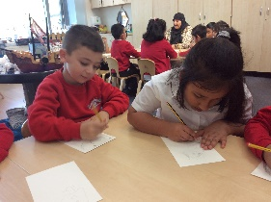
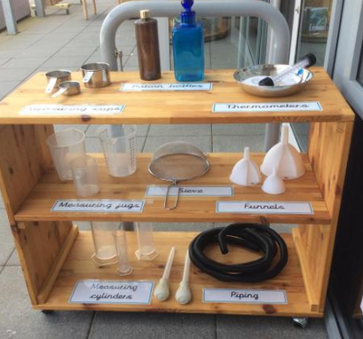
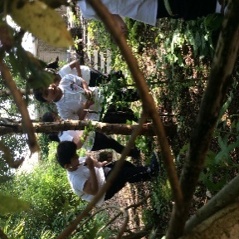

Welcome to Year 1

Slide 2
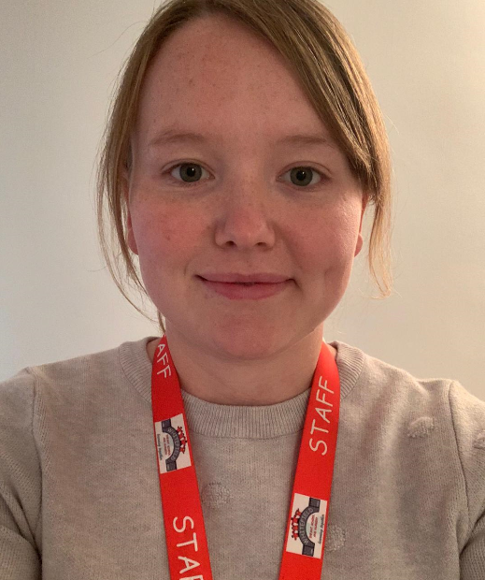
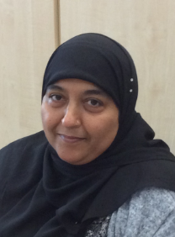
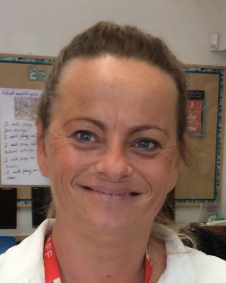
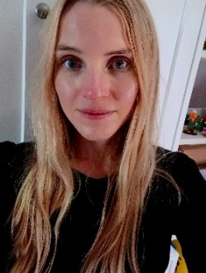
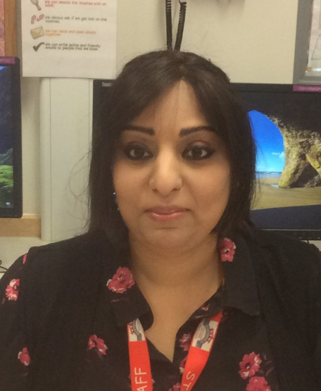
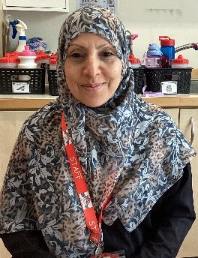
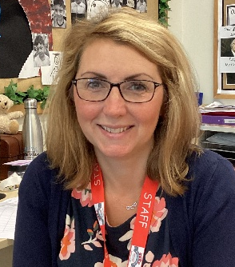
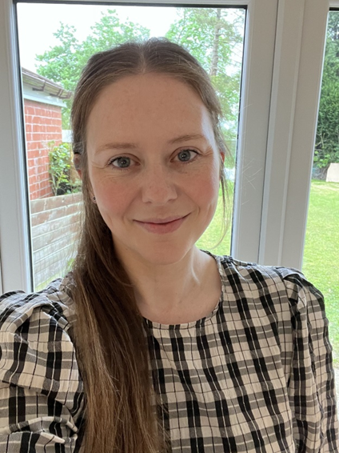
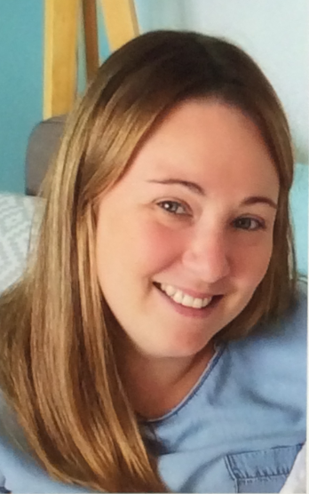
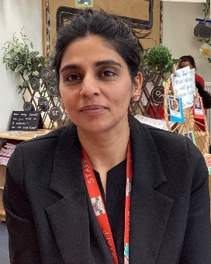
Meet the Year 1 Team!
In Class 4 we have …
Mrs Hutton
Mrs Azam
Mrs
Willan
In Class 5 we have …
Mrs Williams
Mrs Aziz
Mrs Parveen
In Class 6 we have …
Mrs Jones (Mon-Wed)
Miss Stott
(Thurs-Fri)
Miss O’Horo
Mrs Aftakhar

Slide 3

Classroom doors open for drop off at 8.40am and for pickup at 3.10pm
Please ensure your child is dropped off and picked up promptly and you
must hand your child over to the classroom team.
All children must be collected by an authorised adult on the class
collection sheet. (Please make sure you have handed in your contact
sheets so our details are up to date)
If another adult is going to collect your child please inform your class teacher.
Please bring book bag and water bottle everyday.
Timings of the school day

Slide 4









What your child’s school day looks like
Assembly on a Monday morning and a Friday morning
Singing assembly on a Thursday afternoon
PE twice a week delivered by the class teacher
Music once a week- delivered by Mrs Brunton, our Music specialist 3 times a year
Computing session delivered by Mrs Hardacre, every other week
Forest school session, every other week
Golden time on a Friday afternoon!

Slide 5


Slide 6
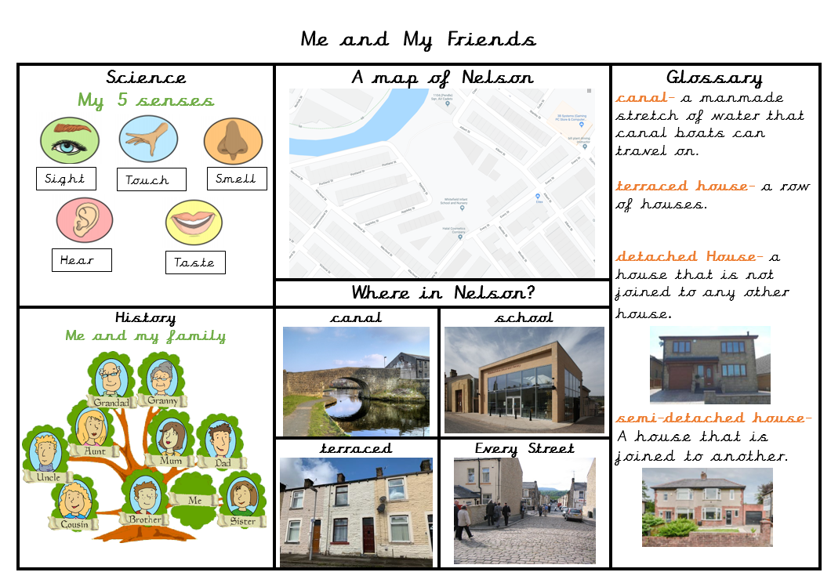

Vocabulary Mats
Each half term your child will bring home a vocabulary mat and key learning hands to show you what we will be learning over the half term.
Please have a look at these with your children and talk about some of the language and things we will be looking at in preparation.

Slide 7
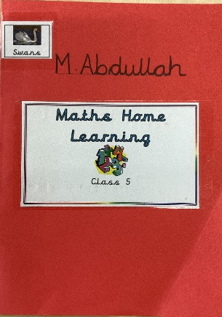
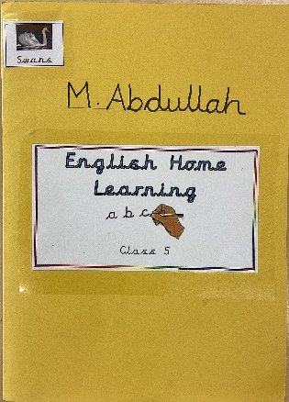
Your child will receive Maths and English home learning every week.
Home learning will be sent home on a Wednesday and should be completed and returned the following Monday.
If you have any questions about home learning please don’t hesitate to ask!
Home Learning

Slide 8
Phonics is a way of teaching children the skills of reading and writing.
How we teach phonics in school
Phonics is taught every day in a discreet 20 minute session.
Phonics interventions also take place daily. This is an additional phonics session aiming to boost any children that have gaps in their phonics knowledge.
Phonics is differentiated in each class and children are grouped based on their phonics needs.
Phonics is reinforced throughout all lessons and learning, to embed the skills and knowledge.
Please visit the ‘Phonics’ page on the school website for more information. https://www.whitefield-inf.lancs.sch.uk/phonics-at-home/
Phonics

Slide 9
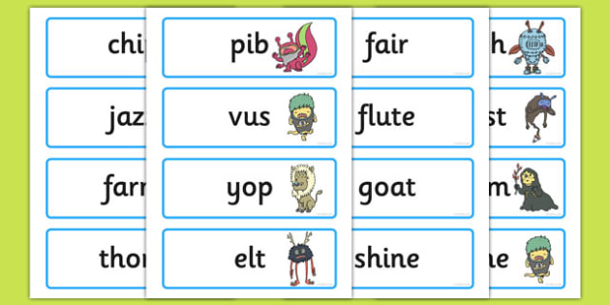
Phonics Screening
At the end of year 1 in June we have a phonics screening check to asses the children’s phonics ability.
Children have to read 40 real and nonsense words.
This is used as an assessment tool to inform teachers planning.
If your child doesn’t meet the pass rate they will retake the check in year 2.
More information regarding the phonics screening check will be given nearer the time.

Slide 10

Reading
Children’s reading will be listened to throughout the week so they will need to bring their reading book, reading record and book bags every day.
It’s incredibly important that you listen to your children read every night to help us develop your child’s reading ability.
Please sign their reading journal
when you have listened to
your child read and we will
give them a new book
Books will be changed on a
Monday,
Wednesday,
Friday.
Please read the book twice.
1- for phonics practise
2- to develop reading fluency

Slide 11
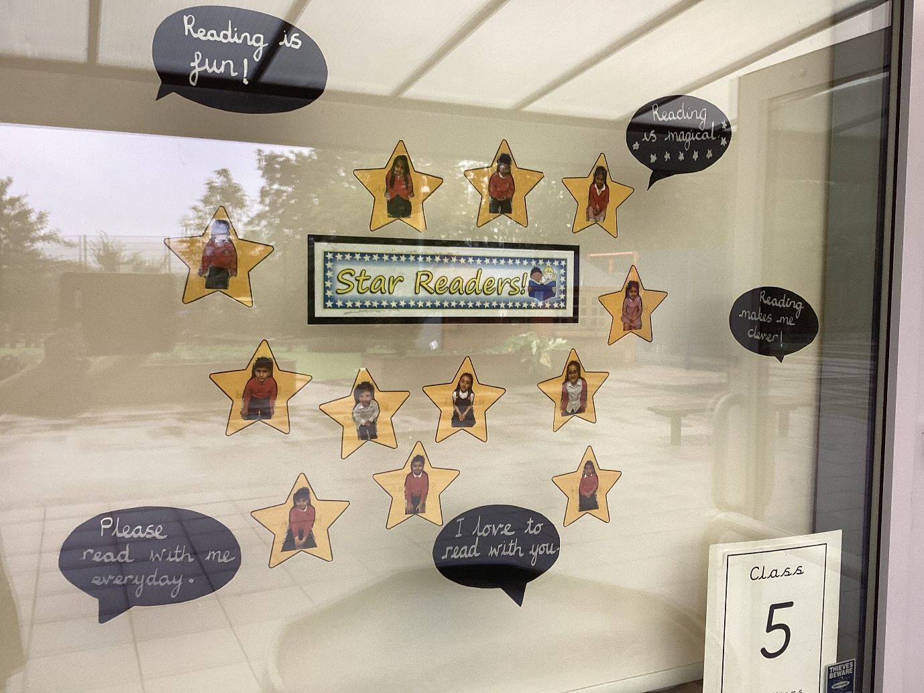
Reading Stars
Children’s reading will be listened to throughout the week so they will need to bring their reading book, reading record and book bags every day.
Each Year 1 class has a ‘Reading Stars’ display in their window which celebrates children’s achievements with reading at home.
When children have read at home their star will be placed in the window. This is checked and updated by teachers.

Slide 12
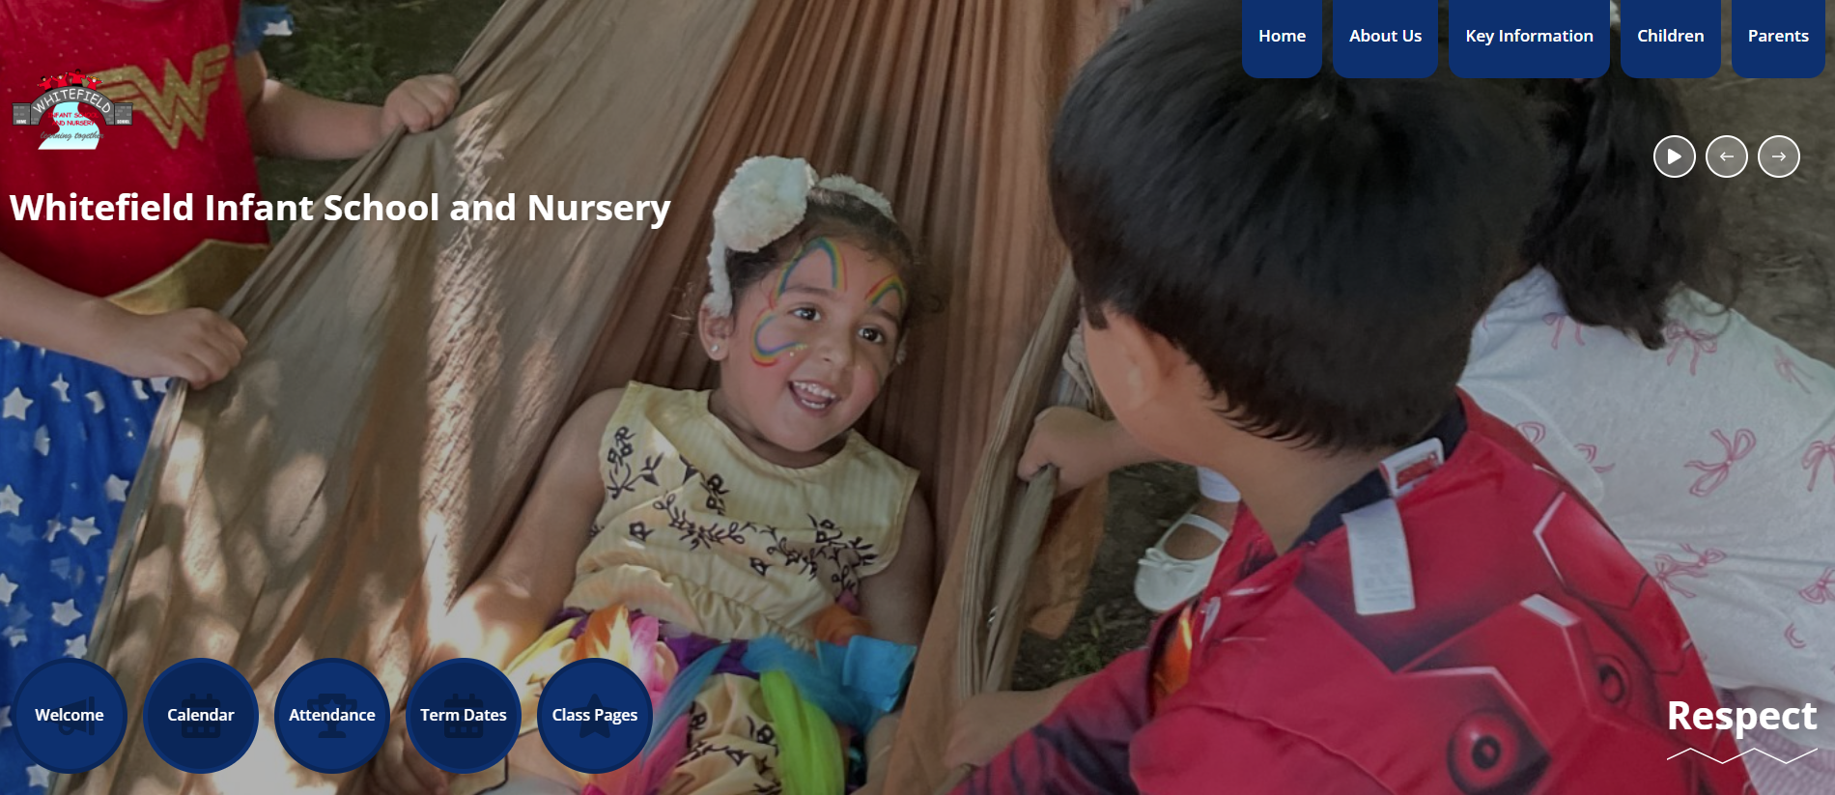
The School Website
New school website- please bear with us whilst we get it up to date.
The school website contains lots of information about school and what’s going on.
Your class teachers will upload pictures and information about your child’s class so you can keep up to date with their learning.
If you do not want your child to be on pictures on the school website please inform your class teacher.
You can access your class page by clicking on the numbers at the bottom of the homepage.

Slide 13




Please can your child come to school wearing their PE kit on their PE day.
Please ensure PE kits and school uniforms have their names written in.
P.E days are as follows
Class 4 – Monday and Tuesday
Class 5 – Tuesday and Wednesday
Class 6 – Monday and Thursday
Our school PE Kit is:
White t-shirt
Black pants/shorts
Black pumps/ trainers
School jumper or cardigan/ black zip up hoodie
P.E

Slide 14


Medical needs and allergies
Please make the class teacher aware if you child has any medical needs or allergies, or if anything changes throughout the year.
If your child has asthma we must have an inhaler kept in school at all times, and one kept at home.
Please ensure any medicine needed is labelled with your child’s name and brought into school. The expiry dates on these will be checked at the end of each term.
No food/ drinks from home must be brought in to share with other children (only packed lunches).
No cakes/ sweets on birthdays thank you. We will celebrate birthdays in other ways in school.

Slide 15
The teachers are on the door at the start and end of each school day. We can answer any questions you have then. If it is something that needs more time we can arrange a meeting with the class teacher after school.
Thank you for all your support!

