Slide 1

Welcome to
Class 8

Slide 2
Our class team
Miss Aslam
Mr Ward
Miss Simpson (Mon)
Mrs Laiqat

Slide 3

Our school day
Classroom doors open for drop off at 8.40am and for pickup at 3.10pm
Please ensure your child is dropped off and picked up promptly and you must hand your child over to the classroom team.
All children must be collected by an authorised adult on the class collection sheet. (Please make sure you have handed in your contact sheets so our details are up to date)
If another adult is going to collect your child please inform your class teacher.
Please bring book bag and water bottle everyday.

Slide 4
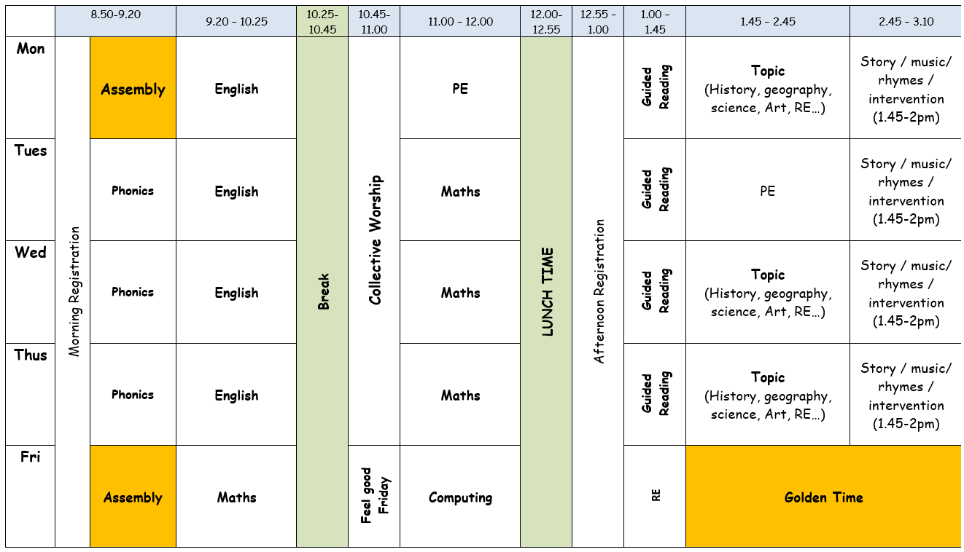
Our class timetable
Assembly on a Monday morning and a Friday morning
Singing assembly on a Thursday afternoon
PE twice a week
Music once a week- delivered by Mrs Brunton,
our Music specialist 3 times a year
Computing session delivered by Mrs Hardacre,
every other week
Forest school
Golden time on a Friday afternoon!

Slide 5


Slide 6
Phonics
Phonics is a way of teaching children the skills of reading and writing.
How we teach phonics in school
Phonics is taught every day in a discreet 20 minute session.
Phonics interventions also take place daily. This is an additional phonics session aiming to boost any children that have gaps in their phonics knowledge.
Phonics is differentiated in class and children are grouped based on their phonics needs.
Phonics is reinforced throughout all lessons and learning to embed the skills and knowledge taught.

Slide 7

Reading
Children will be provided with a reading book that matches their phonics level. Throughout the week, your child’s reading will be listened to in school, so they will need to bring their book and reading record everyday.
It is incredibly important that you listen to your child read every night to help develop their reading ability. Please write what page your child has read up to or if they have read all their book.
Please sign your child’s reading record after you have listened to them read and we will change their book on a Monday, Wednesday and Friday.

Slide 8
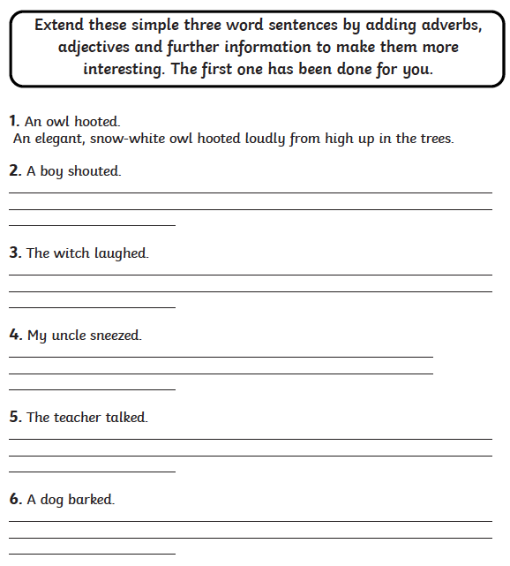
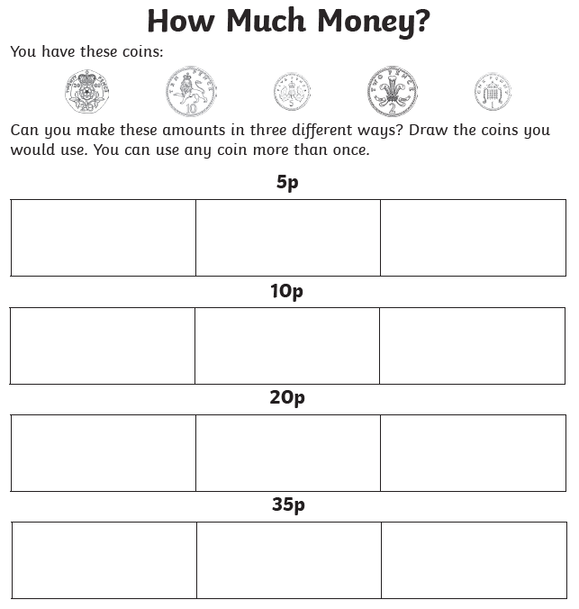
Home learning
Your child will receive home learning each week. This will be sent home on a Wednesday and is expected to be completed and returned on the following Monday.
This learning will consist of an English and maths activity. If you have any questions regarding your child’s home learning, then please do not hesitate to ask.

Slide 9
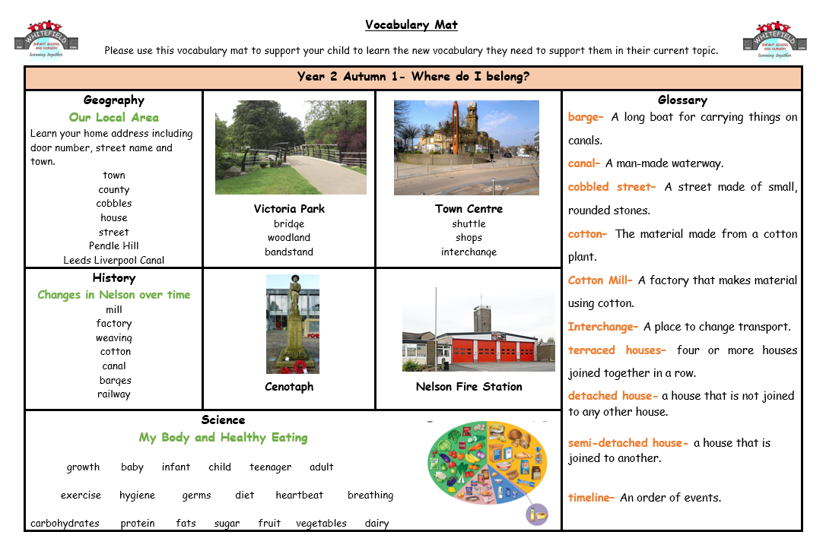
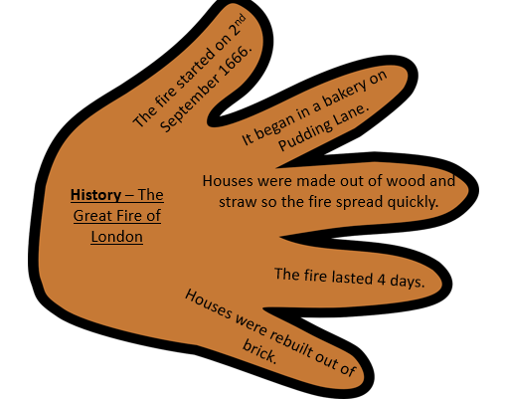
Knowledge Hands and
Vocabulary mats.
Each half term your child will bring home a vocabulary mat and key learning hands to show you what we will be learning over the half term.
Please have a look at these with your children and talk about some of the language and things we will be looking at in preparation.

Slide 10

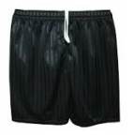


P.E
Our PE day is Monday and Thursday. Children should come to school wearing their PE kit on these days.
Our school PE kit is:
White t-shirt
Black pants or shorts
Black pumps or trainers
School jumper or cardigan/black hoodie

Slide 11
Year 2 SATs
At the end of Year 2, we will judge the standard that your child is working at in English, maths and science. To help make these judgements, your child will sit national curriculum tests in maths and English, known as standard attainment tests (SATs).
These tests, along with your child’s work throughout the year, help to assess your child’s performance and, as they move up to key stage 2, identify their needs.
Subject | Test paper
English reading | Short text and questions and long text and questions
Mathematics | Arithmetic and mathematical reasoning
English grammar, punctuation and spelling (optional test) | Spelling and punctuation and grammar (including vocabulary)

Slide 12
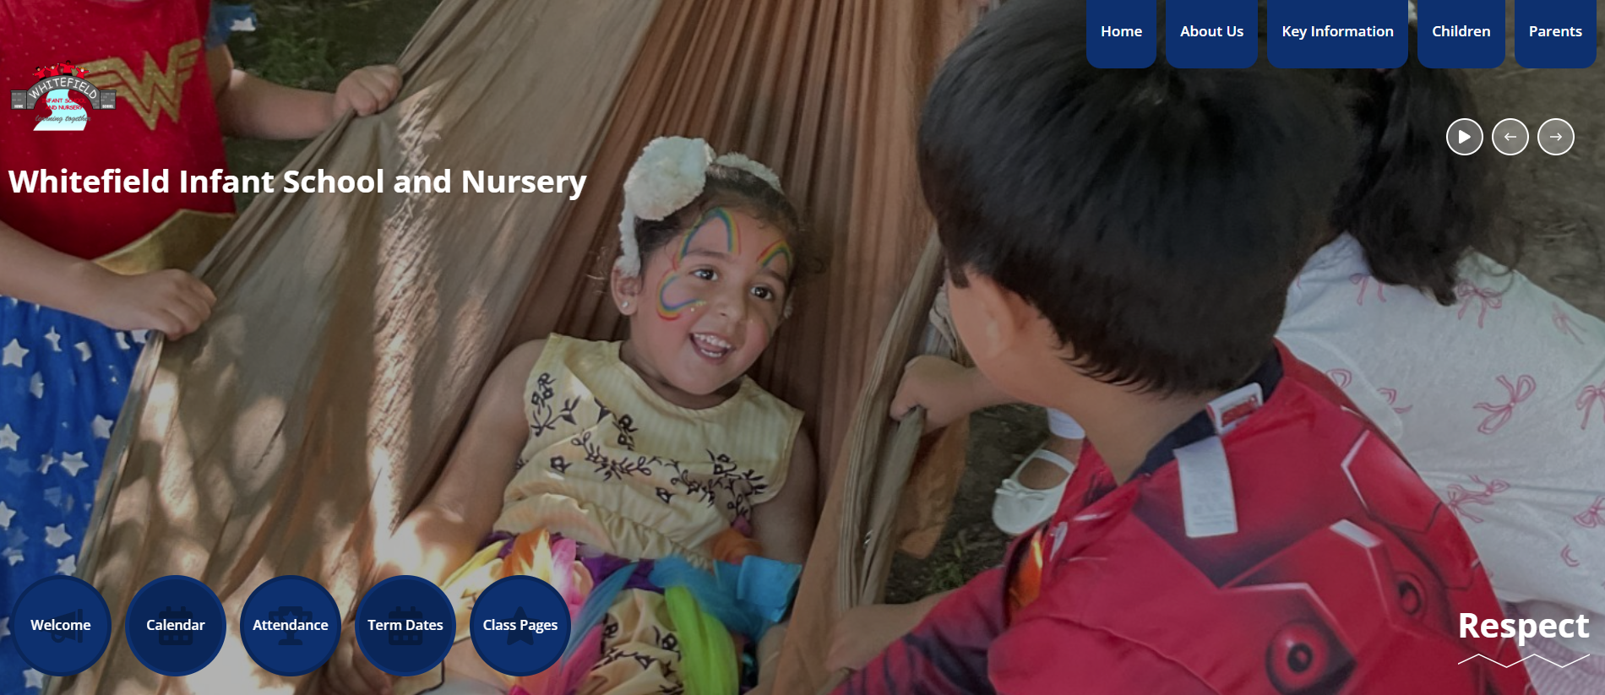
School Website
New school website- please bear with us whilst we get it up to date.
The school website contains lots of information about school and what’s going on.
Your class teachers will upload pictures and information about your child’s class so you can keep up to date with their learning.
You can access your class page by clicking on the numbers at the bottom of the homepage.

Slide 13


Medical Needs
Please make the class teacher aware if you child has any medical needs or allergies, or if anything changes throughout the year.
If your child has asthma we must have an inhaler kept in school at all times, and one kept at home.
Please ensure any medicine needed is labelled with your child’s name and brought into school. The expiry dates on these will be checked at the end of each term.
No food/ drinks from home must be brought in to share with other children (only packed lunches).
No cakes/ sweets on birthdays thank you. We will celebrate birthdays in other ways in school.

Slide 14
Are there any questions?
Thank you for your continued support and cooperation.

