Slide 1


Online Safety
Parent Workshop

Slide 2
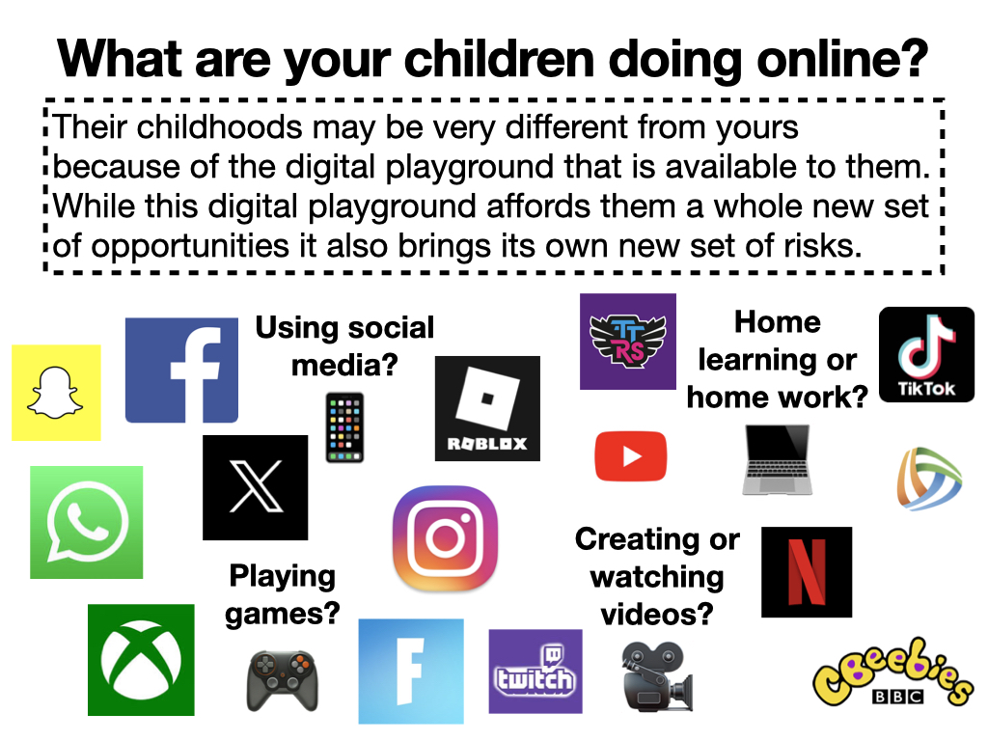

Slide 3
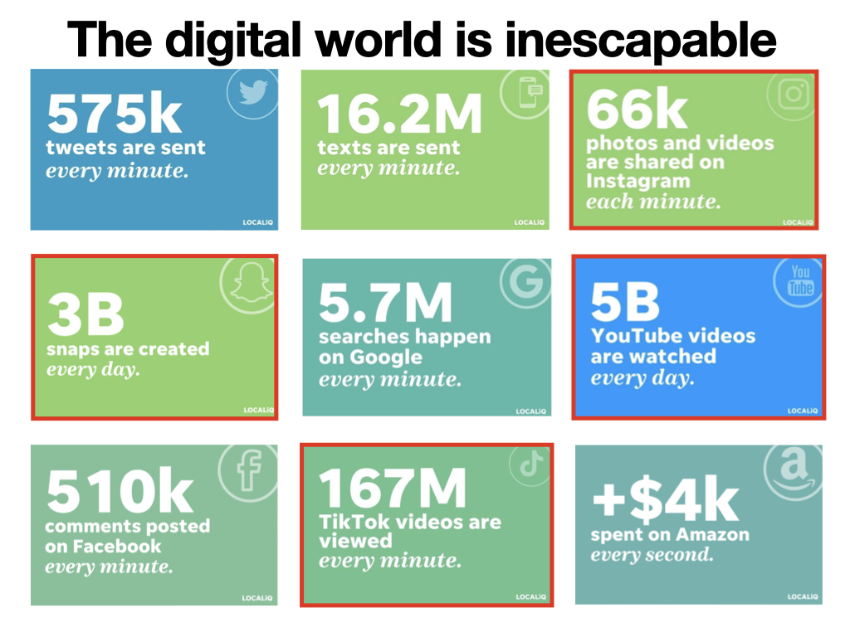

Slide 4

Via Ofcom children’s media use and attitudes report
https://www.ofcom.org.uk/__data/assets/pdf_file/0027/255852/childrens-media-use-and-attitudes-report-2023.pdf

Slide 5
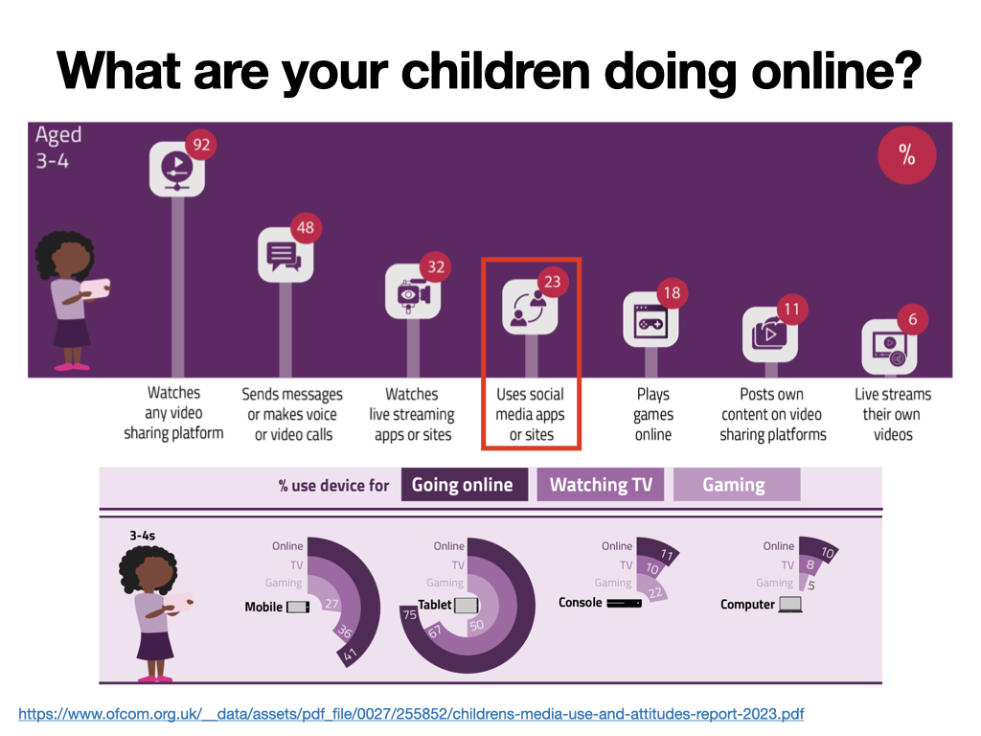
https://www.ofcom.org.uk/__data/assets/pdf_file/0027/255852/childrens-media-use-and-attitudes-report-2023.pdf

Slide 6
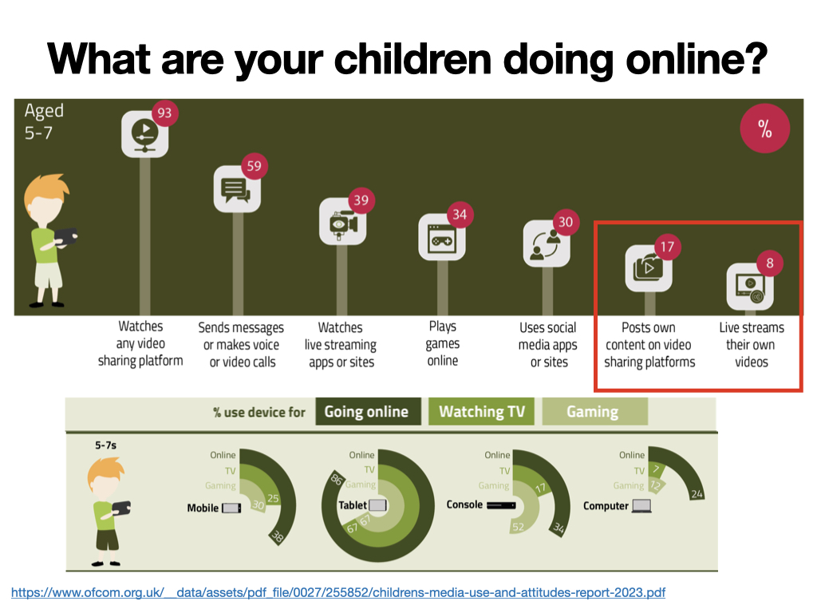
https://www.ofcom.org.uk/__data/assets/pdf_file/0027/255852/childrens-media-use-and-attitudes-report-2023.pdf

Slide 7
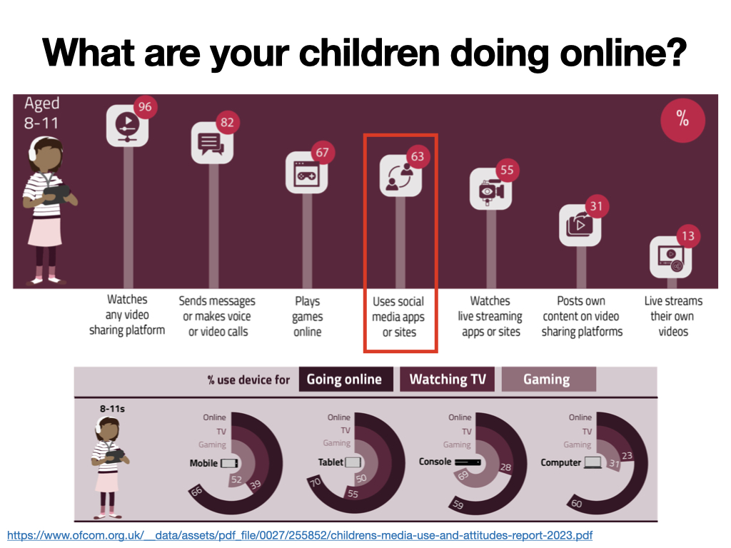
https://www.ofcom.org.uk/__data/assets/pdf_file/0027/255852/childrens-media-use-and-attitudes-report-2023.pdf

Slide 8
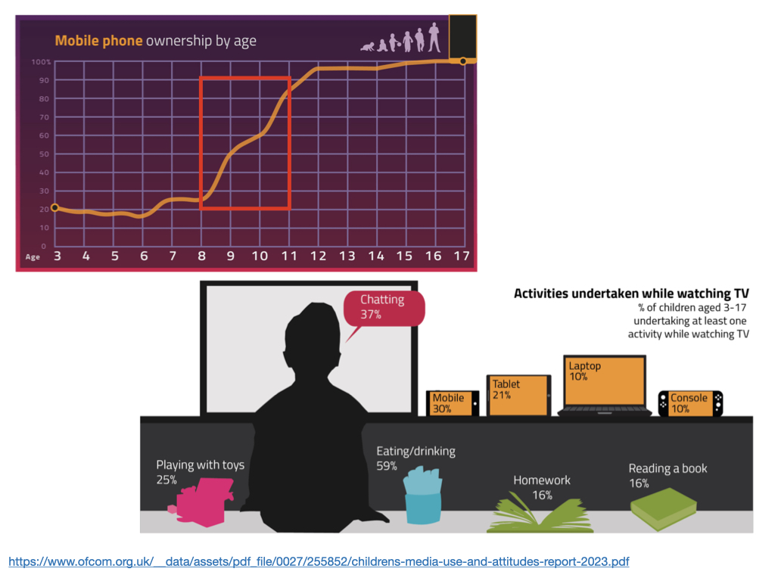
https://www.ofcom.org.uk/__data/assets/pdf_file/0027/255852/childrens-media-use-and-attitudes-report-2023.pdf

Slide 9


Slide 10

https://www.bbc.com/mediacentre/2023/ai-week
https://www.internetmatters.org/tech-and-kids-digital-futures/using-artificial-intelligence-safely/
https://www.bbc.co.uk/news/resources/idt-74697280-e684-43c5-a782-29e9d11fecf3
https://www.unicef.org/innovation/sites/unicef.org.innovation/files/2018-11/Children and AI_Short Verson (3).pdf
https://www.bbc.co.uk/newsround/64801896

Slide 11
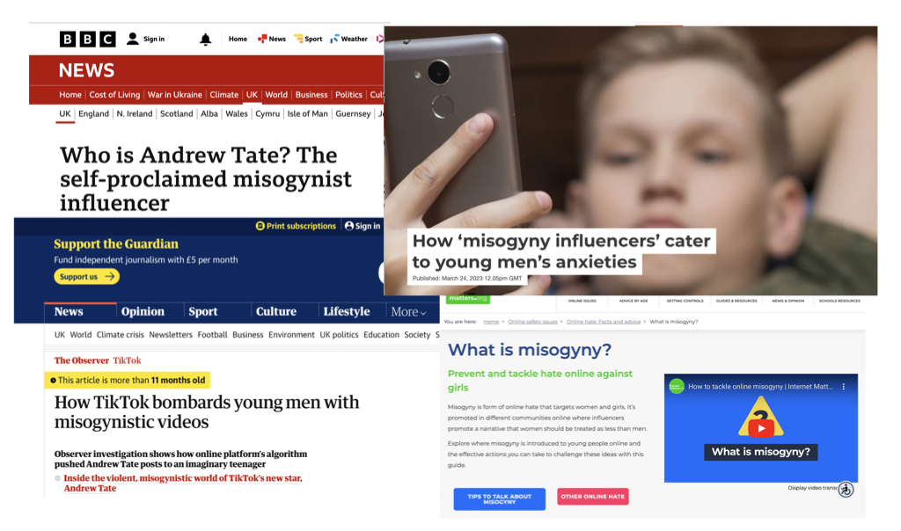
https://theconversation.com/how-misogyny-influencers-cater-to-young-mens-anxieties-201498#:~:text=
https://www.theguardian.com/technology/2022/aug/06/revealed-how-tiktok-bombards-young-men-with-misogynistic-videos-andrew-tate?CMP=Share_iOSApp_Other
https://www.internetmatters.org/issues/online-hate/what-is-misogyny/
https://www.bbc.co.uk/news/uk-64125045

Slide 12


Slide 13
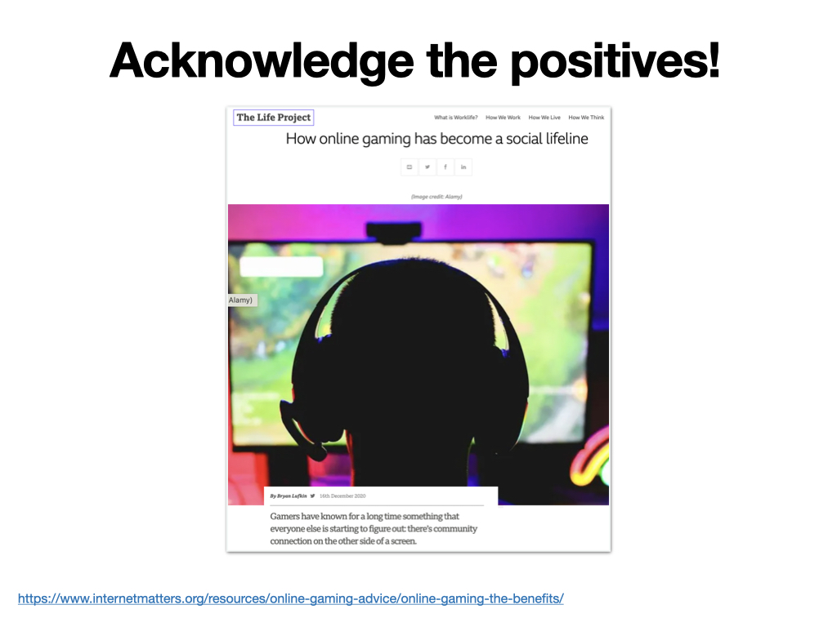
https://www.internetmatters.org/resources/online-gaming-advice/online-gaming-the-benefits/

Slide 14
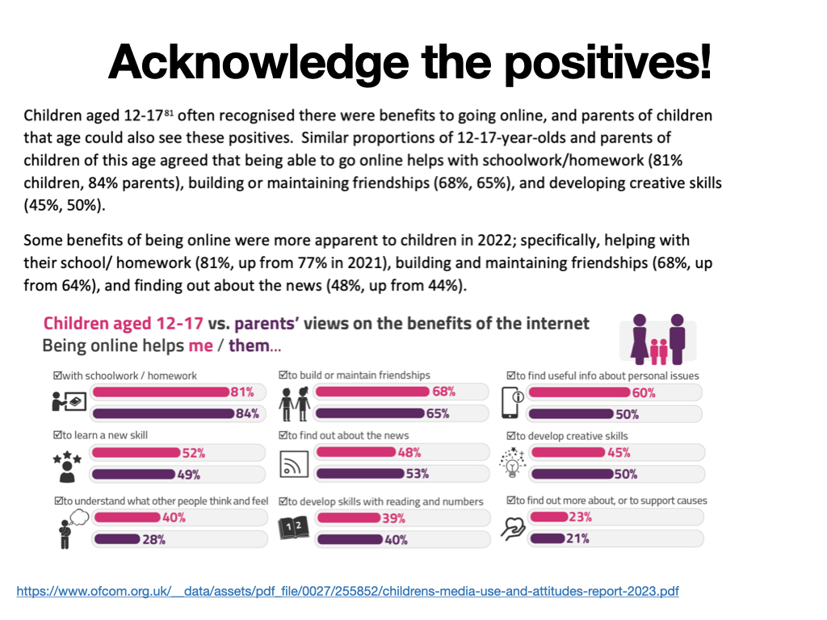
https://www.ofcom.org.uk/__data/assets/pdf_file/0027/255852/childrens-media-use-and-attitudes-report-2023.pdf

Slide 15
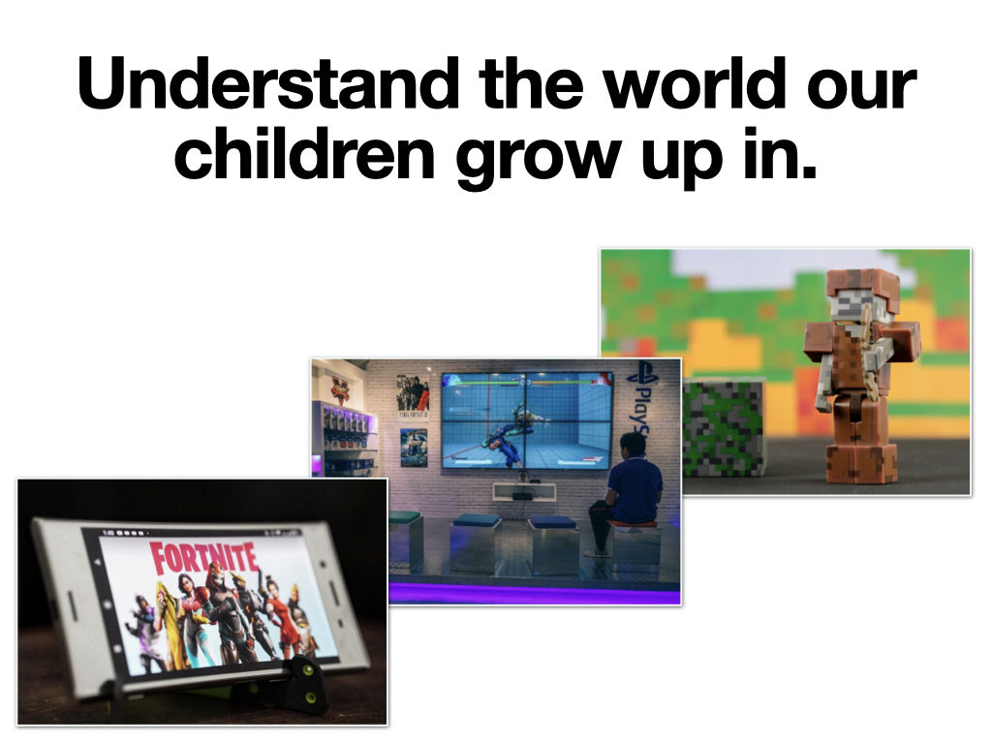

Slide 16
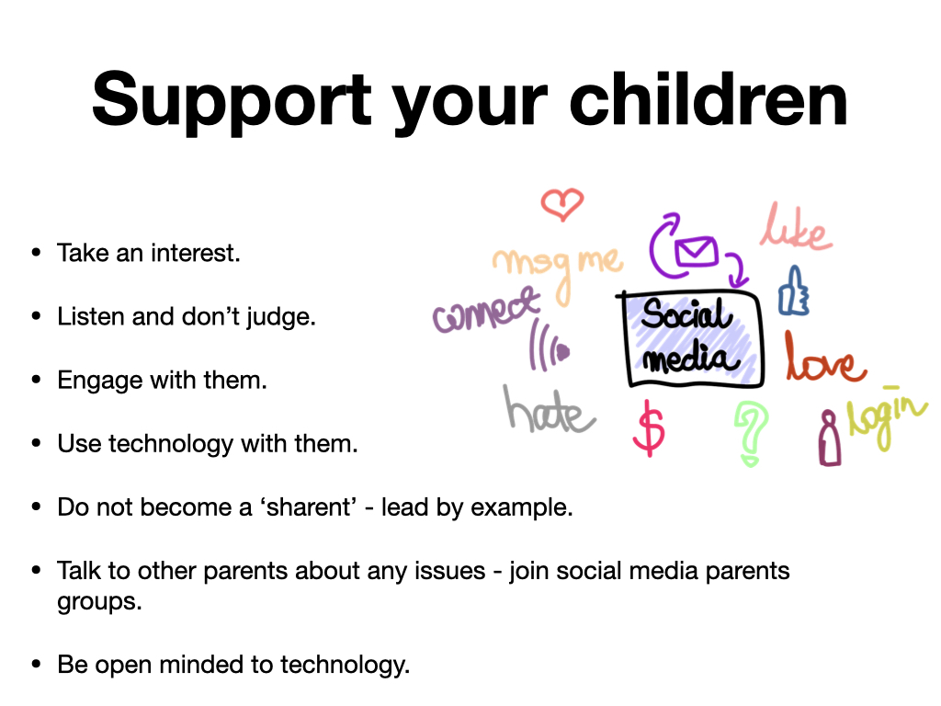

Slide 17
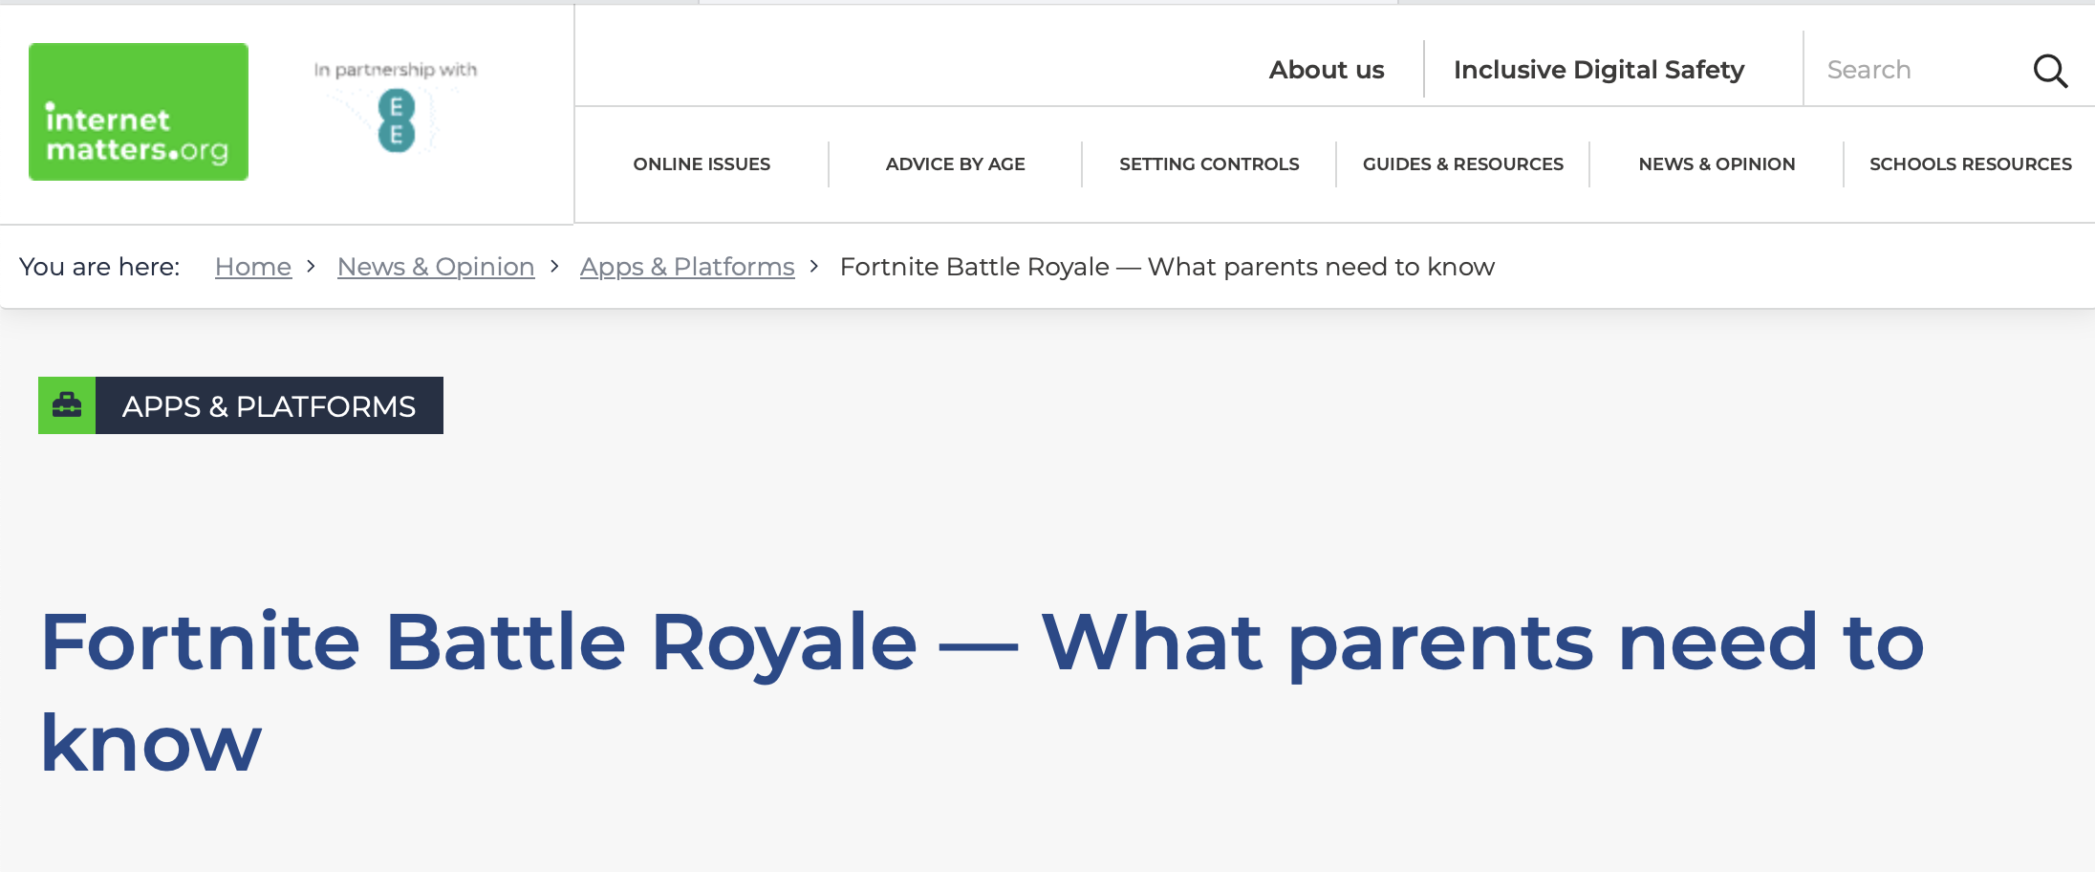
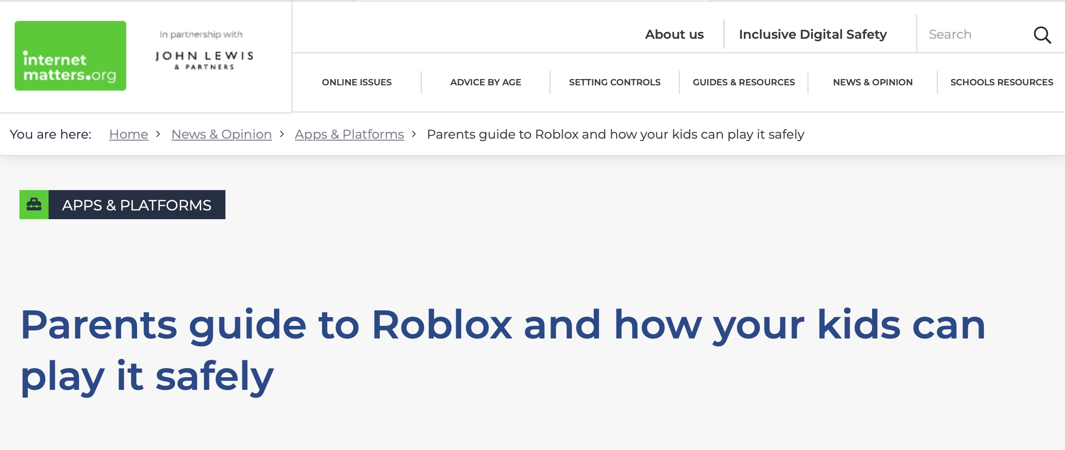


Be Knowledgeable
https://www.internetmatters.org/
https://www.nspcc.org.uk/keeping-children-safe/online-safety

Slide 18
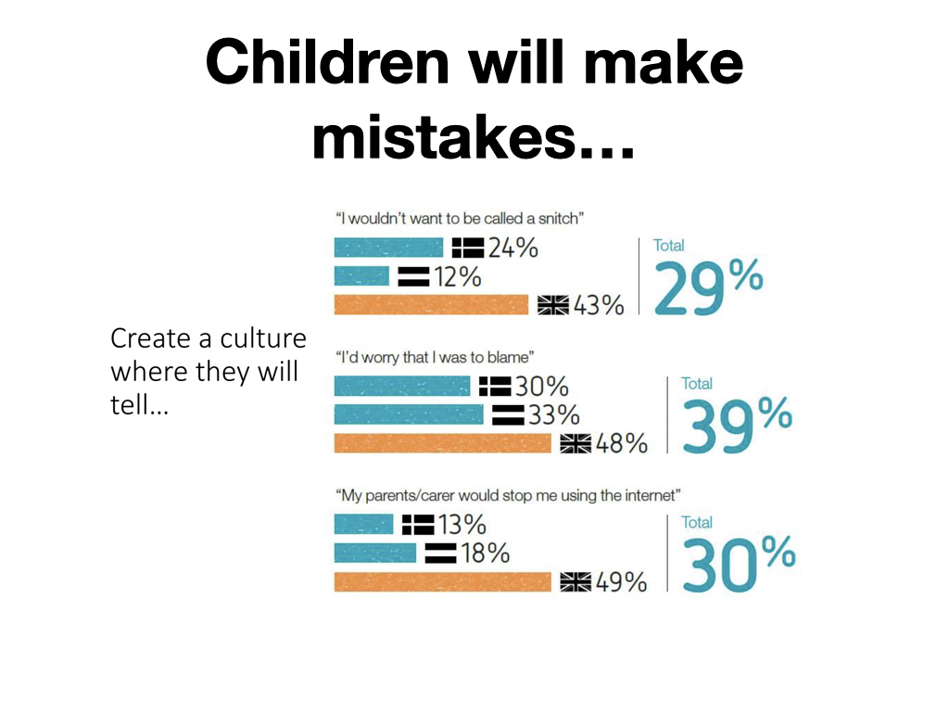

Slide 19

https://www.taminggaming.com/home

Slide 20
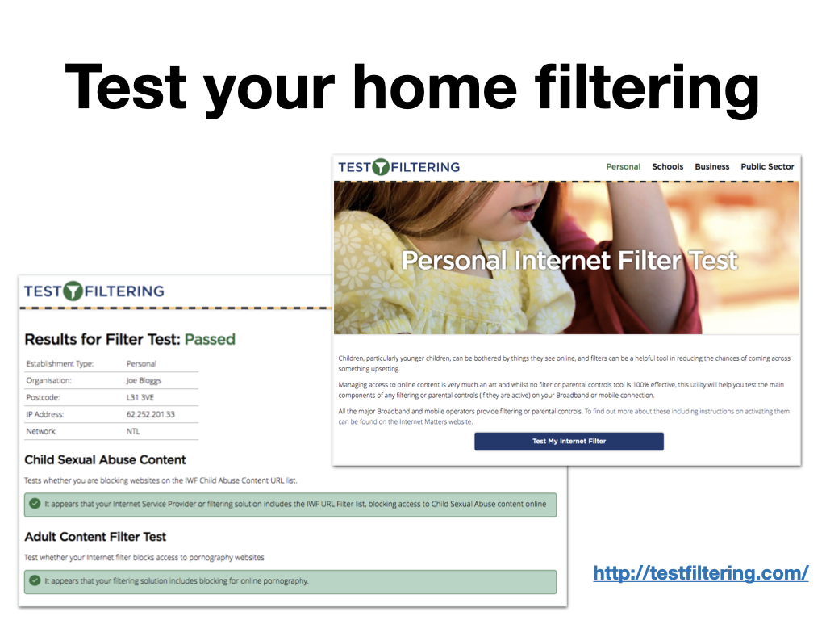
http://testfiltering.com/

Slide 21


Slide 22
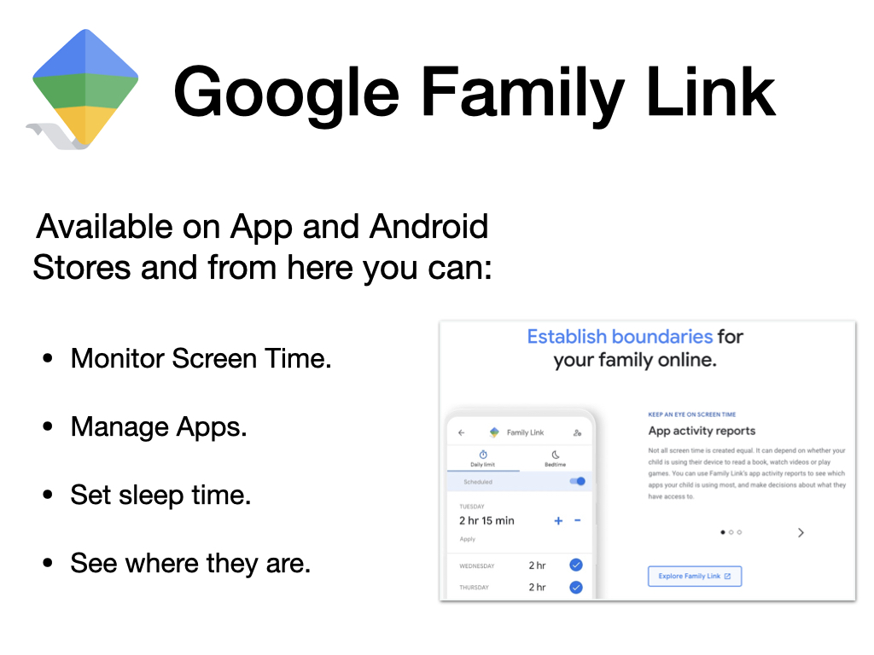

Slide 23
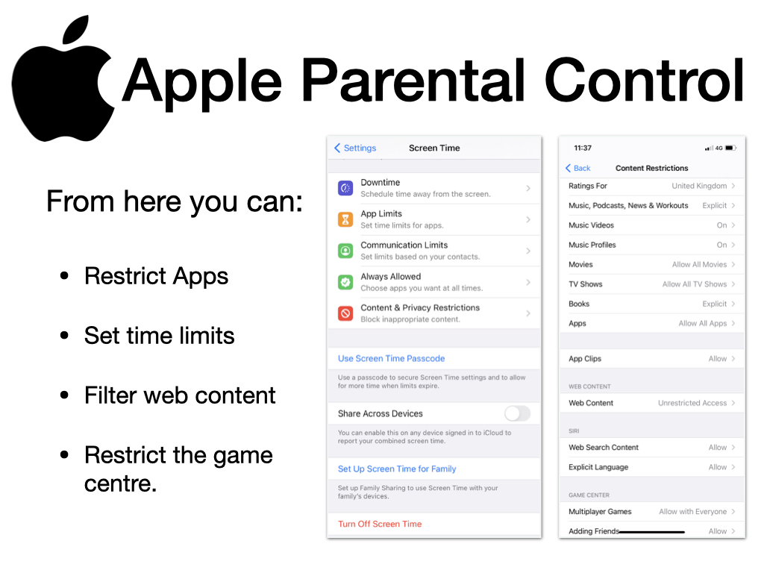

Slide 24
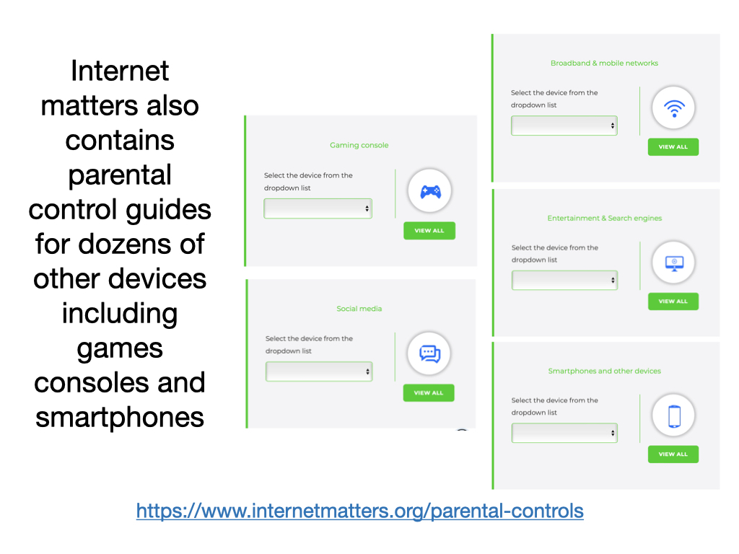
https://www.internetmatters.org/parental-controls

Slide 25
Support for you
You can alway speak to:
  CEOP
  NSPCC
  School
Or for more general information you can visit these sites:
  UK Safer Internet Centre (https://www.saferinternet.org.uk/)
  Internet Matters (https://www.internetmatters.org/)
  The Parent Zone (https://parentzone.org.uk/home)
Mr. Ward – Computing Lead and online safety champion in school
Mrs. Hardacre – ICT Leader in school

