Slide 1
(This is your fact book, write your name here)
Fact Book

Slide 2
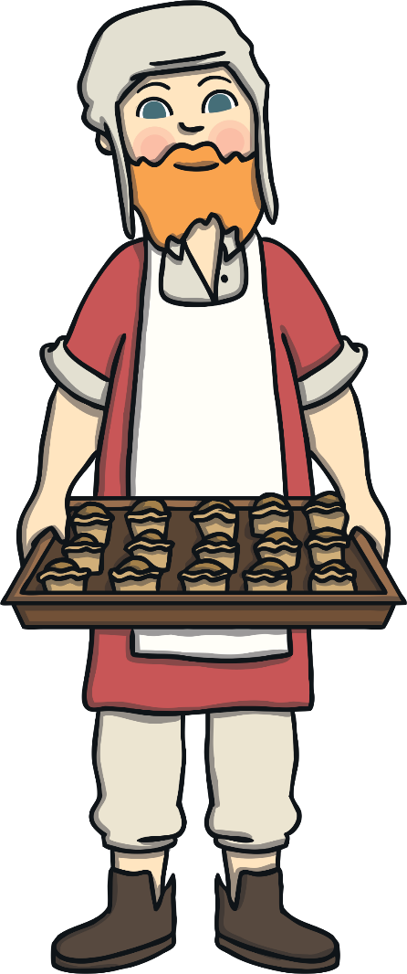
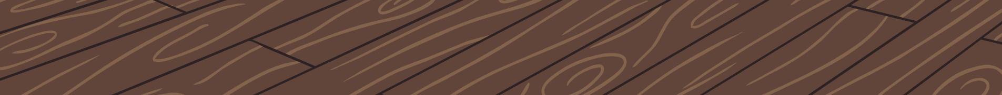
The Great Fire of London
When did it start? Where did it start?
The ‘Great Fire of London’ started on Sunday the 2nd of September 1666 in a bakery on Pudding Lane.
Page 1

Slide 3
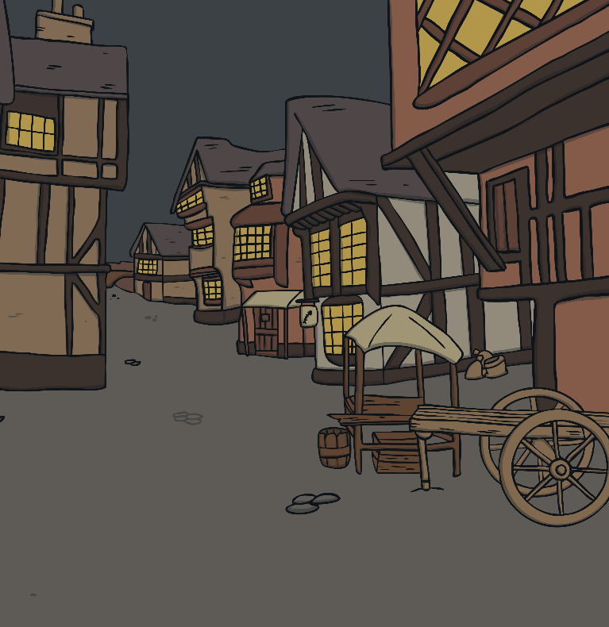
The Great Fire of London
Why did the fire spread so quickly?
The buildings were made from wood.
They were also very close together.
Page 2

Slide 4
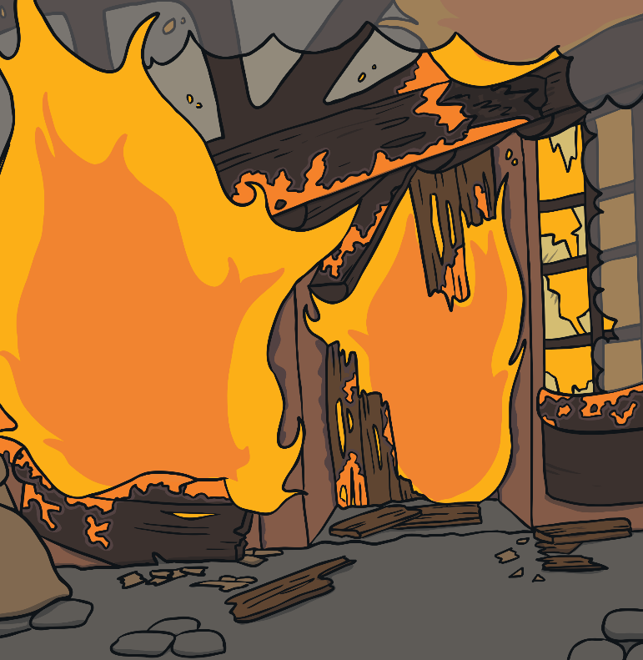
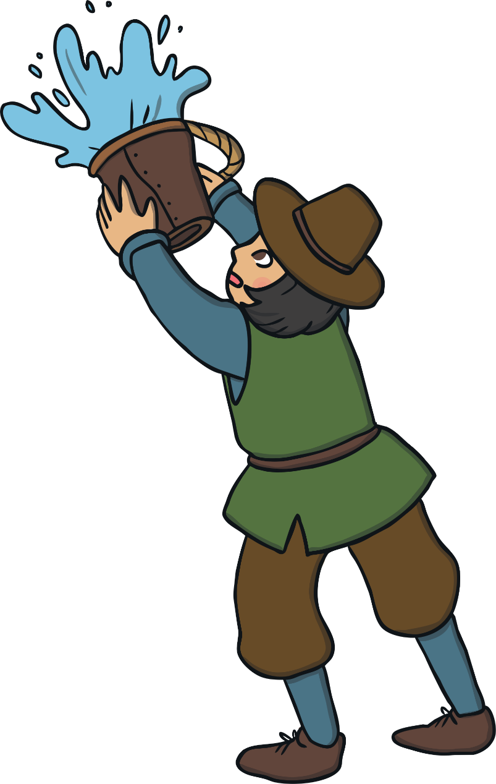
The Great Fire of London
How did they try to put the fire out?
People had to try and put the fire out! They used leather buckets filled with water from the river.
Page 3

Slide 5
The Great Fire of London
What happened after the fire?
When they rebuilt the city they made the buildings out of brick instead of wood.
Page 4

Slide 6
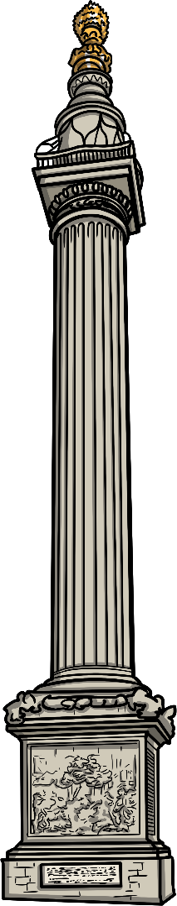

The Great London Fire
What happened after the fire?
The Monument to the Great Fire of London was erected.
The monument still remains in place today so that no one will ever forget what happened.
Page 5

