Slide 1
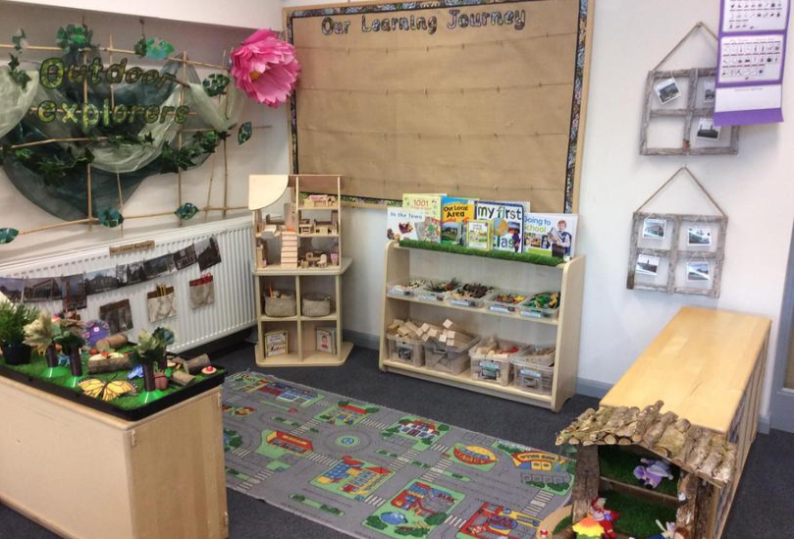
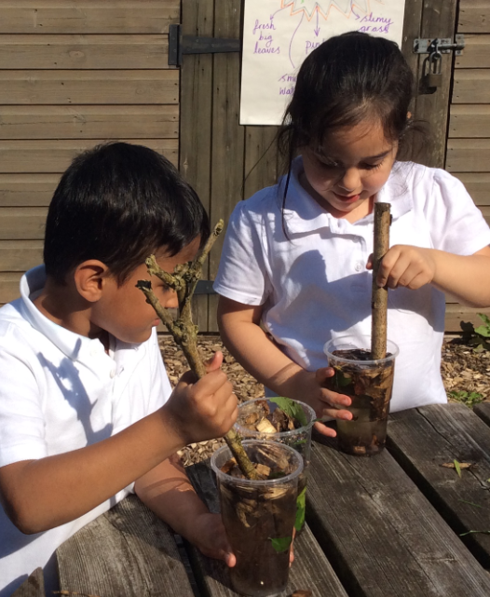
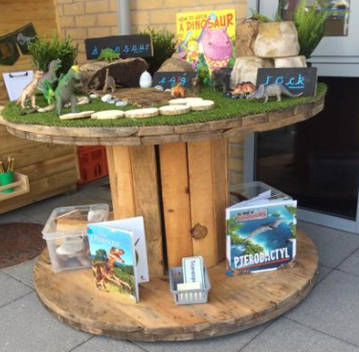

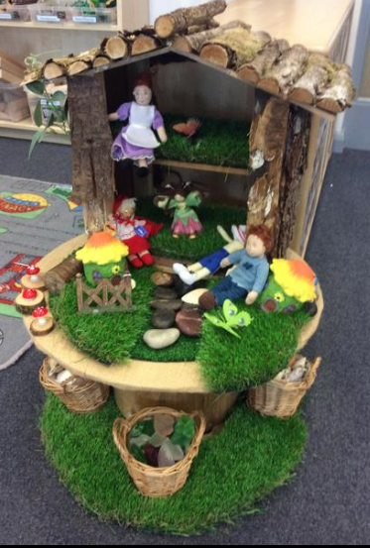
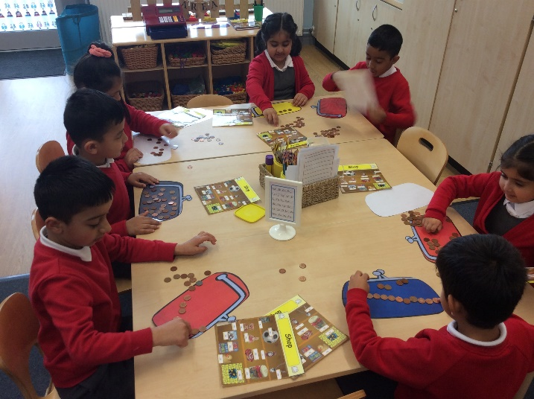
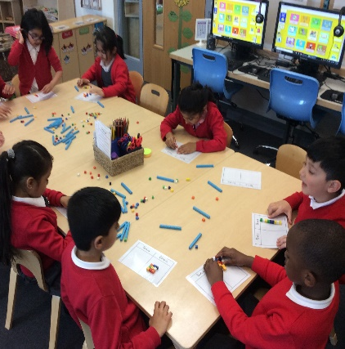
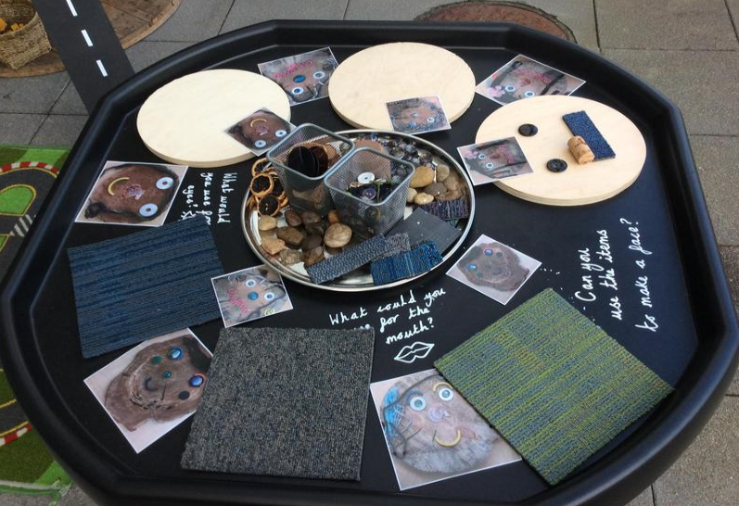
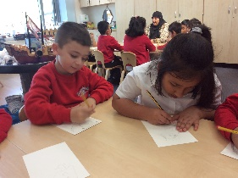
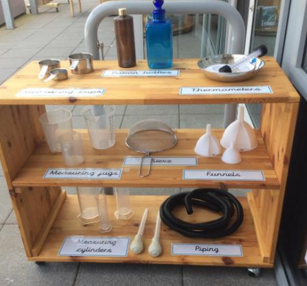
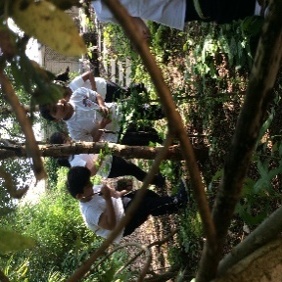

Welcome to Year 1

Slide 2
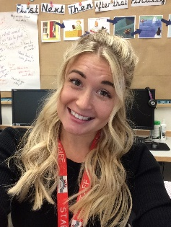
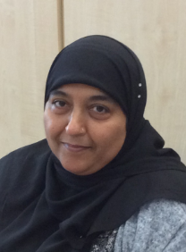
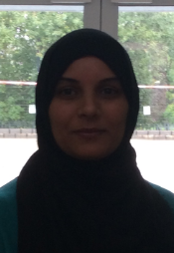
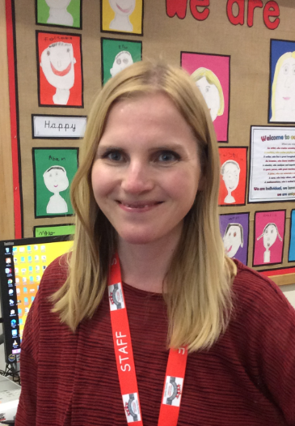
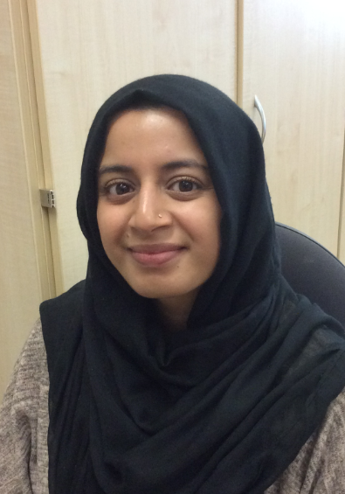
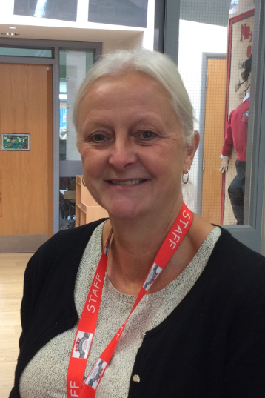
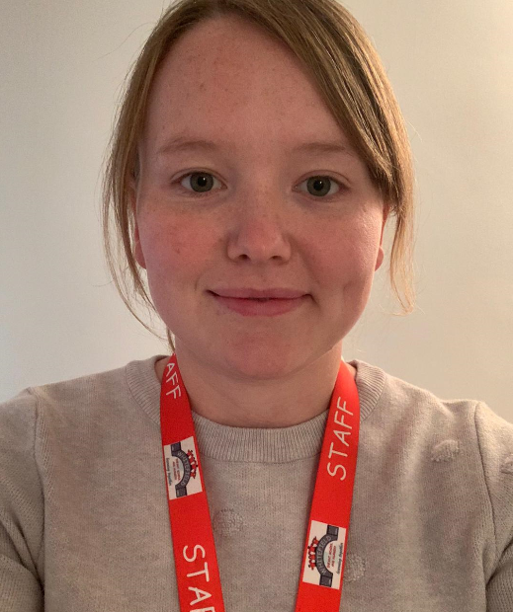
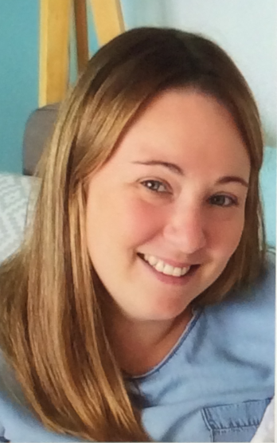
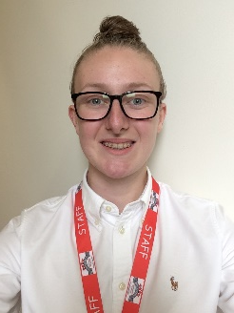
Meet the Year 1 Team!
In Class 4 we have …
Miss Kearsley
Mrs Azam
Mrs Mehmood
In Class 5 we have …
Mrs Williams
Mrs
Rizaq
Mrs Farrell
In Class 6 we have …
Miss
Sykes
Miss
Farrell
Miss
O’Horo

Slide 3
Classroom doors open for drop off at 8.30am and for pickup at 2.40pm
Please ensure your child is dropped off and picked up promptly.
All children must be collected by an authorised adult on the class collection sheet. If another adult is going to collect your child please inform your class teacher.
Parent Reminders

Slide 4
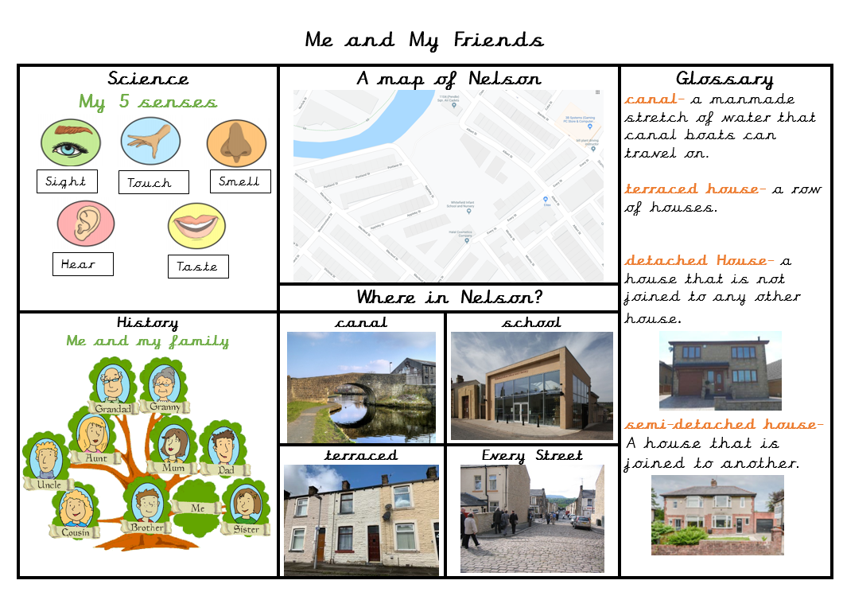
Vocabulary Mats
Each half term your child will bring home a vocabulary mat to show you what we will be learning over the term.
Please have a look at these with your children and talk about some of the language and things we will be looking at in preparation.

Slide 5
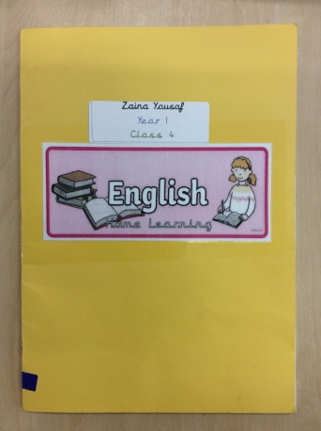
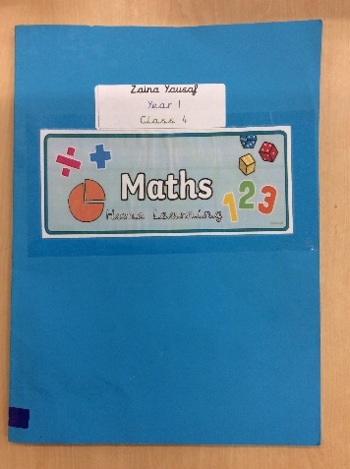
Your child will receive Maths and English home learning every week.
Home learning will be sent home on a Wednesday and should be completed and returned the following Monday.
If you have any questions about home learning please don’t hesitate to ask!
Home Learning

Slide 6
Phonics is a way of teaching children the skills of reading and writing.
How we teach phonics in school
Phonics is taught every day in a discreet 20 minute session.
Phonics interventions also take place daily. This is an additional phonics session aiming to boost any children that have gaps in their phonics knowledge.
Phonics is differentiated in each class and children are grouped based on their phonics needs.
Phonics is reinforced throughout all lessons and learning, to embed the skills and knowledge.
Please visit the ‘Phonics’ page on the school website for more information.
Phonics

Slide 7
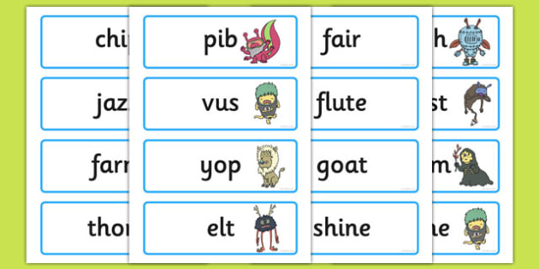
Phonics Screening
At the end of year 1 we have a phonics screening check to asses the children’s phonics ability.
Children have to read 40 real and nonsense words.
This is used as an assessment tool to inform teachers planning.
If your child doesn’t meet the pass rate they will retake the check in year 2.
More information regarding the phonics screening check will be given nearer the time.

Slide 8
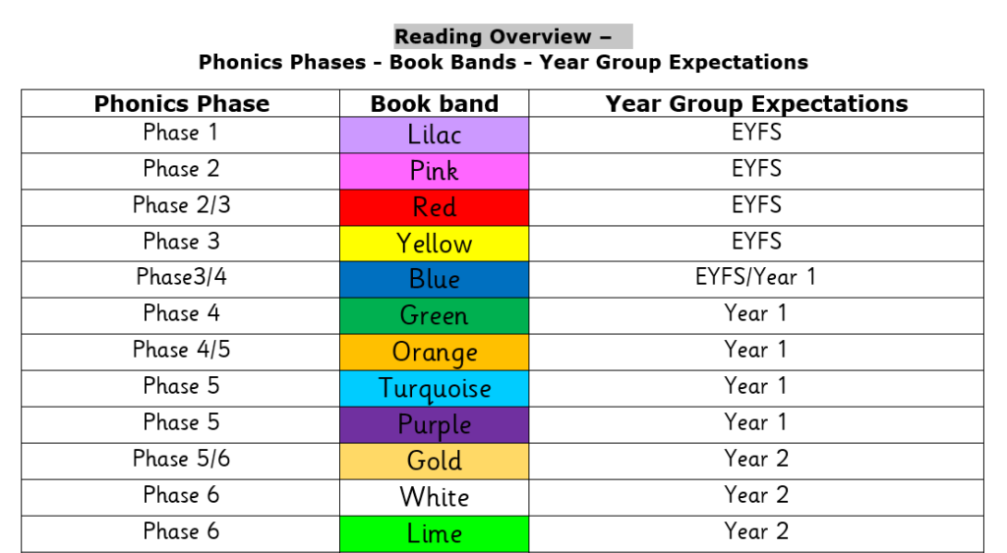

Reading
Children’s reading will be listened to throughout the week so they will need to bring their reading book, reading record and book bags every day.
It’s incredibly important that you listen to your children read every night to help us develop your child’s reading ability.
Please sign their reading journal
when you have listened to
your child read and we will
give them a new book the
following day.

Slide 9




To keep your children as safe as possible we are asking all children to come to school wearing their PE kit on their PE day.
P.E days are as follows
Class 4 – Tuesday
Class 5 – Thursday
Class 6 – Wednesday
Our school PE Kit is:
White t-shirt
Black pants/shorts
Black pumps/ trainers
School jumper or cardigan
P.E

Slide 10
And Finally …
Please ensure all your child’s jumpers have their names in them.
Please send them to school with a named water bottle every day.
If your child has any new medical issues please let your class teacher know.

Slide 11
If you have any questions please phone the school office and make a telephone appointment or send your class teacher an email.
We will not hesitate to help!
Thank you for all your support and cooperation!

