Slide 2
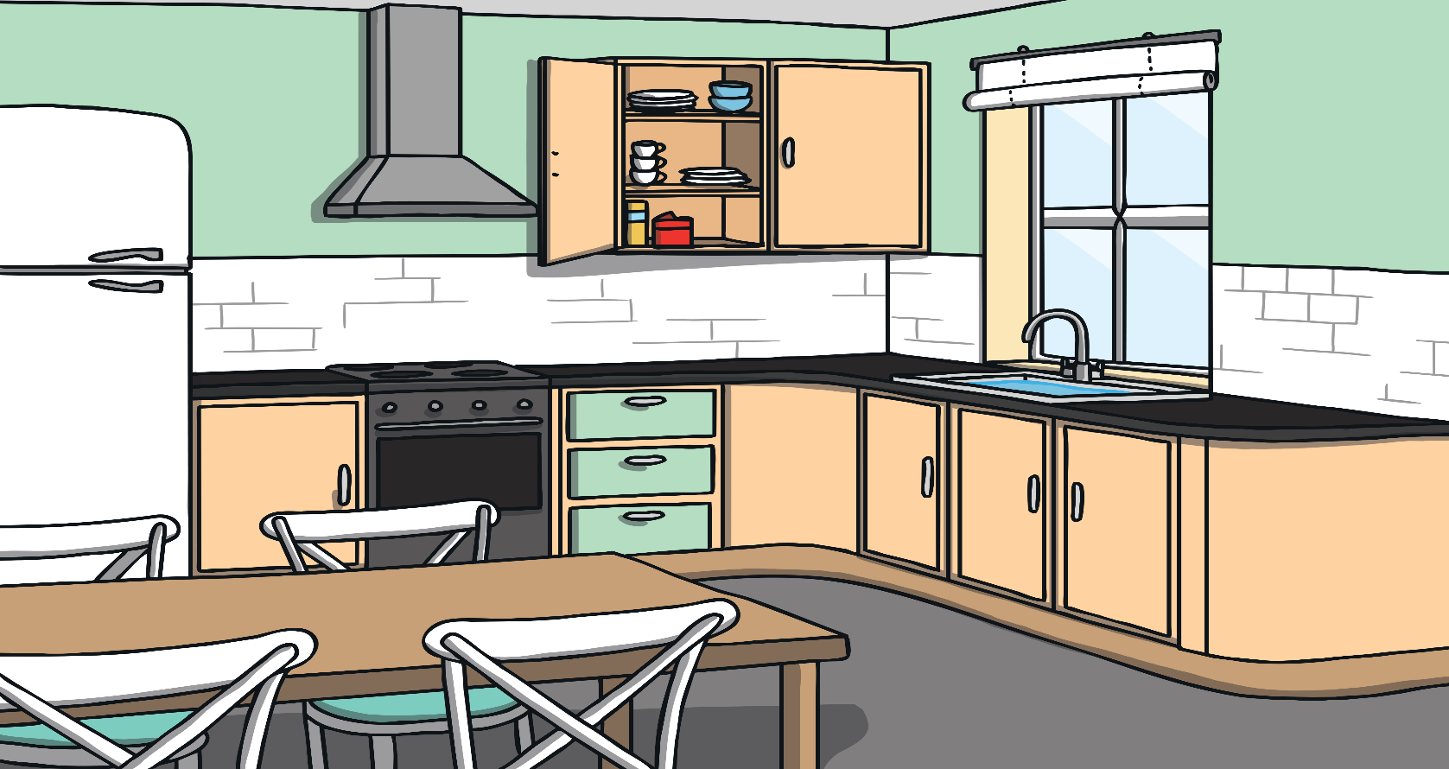


Metal Mike’s Mix Up
Metal Mike has dropped his bag and lost some of his things.
Can you help him find them?
Click on Metal Mike on each slide to hear what he has lost.

Slide 3







Click on Metal Mike to find out what he has lost.

Slide 4


Well Done!
Click to help Mike find his other things!
You found the cat!

Slide 5

Click on Metal Mike to find out what he has lost.

Slide 6
Well Done!
Click to help Mike find his other things!
You found the duck!

Slide 7
Click on Metal Mike to find out what he has lost.

Slide 8
Well Done!
Click to help Mike find his other things!
You found the bus!

Slide 9


Click on Metal Mike to find out what he has lost.

Slide 10
Well Done!
Click to help Mike find his other things!
You found the net!

Slide 11
Click on Metal Mike to find out what he has lost.

Slide 12
Well Done!
Click to help Mike find his other things!
You found the hat!

Slide 13

Click on Metal Mike to find out what he has lost.

Slide 14
Well Done!
You found the bed!
Click to help Mike find his other things!

Slide 15
Click on Metal Mike to find out what he has lost.

Slide 16
Well Done!
Click to help Mike find the last thing!
You found the dog!

Slide 17

Click on Metal Mike to find out what he has lost.

Slide 18
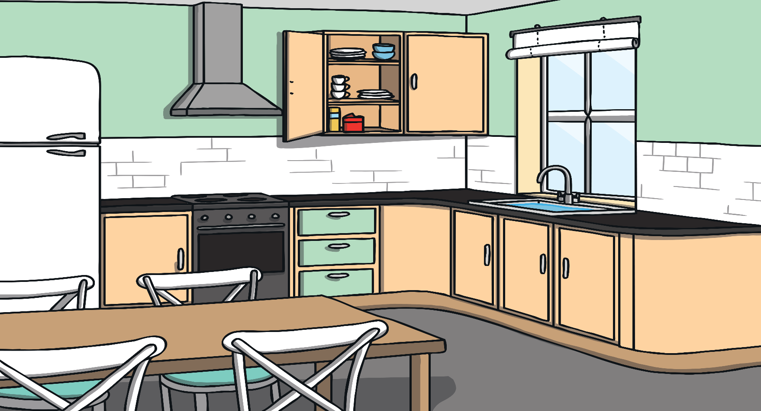

Well Done!
Thank you for helping Metal Mike.
You found the pan!

